Slide 1
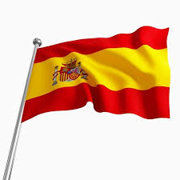
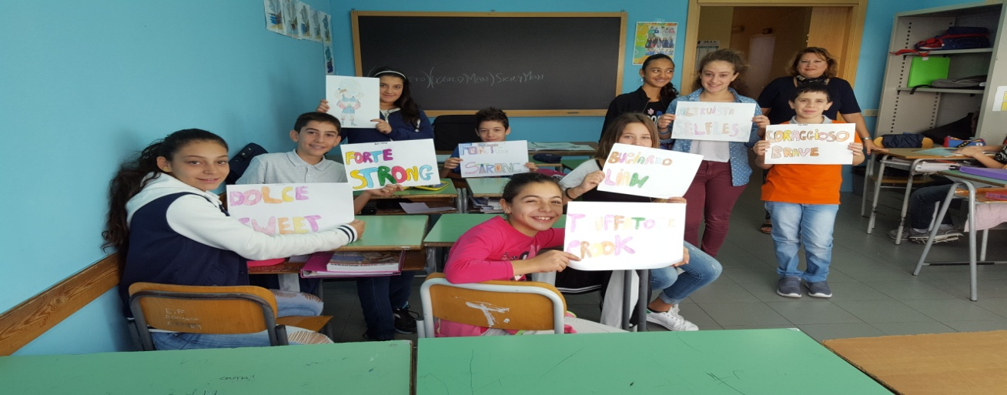
“Magic and Myths Unite Europe”

Slide 2
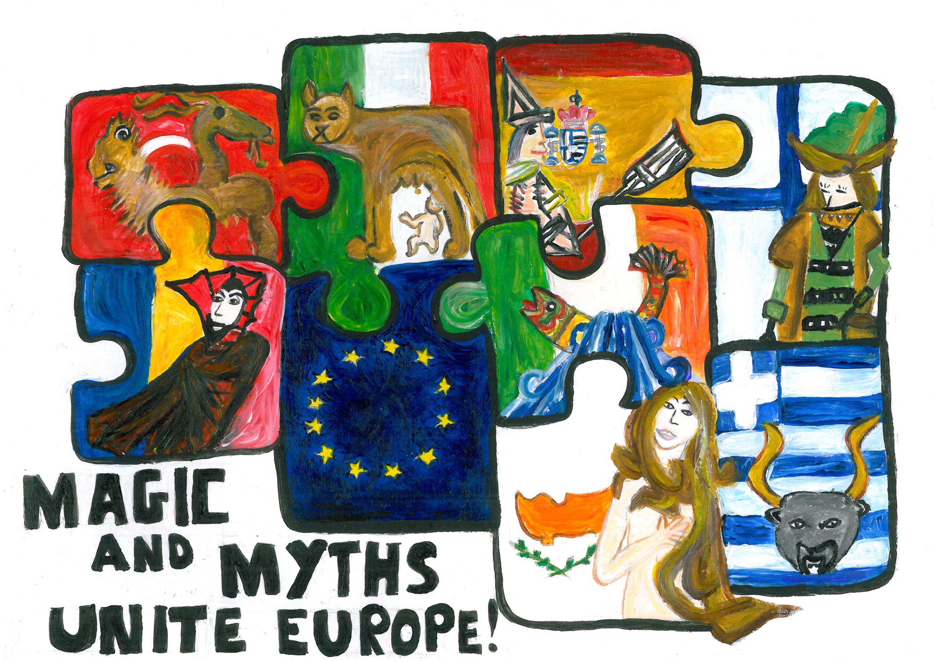

Slide 3
I.C.S. ELIO VITTORINI
SAN PIETRO CLARENZA
CATANIA
SCUOLA SECONDARIA DI I° GRADO
ANNO SCOLASTICO 2016 – 2017

Slide 4
COLAPESCE

Slide 5
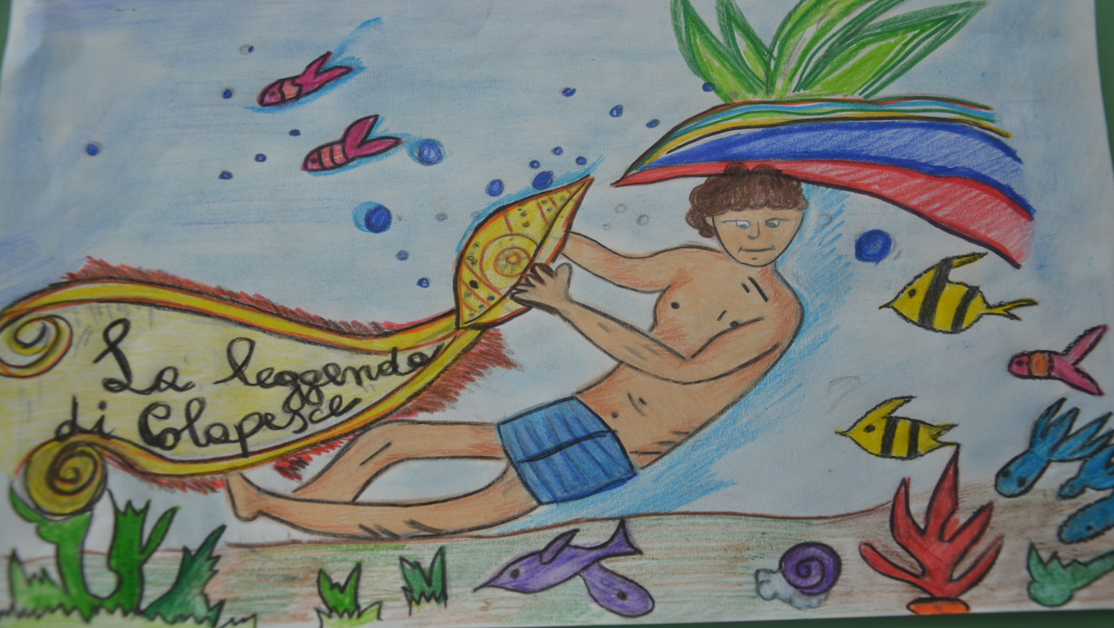
COLAPESCE IT IS SAID THAT A CERTAIN NICOLAS, SON OF A FISHERMAN, HE WAS CALLED COLAPESCE FOR HIS ABILITY IN THE WATER: WHEN HE CAME BACK FROM DIVING, HE ALWAYS TOLD ABOUT THE WONDERFUL LIFE UNDER THE SEA AND HE SOMETIMES BROUGHT THE HIDDEN TREASURES WITH HIM.

Slide 6
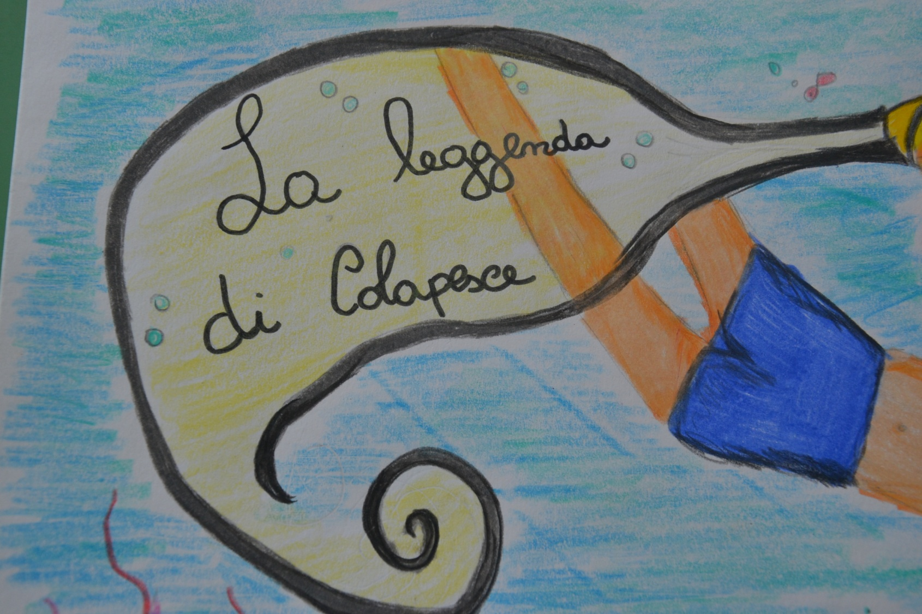
THE KING OF SICILY AND EMPEROR OF SWEDEN FREDERYCK II HEARD ABOUT THIS MAN AND DECIDED TO TEST HIM.

Slide 7
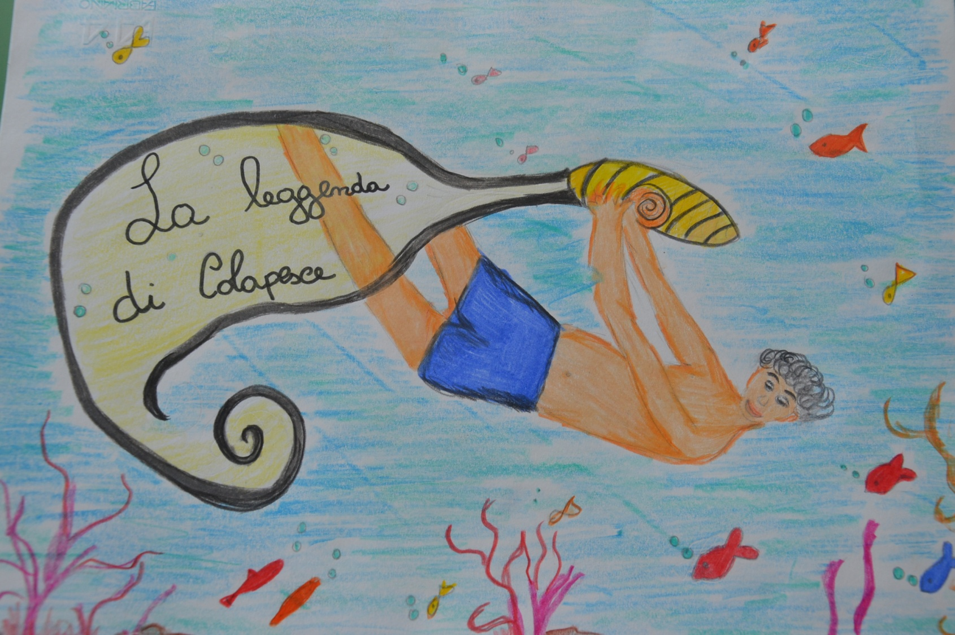
THE KING AND HIS ENTUORAGE WENT TO COLAPESCE’S LITTLE VILLAGE BY THE SEA.

Slide 8
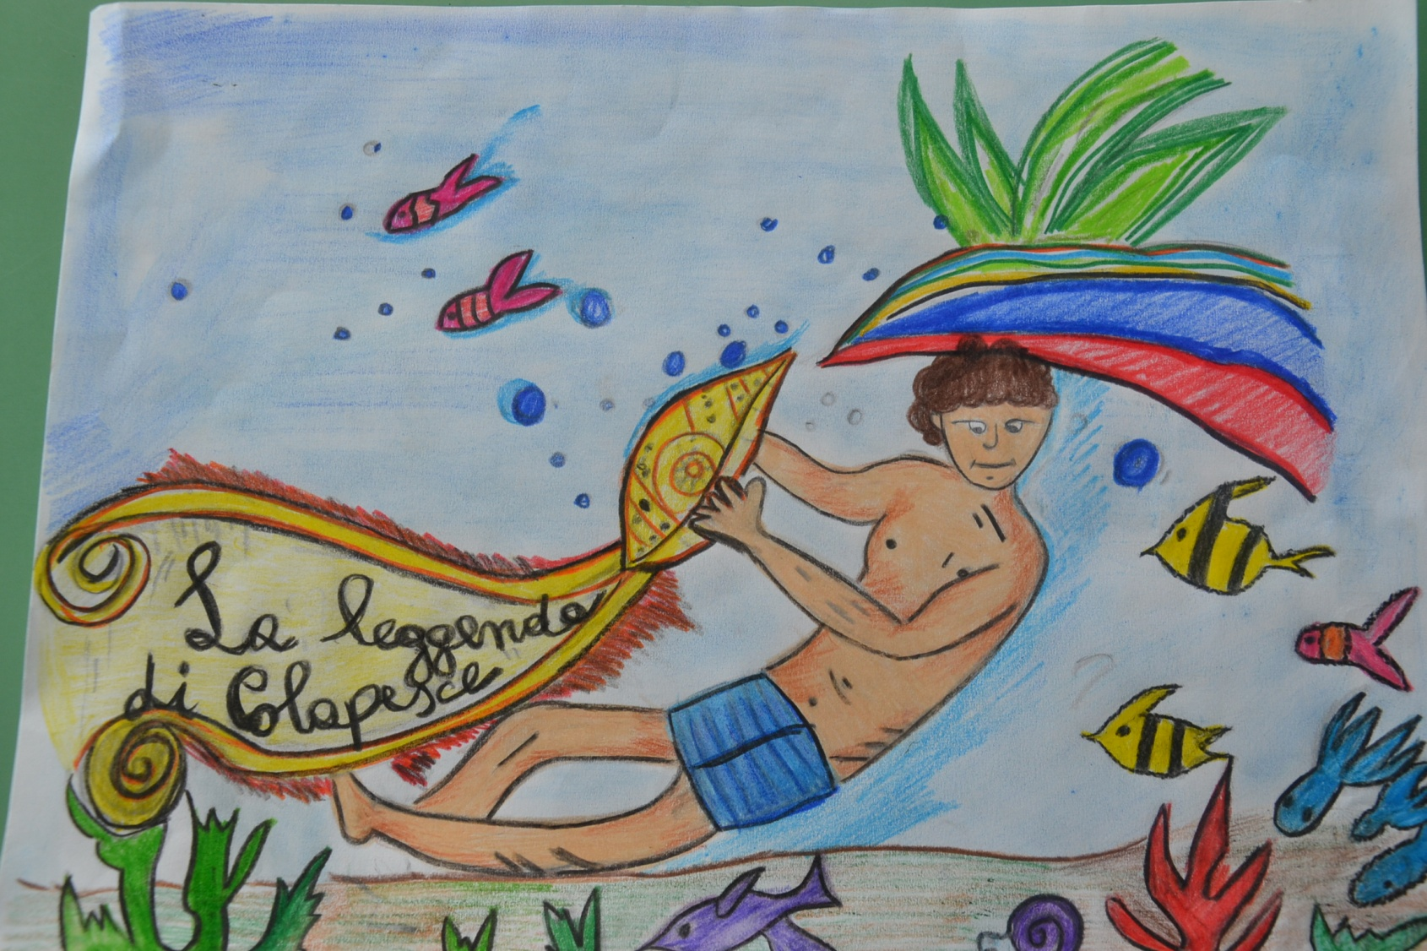
HE THREW A CUP IN THE WATER FROM HIS ROYAL BOAT AND ASKED COLAPESCE TO FIND IT.

Slide 9
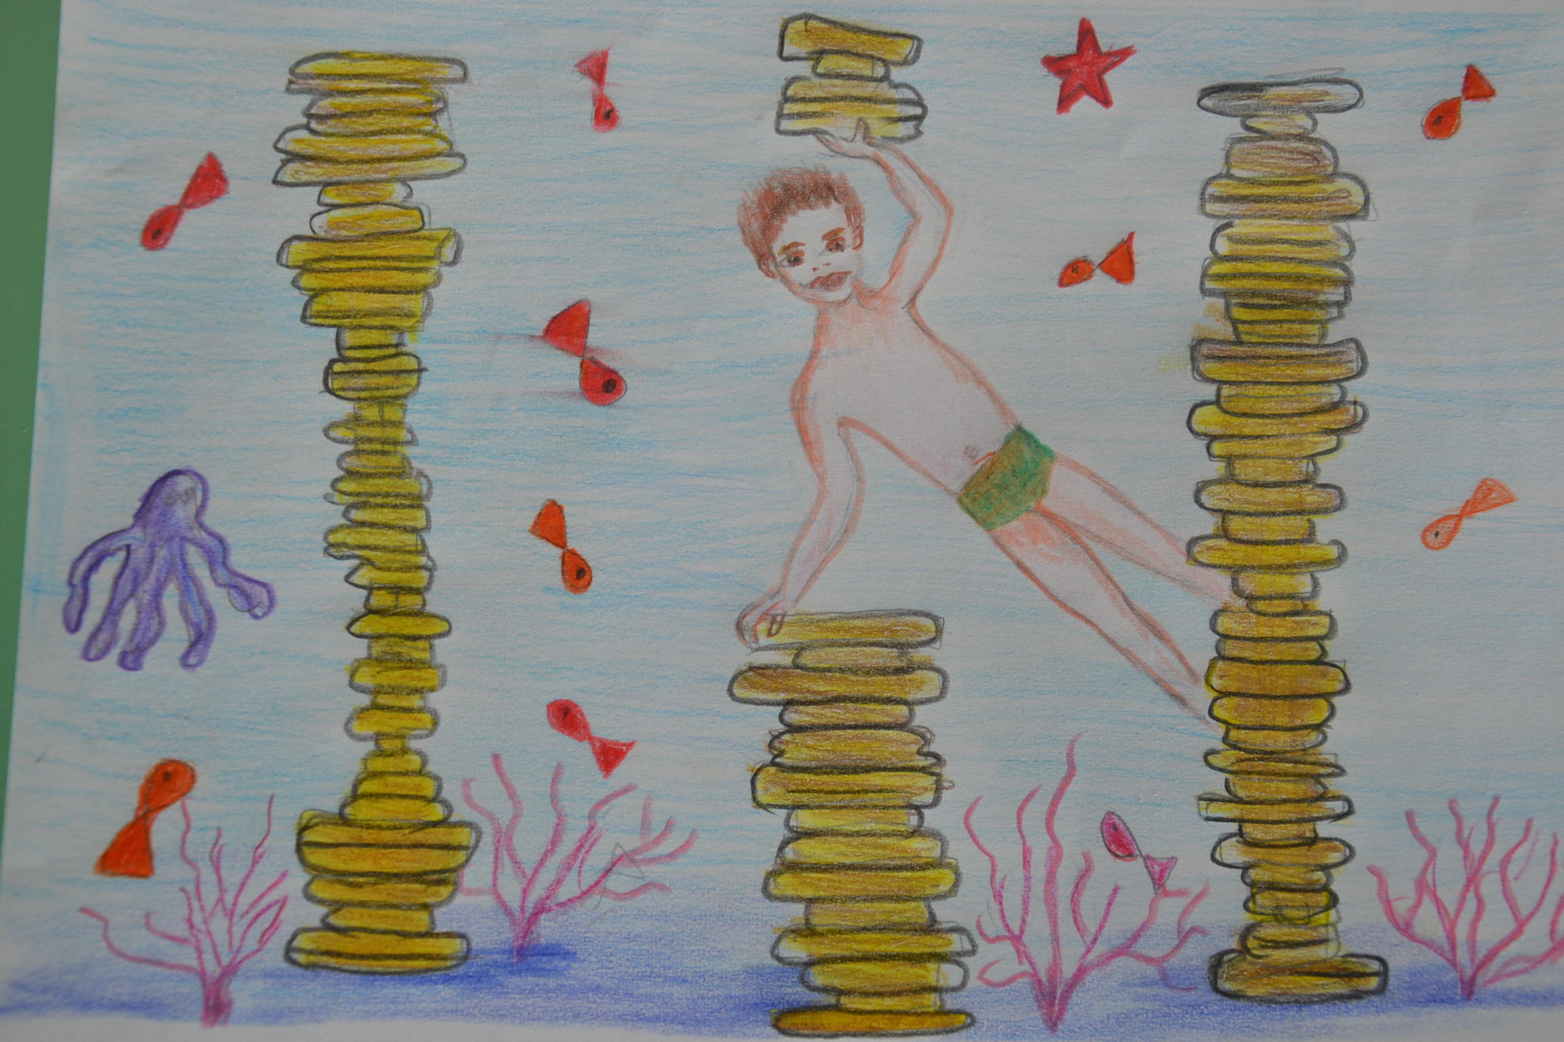
COLAPESCE
SUCCESFULLY FOUND AND BROUGHT BACK THE CUP TO THE KING.

Slide 10
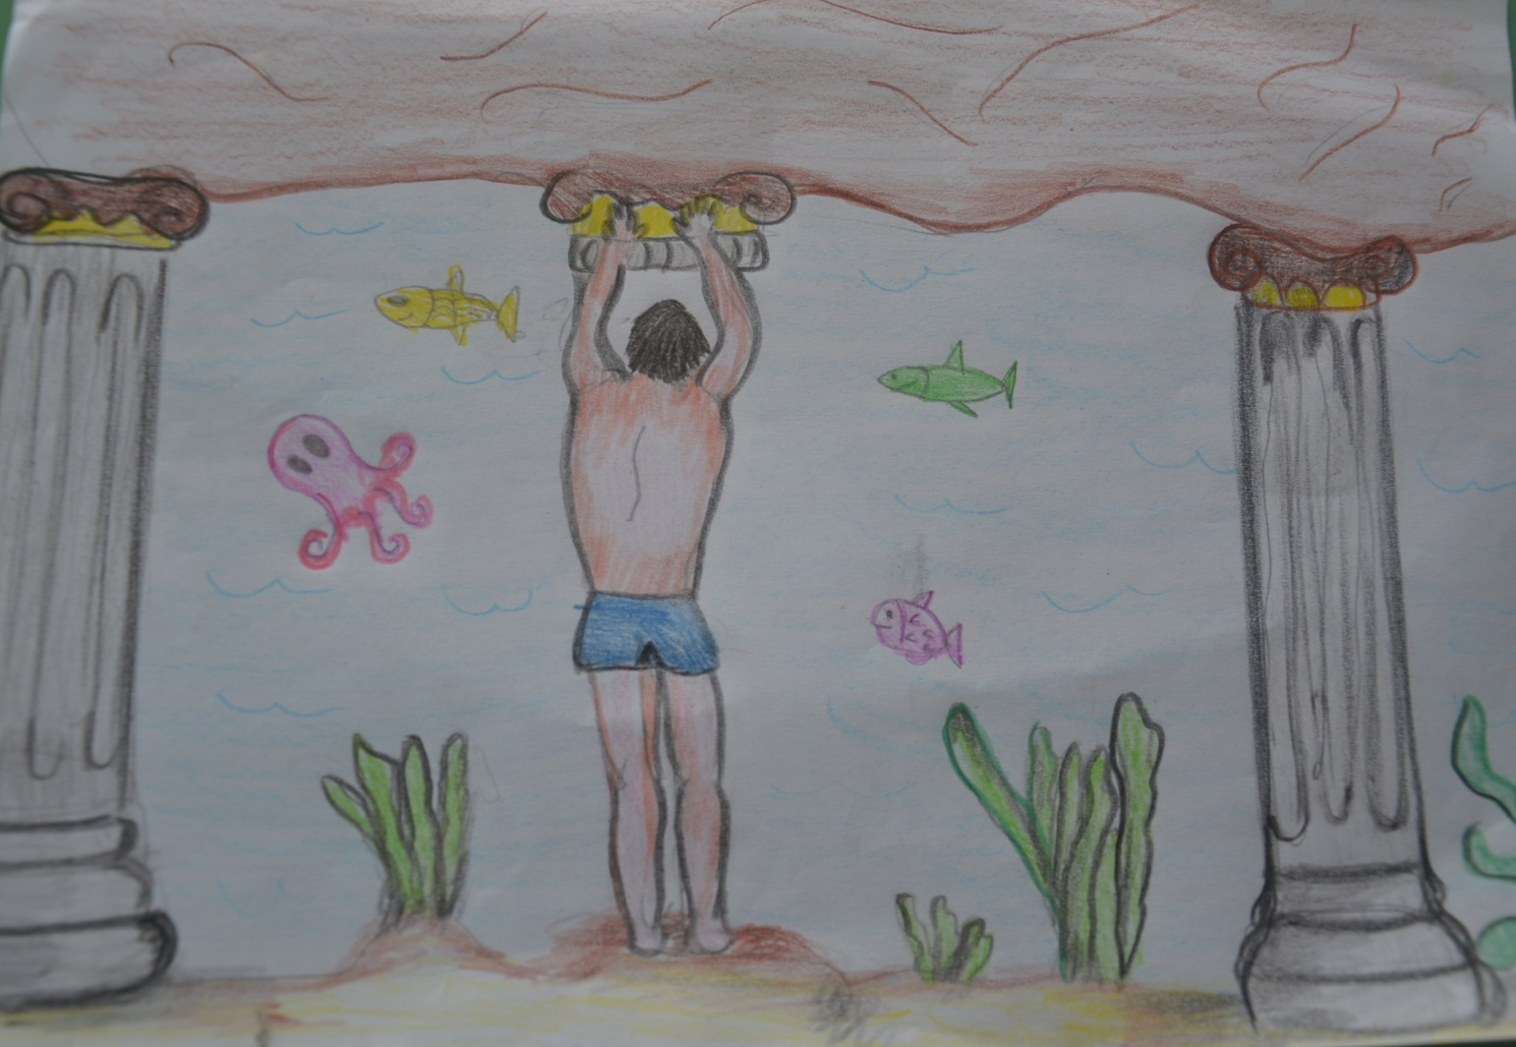
THEN THE KING THREW HIS CROWN IN THE SEA AND COLAPESCE RESCUED IT. FINALLY, THREW HIS RING IN THE DEEPEST SEA OF SICILY, BUT THIS TIME COLAPESCE DIDN’T COME BACK ANYMORE.

Slide 11
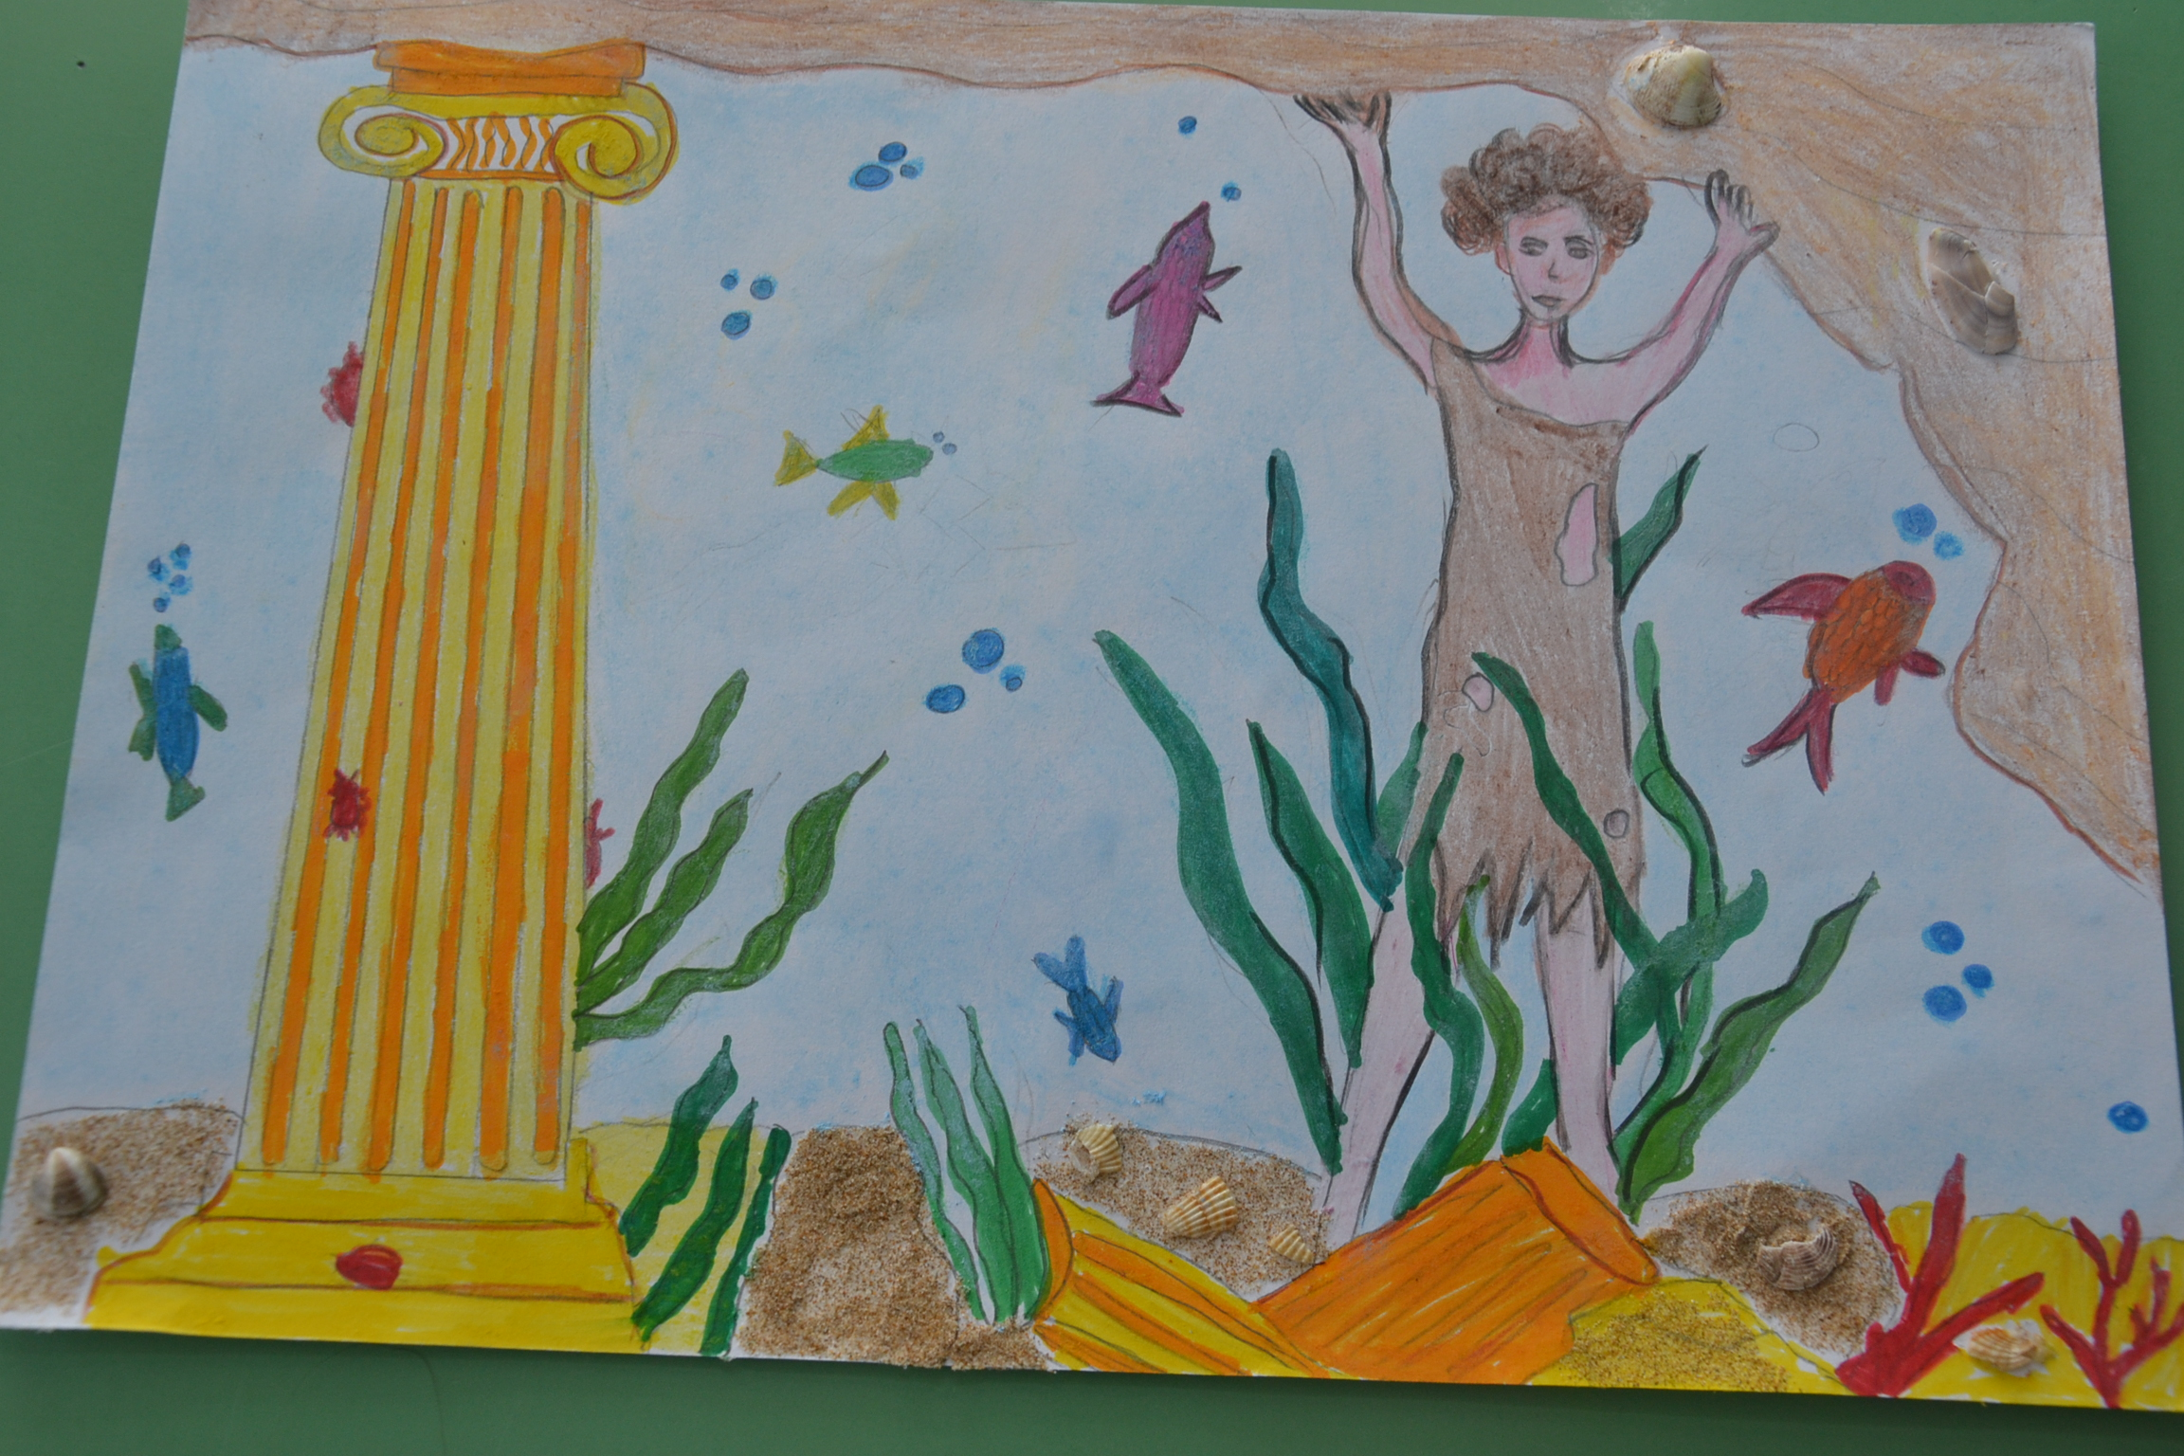
THE MOST FAMOUS LEGEND SAYS THAT COLAPESCE, GOING SO DEEP, SAW THAT SICILY WAS PLACED ON THREE COLUMN, ONE OF WHICH WAS SERIOUSLY CRACKED.

Slide 12
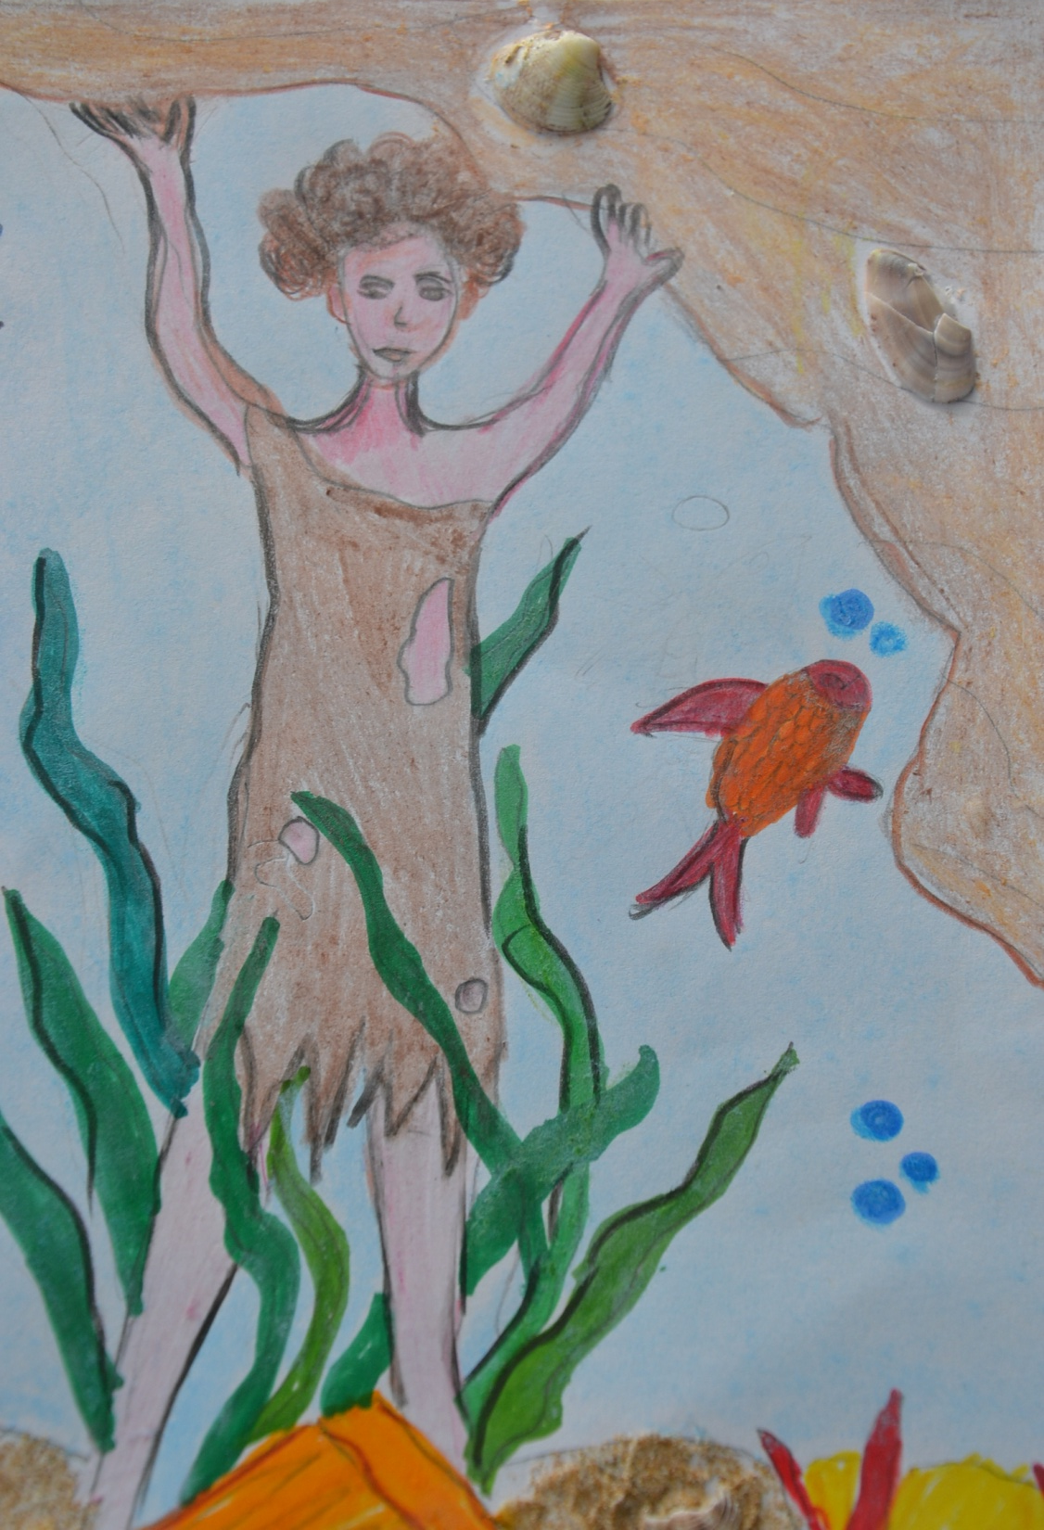
SO HE DECIDED TO STAY UNDERWATER SUPPORTING THE DANGER COLUMN TO AVOID SICILY TO COLAPESCE UNDER THE WATER. STILL NOW HE SUPPORTS THE ISLAND.

Slide 13
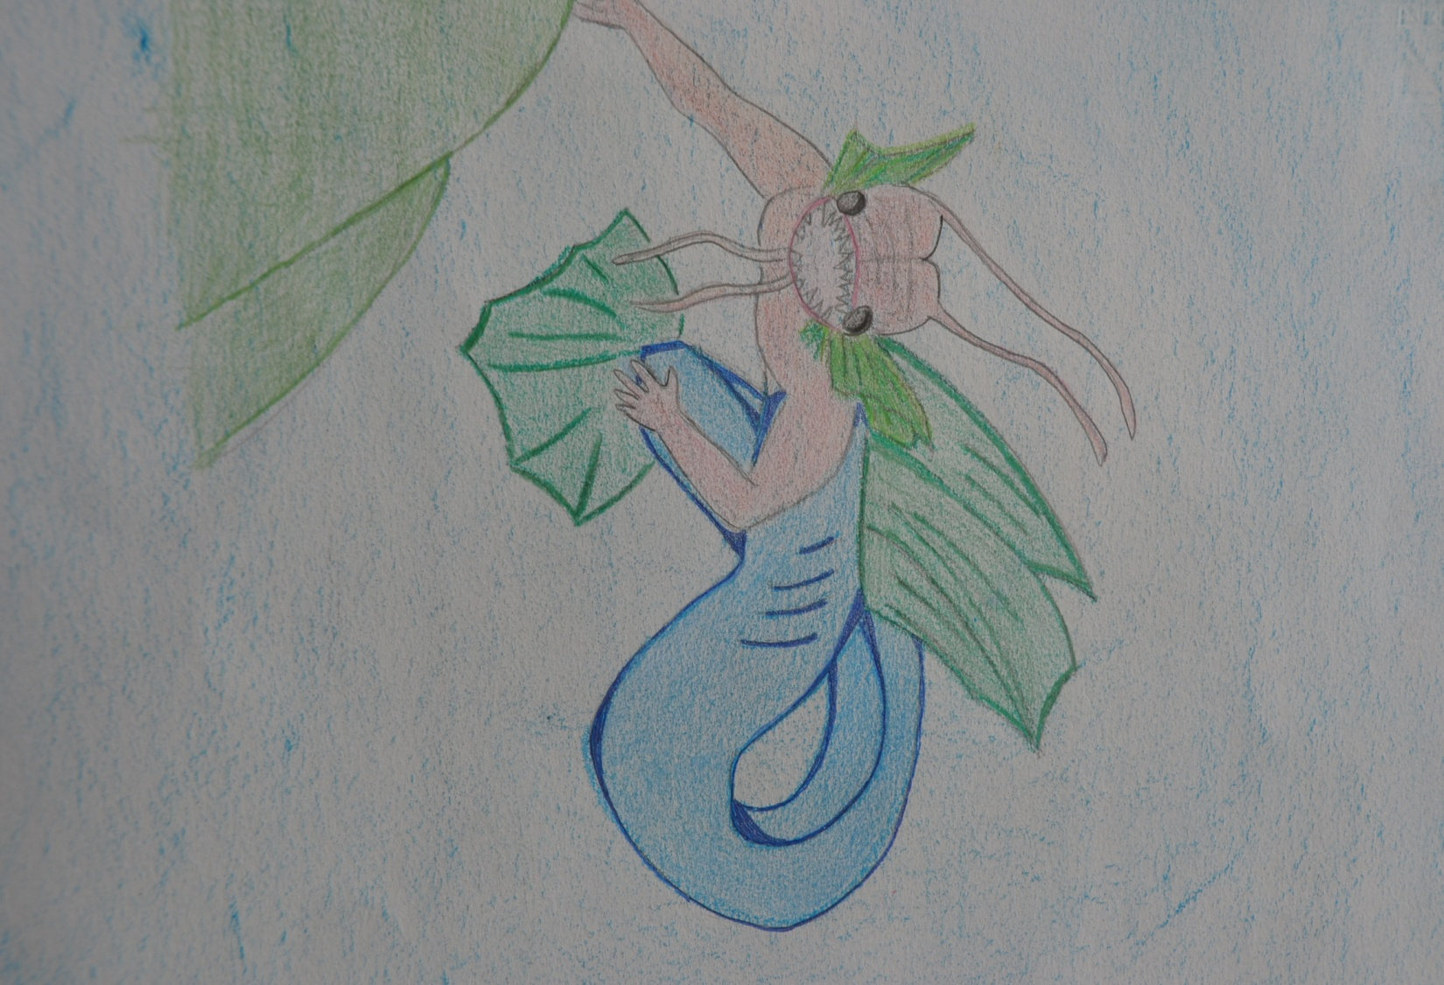
ANOTHER LEGEND SAYS THAT HE BECOMES A FISH AND HE LIVES EVEN NOWADAYS
UNDER THE FOUND OF THE SEA.

Slide 14
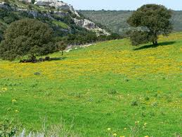
GIUFÀ

Slide 15
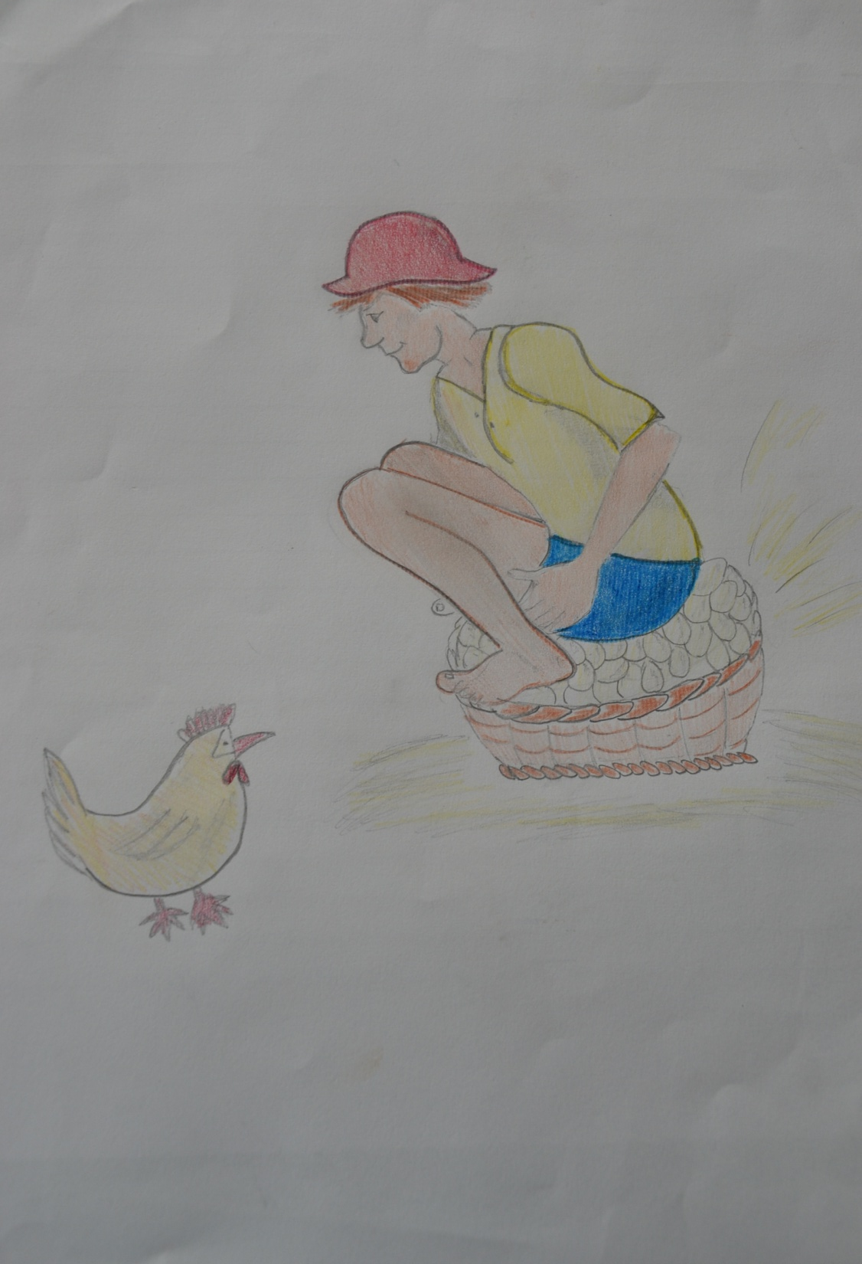
GIUFÀ, SOMETIMES CALLED GIUFÀ, IS A LITERARY CHARACTER OF SICILIAN, JEWISH, SPANISH POPULAR ORAL TRADITION.
GIUFÀ IS A VERY IGNORANT CHILD THAT TALKS SET PHRASES AND KNOWS ONLY THE ORAL TRADITION THAUHGT BY HIS MOTHER.

Slide 16
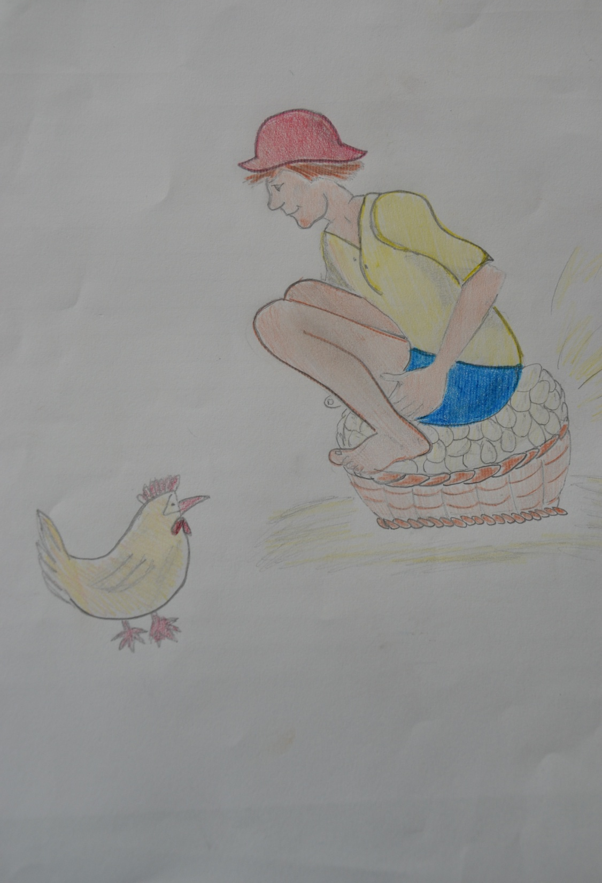
IN HIS STORIES HE IS OFTEN IN TROUBLES BUT HE ALWAYS SUCCEEDS TO GET OUT UNINJURED.
HE LIVES HIS LIFE IN A INNOCENT AND CAREFREE WAY, UNCONCERNED ABOUT THE WORLD AROND HIM.

Slide 17
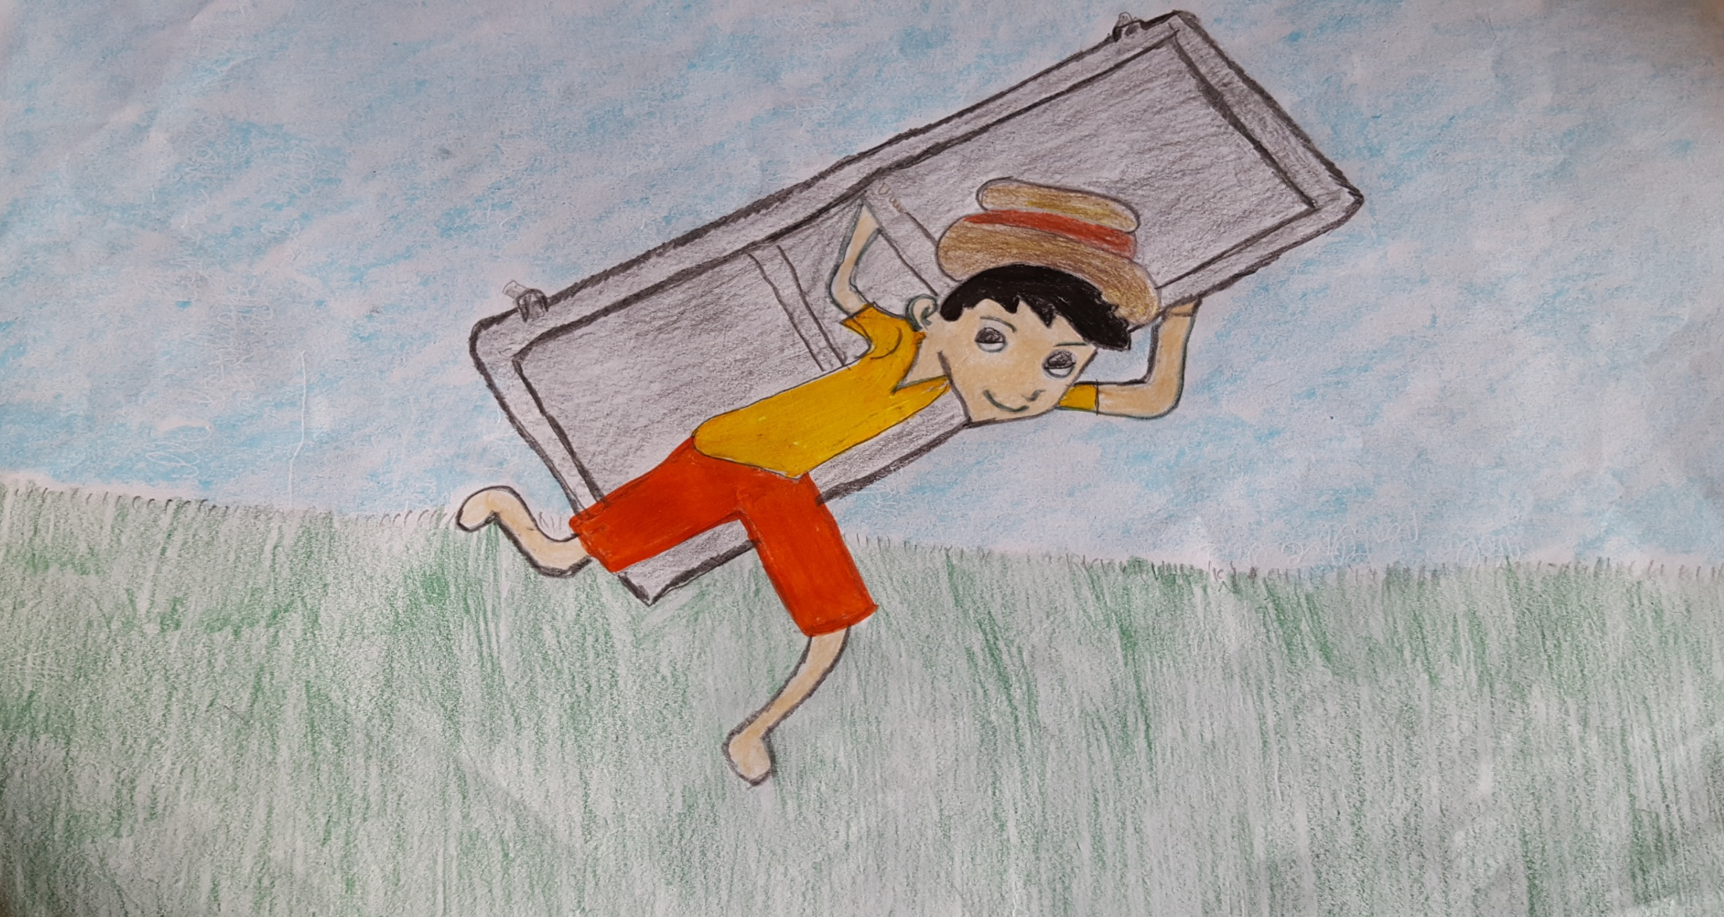
HE IS A COMIC CARACTER, PARODY OF ALL SICILIAN CHILDREN.
GIUFÀ MAKES THE PEOPLE SMILE WITH HIS INCREDIBLE STORIES ABOUT BAD LUCK, WISDOM AND FOOLISHNESS.

Slide 18
ANYWAY HE ALSO MAKES PEOPLE KNOW THE SICILIAN CULTURE AND TRADITIONS BETWEEN THE END OF 19th AND THE BEGINNING OF THE 20th CENTURY.

Slide 19
OUR MASCOT

Slide 20
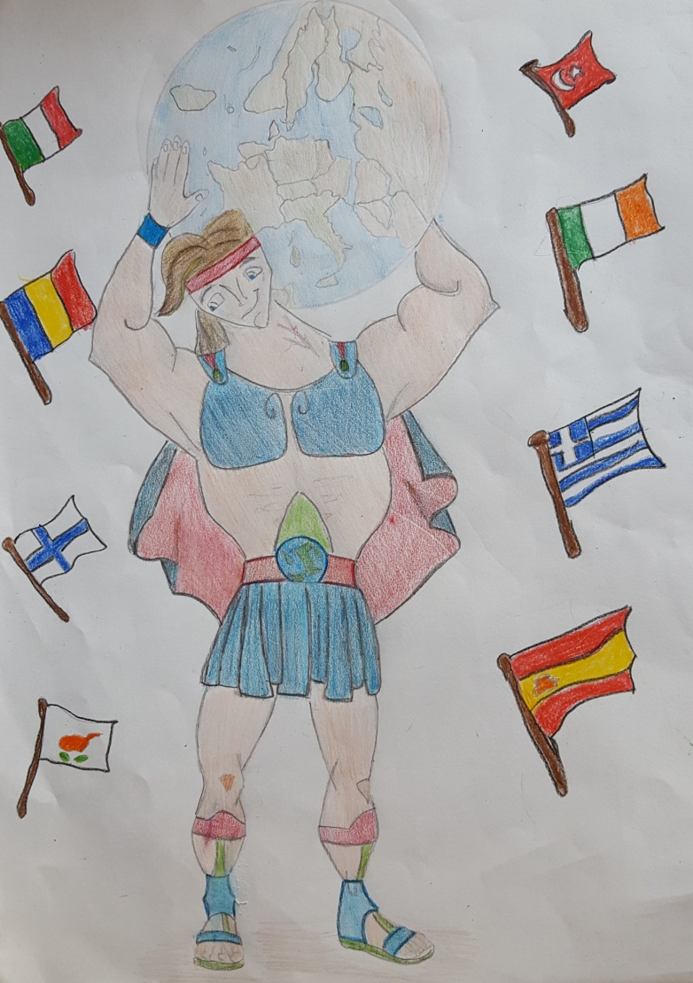
STRONG
GENEROUS
FAIR
SUPPORTIVE
SWEET
COURAGEOUS

