Slide 1
Visit to the Häme Castle on the 9th of March

Slide 2
Häme Castle
Häme Castle was built in the Middle Ages.
Häme Castle is 700 years old.
In the Middle Ages Sweden and Russia battled the land. Sweden won the battle and built the castle.
The Castle is situated next to the lake Vanajavesi.
Häme Castle is a royal castle where there didn't live any kings but there was one visit of the king. The visitor was king from Sweden.
Häme Castle was under attack many many times.

Slide 3
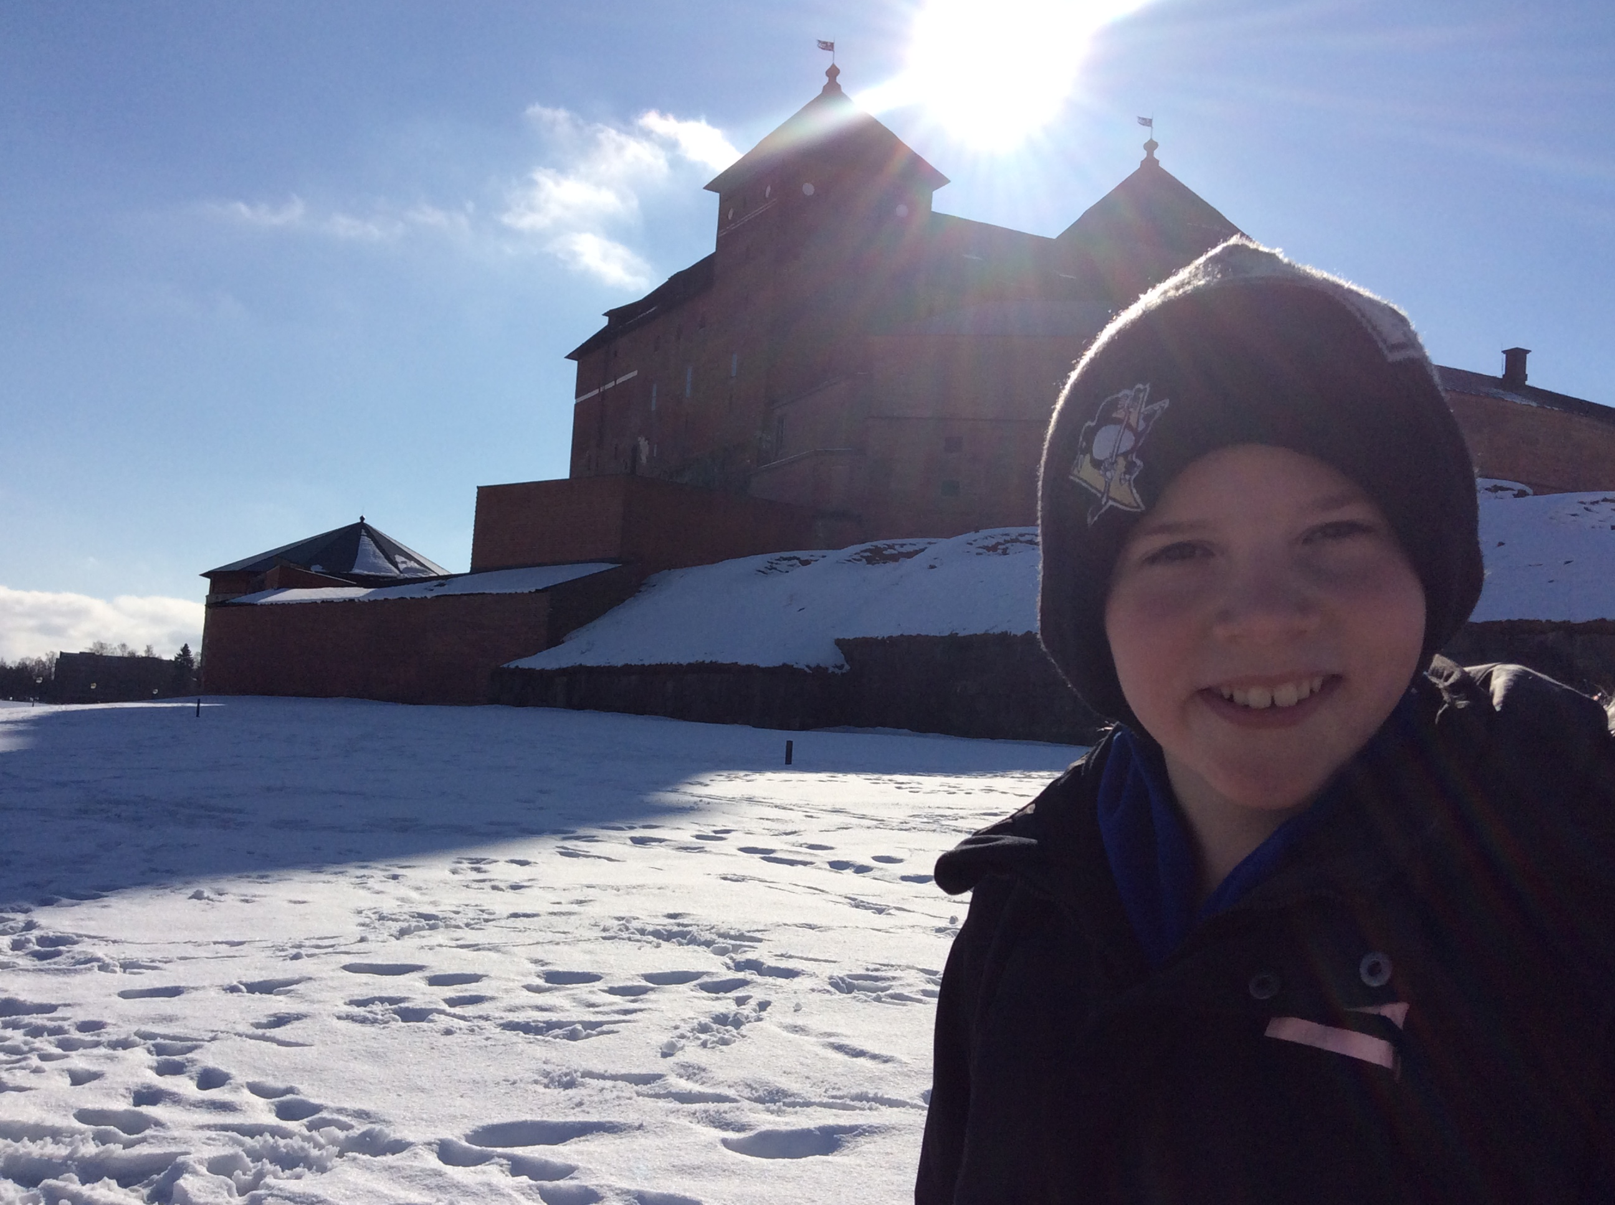
Häme Castle :)
We went to Häme Castle by bus. Häme Castle is a a medieval castle. Häme Castle is 700 years old. First we were at chain armor workshop.After that we went to a guided tour in the castle. We saw a really cool and interesting places such as a dungeon, a chapel , a turret ,an old toilet and other places. We had a picnic lunch in the bakery of the castle . In the castle there was a pit where were plenty of coins in the bottom of it . The money is drained every four years and that is why the pit was a bit empty because it was already emptied this year.

Slide 4
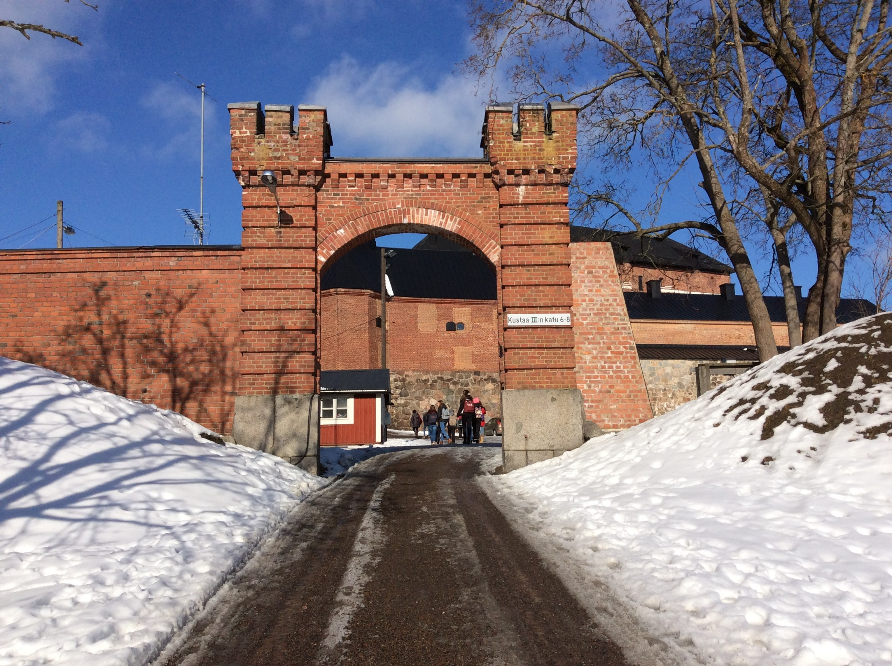

Slide 5
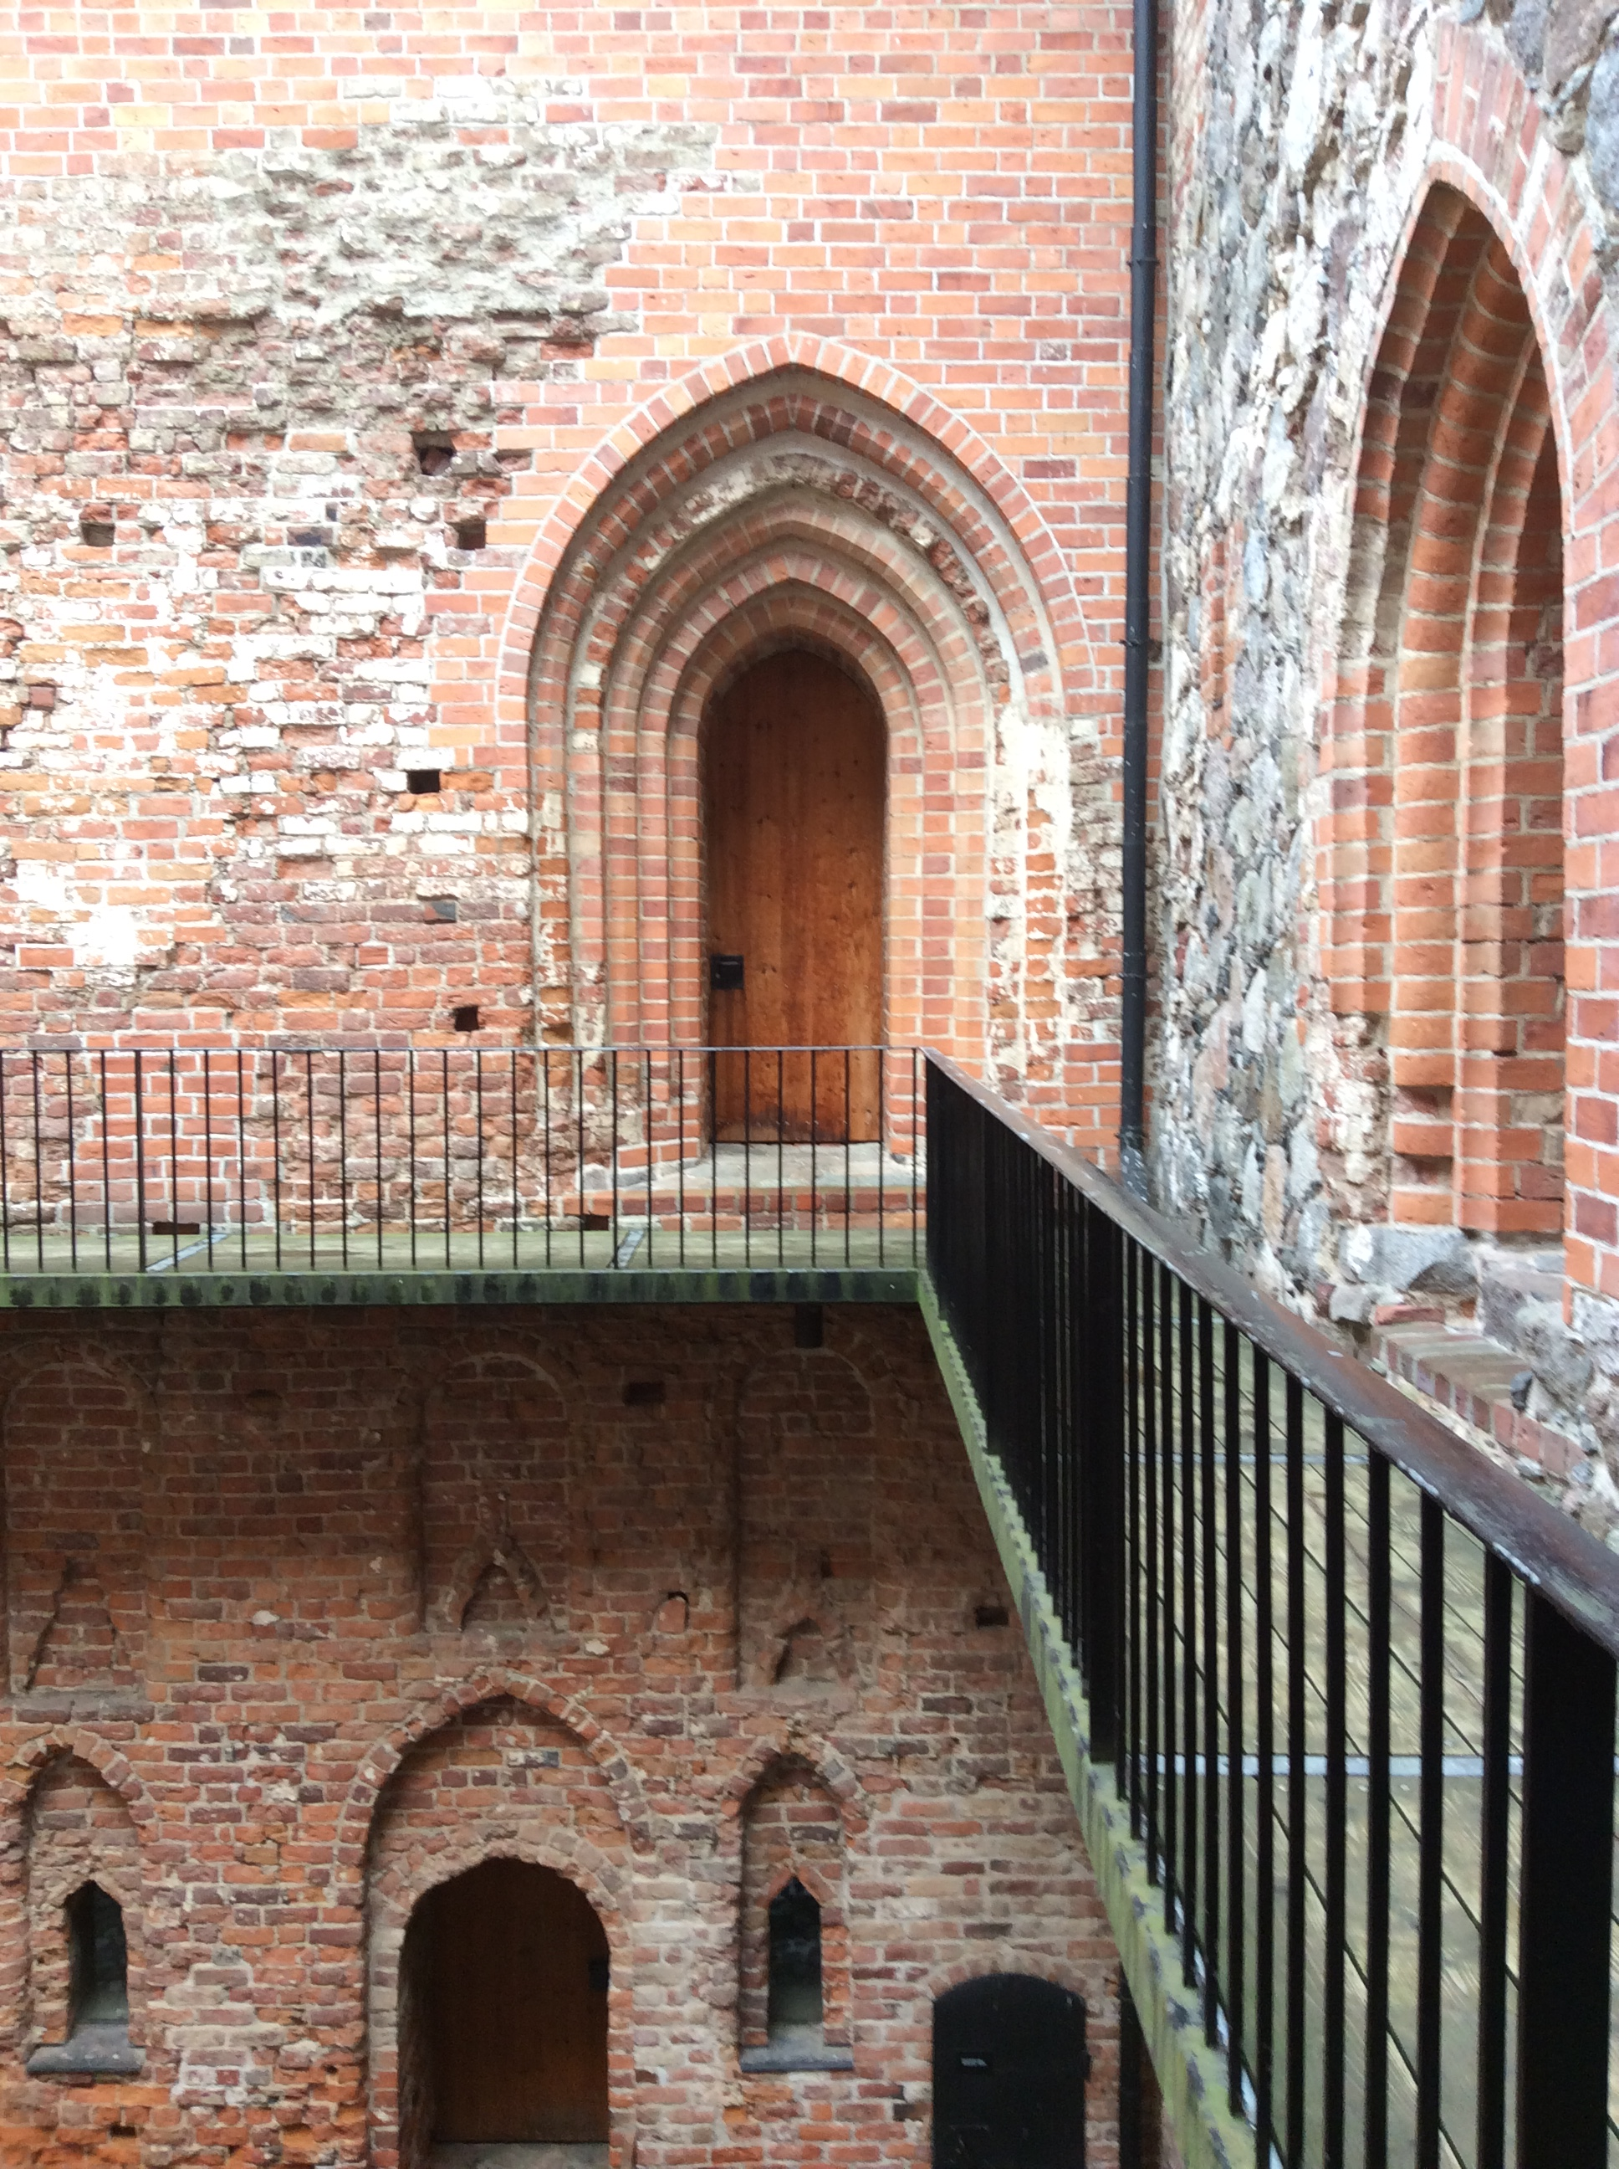
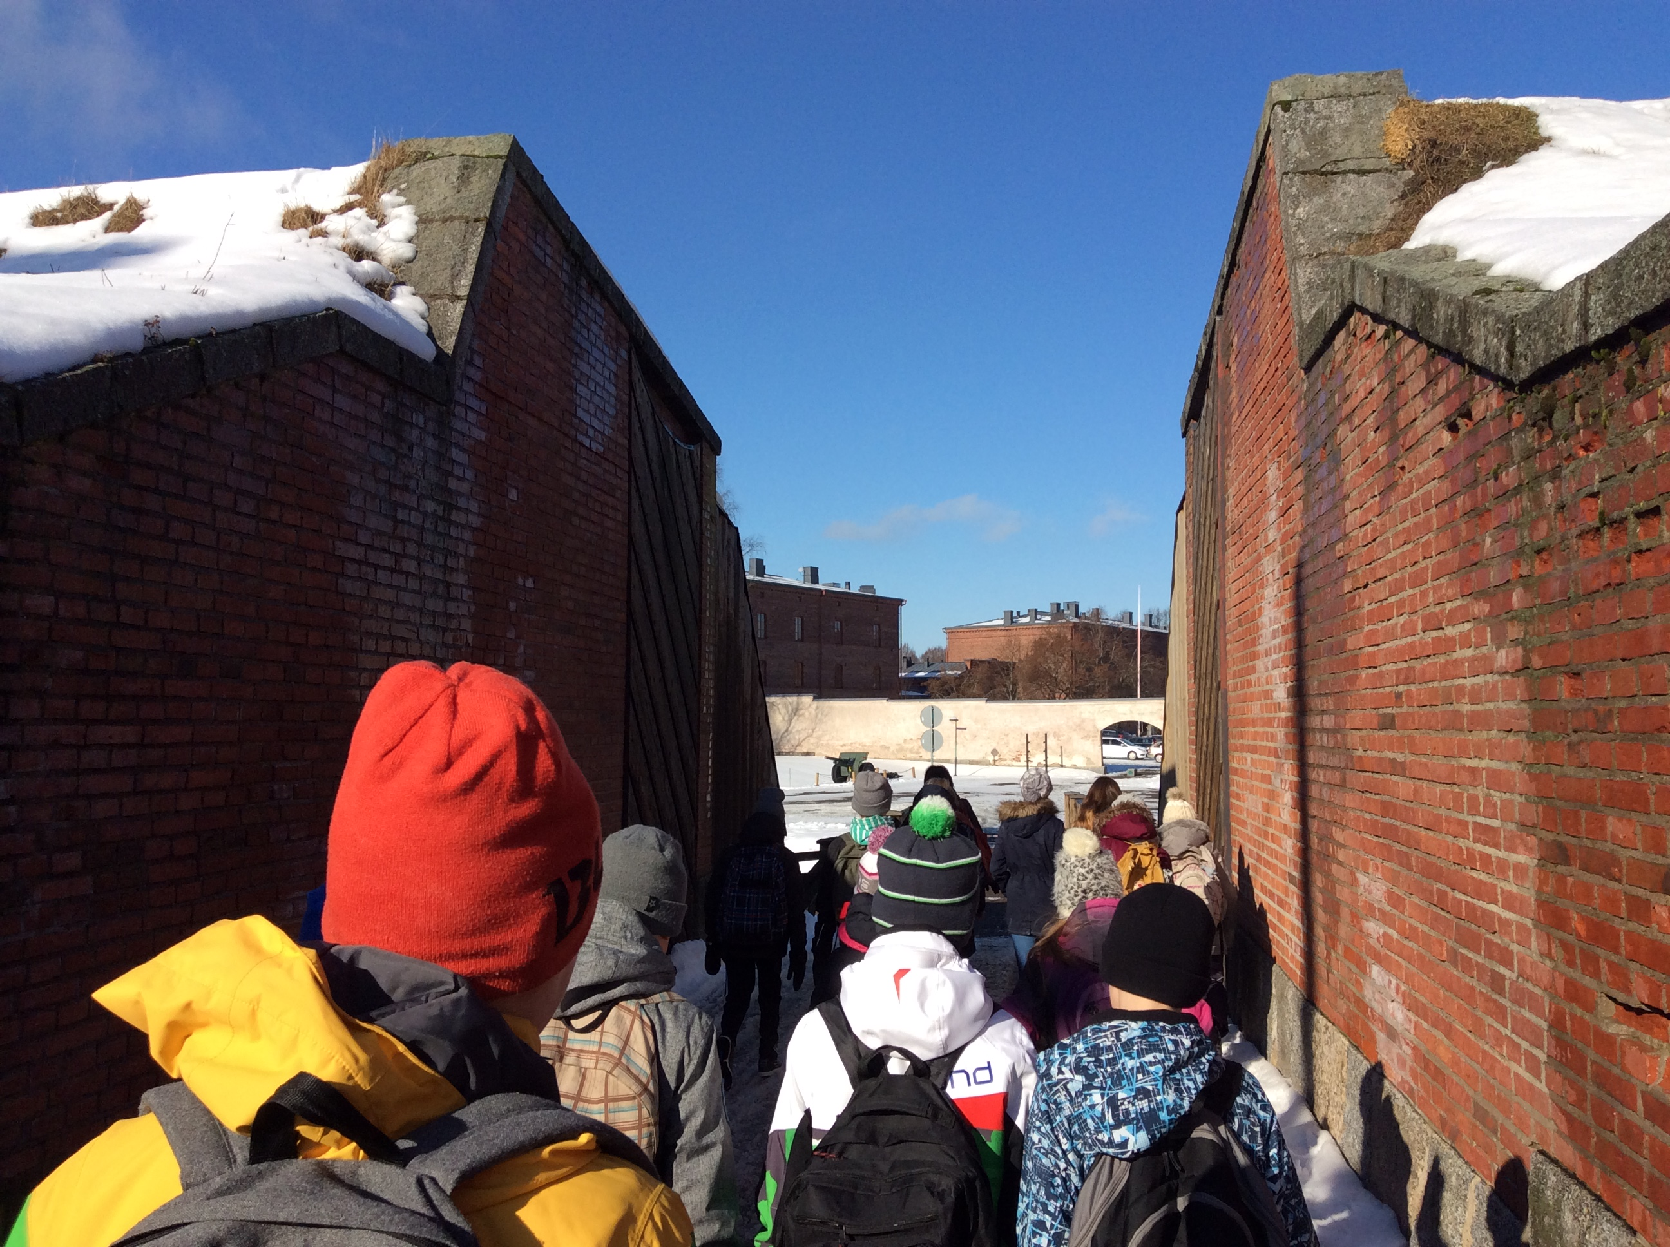
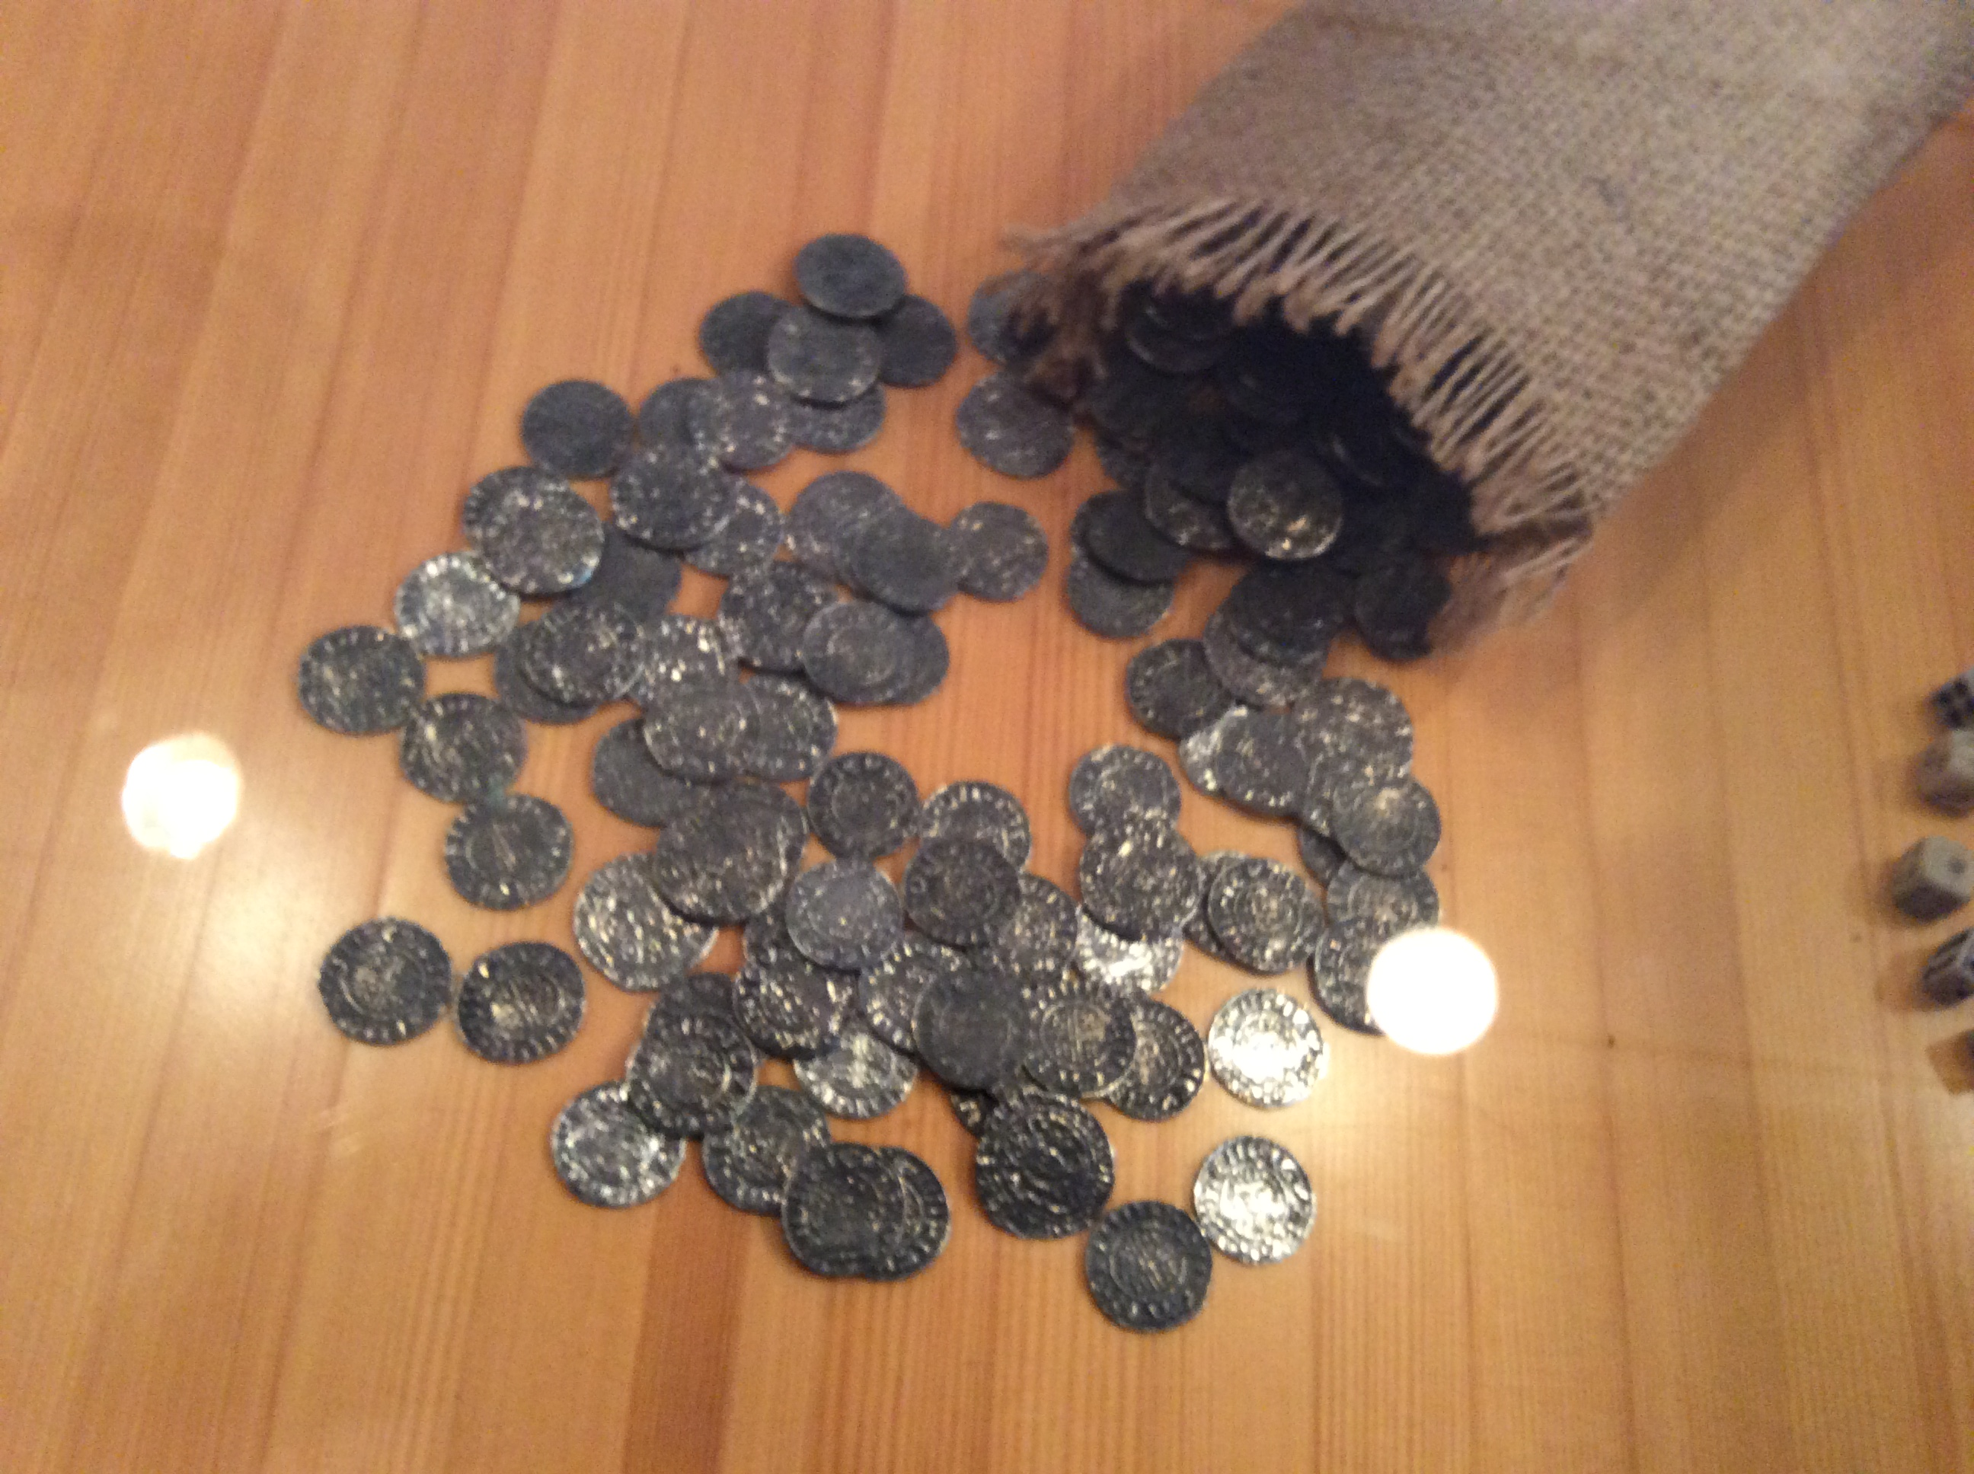
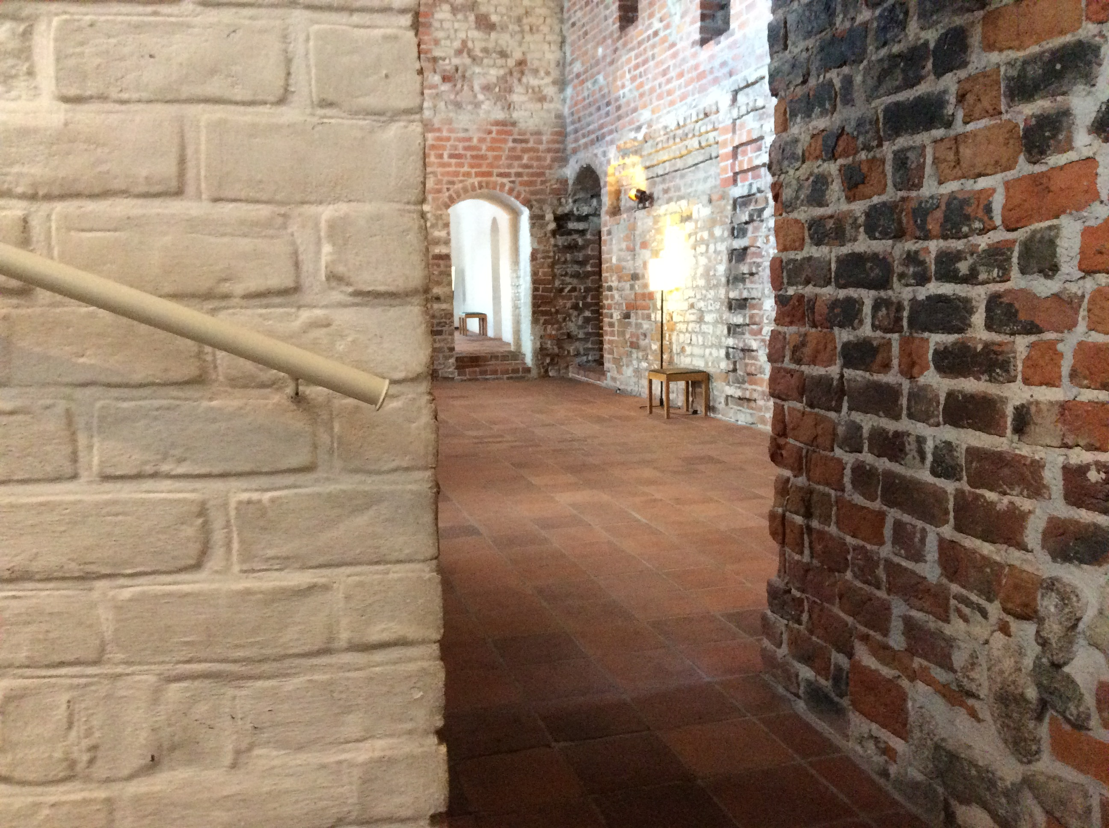
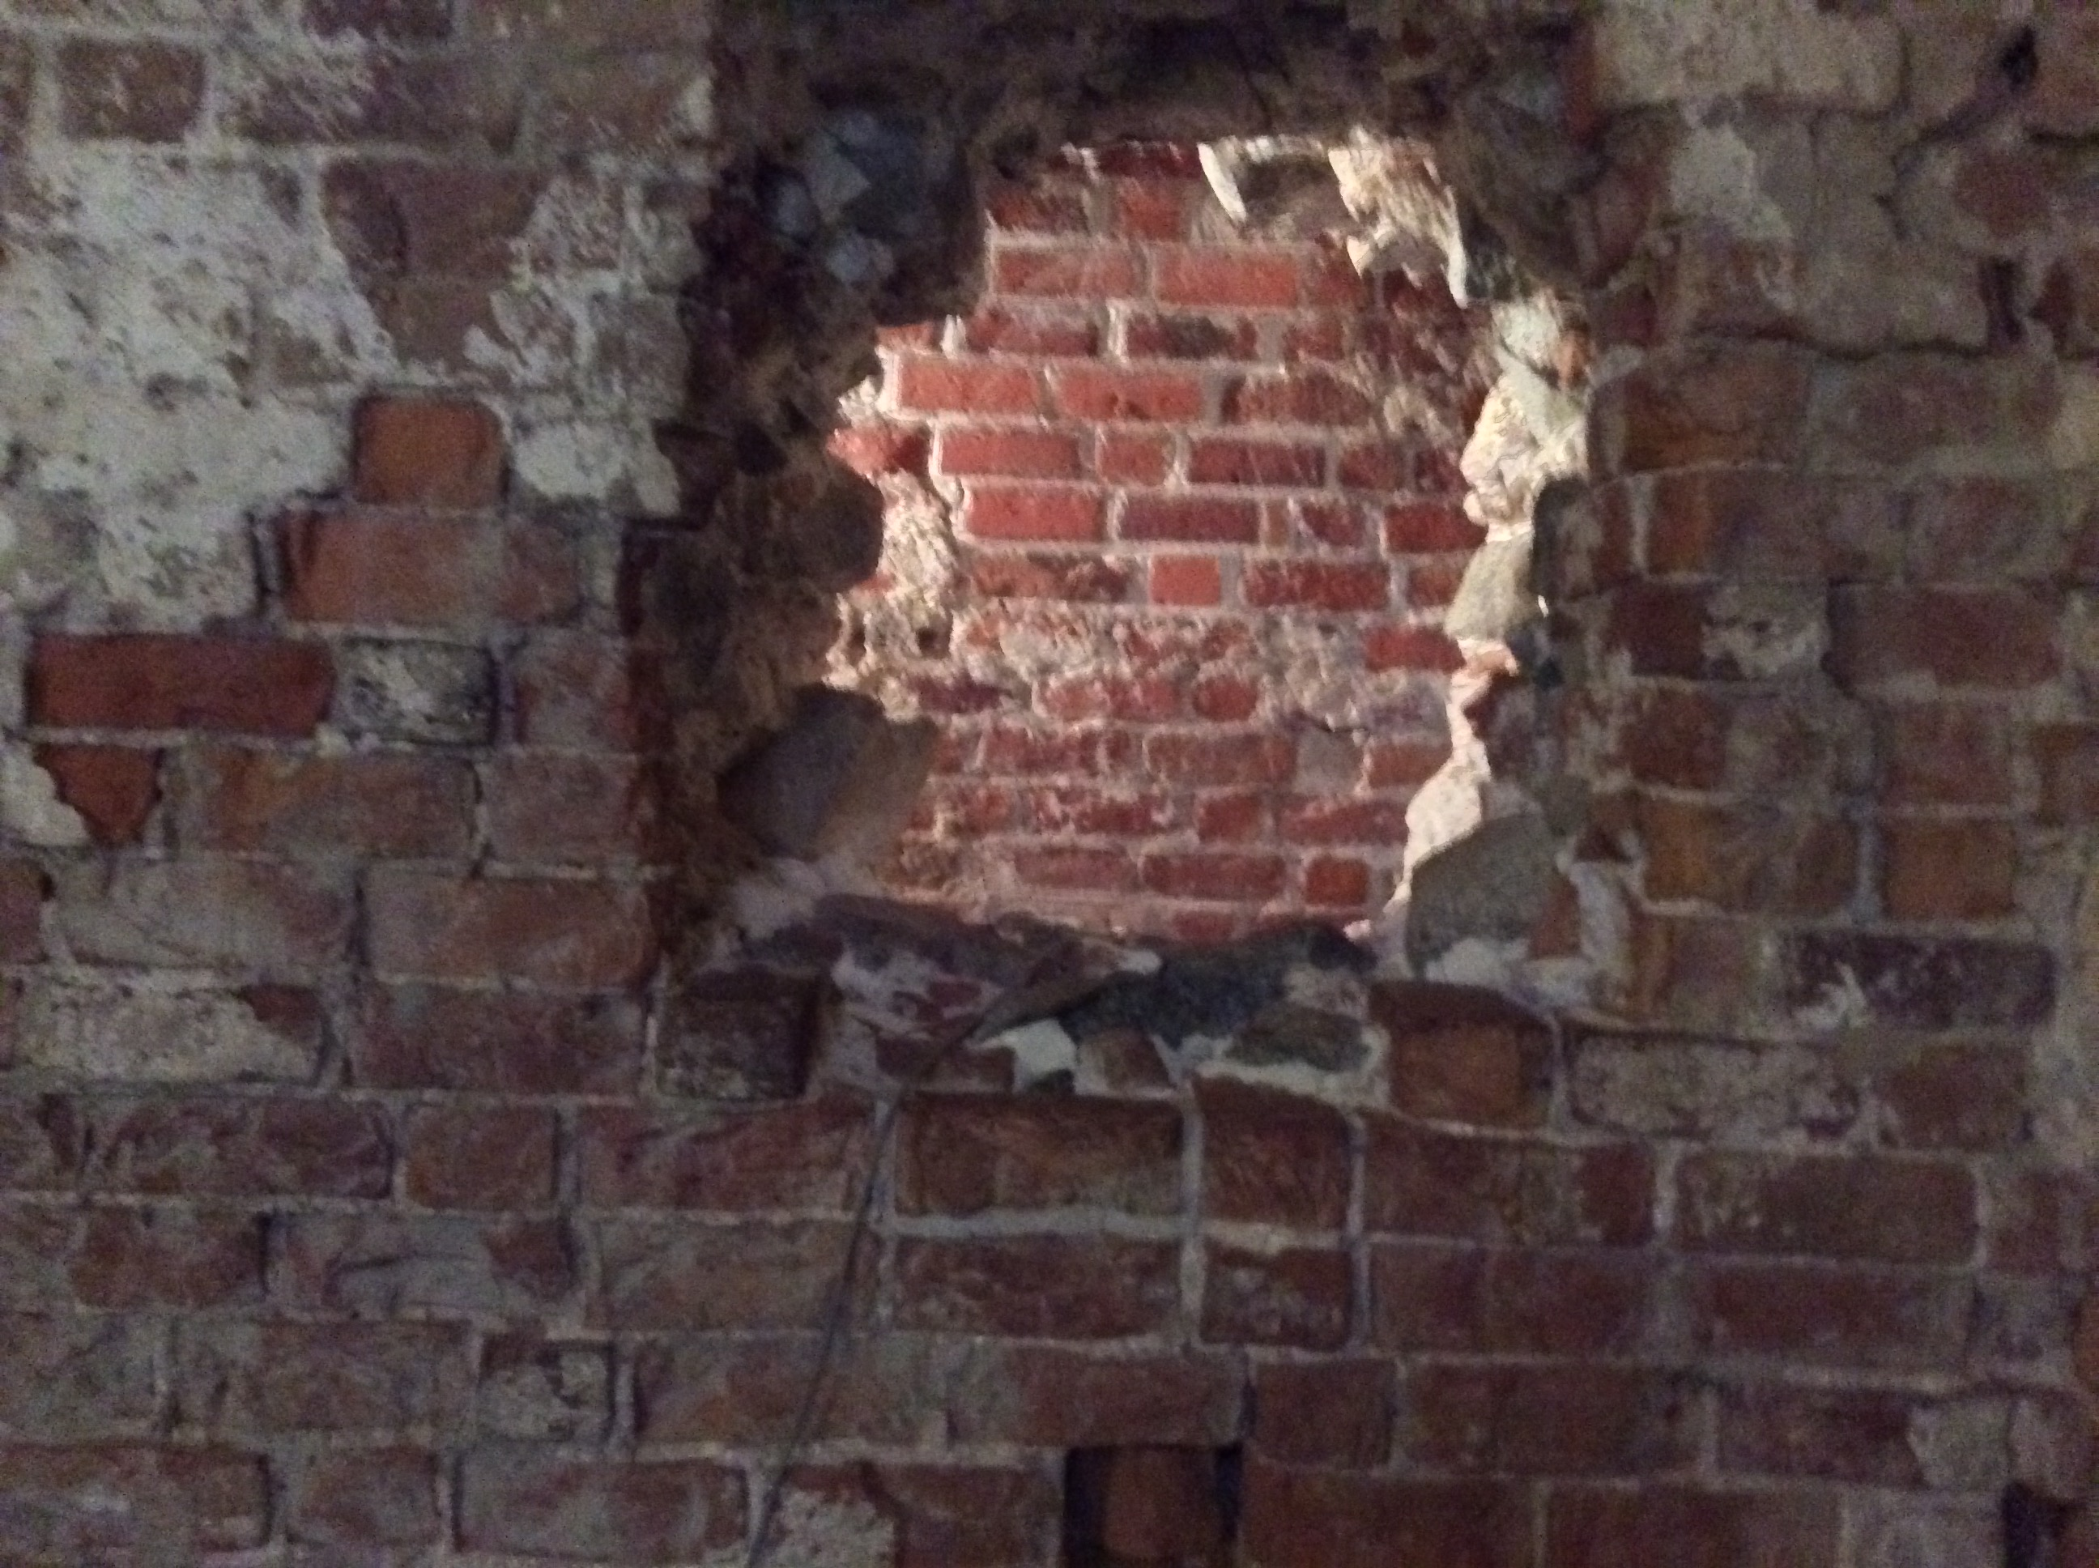
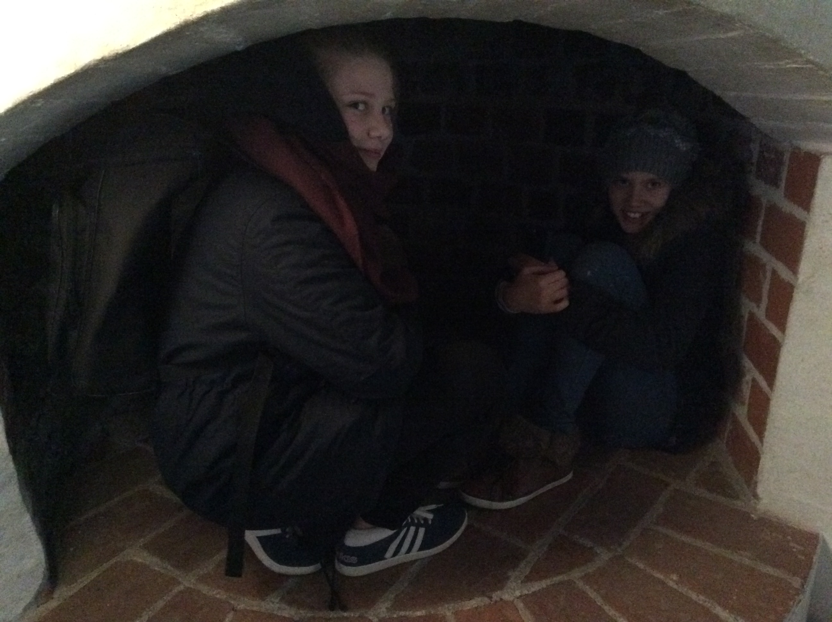
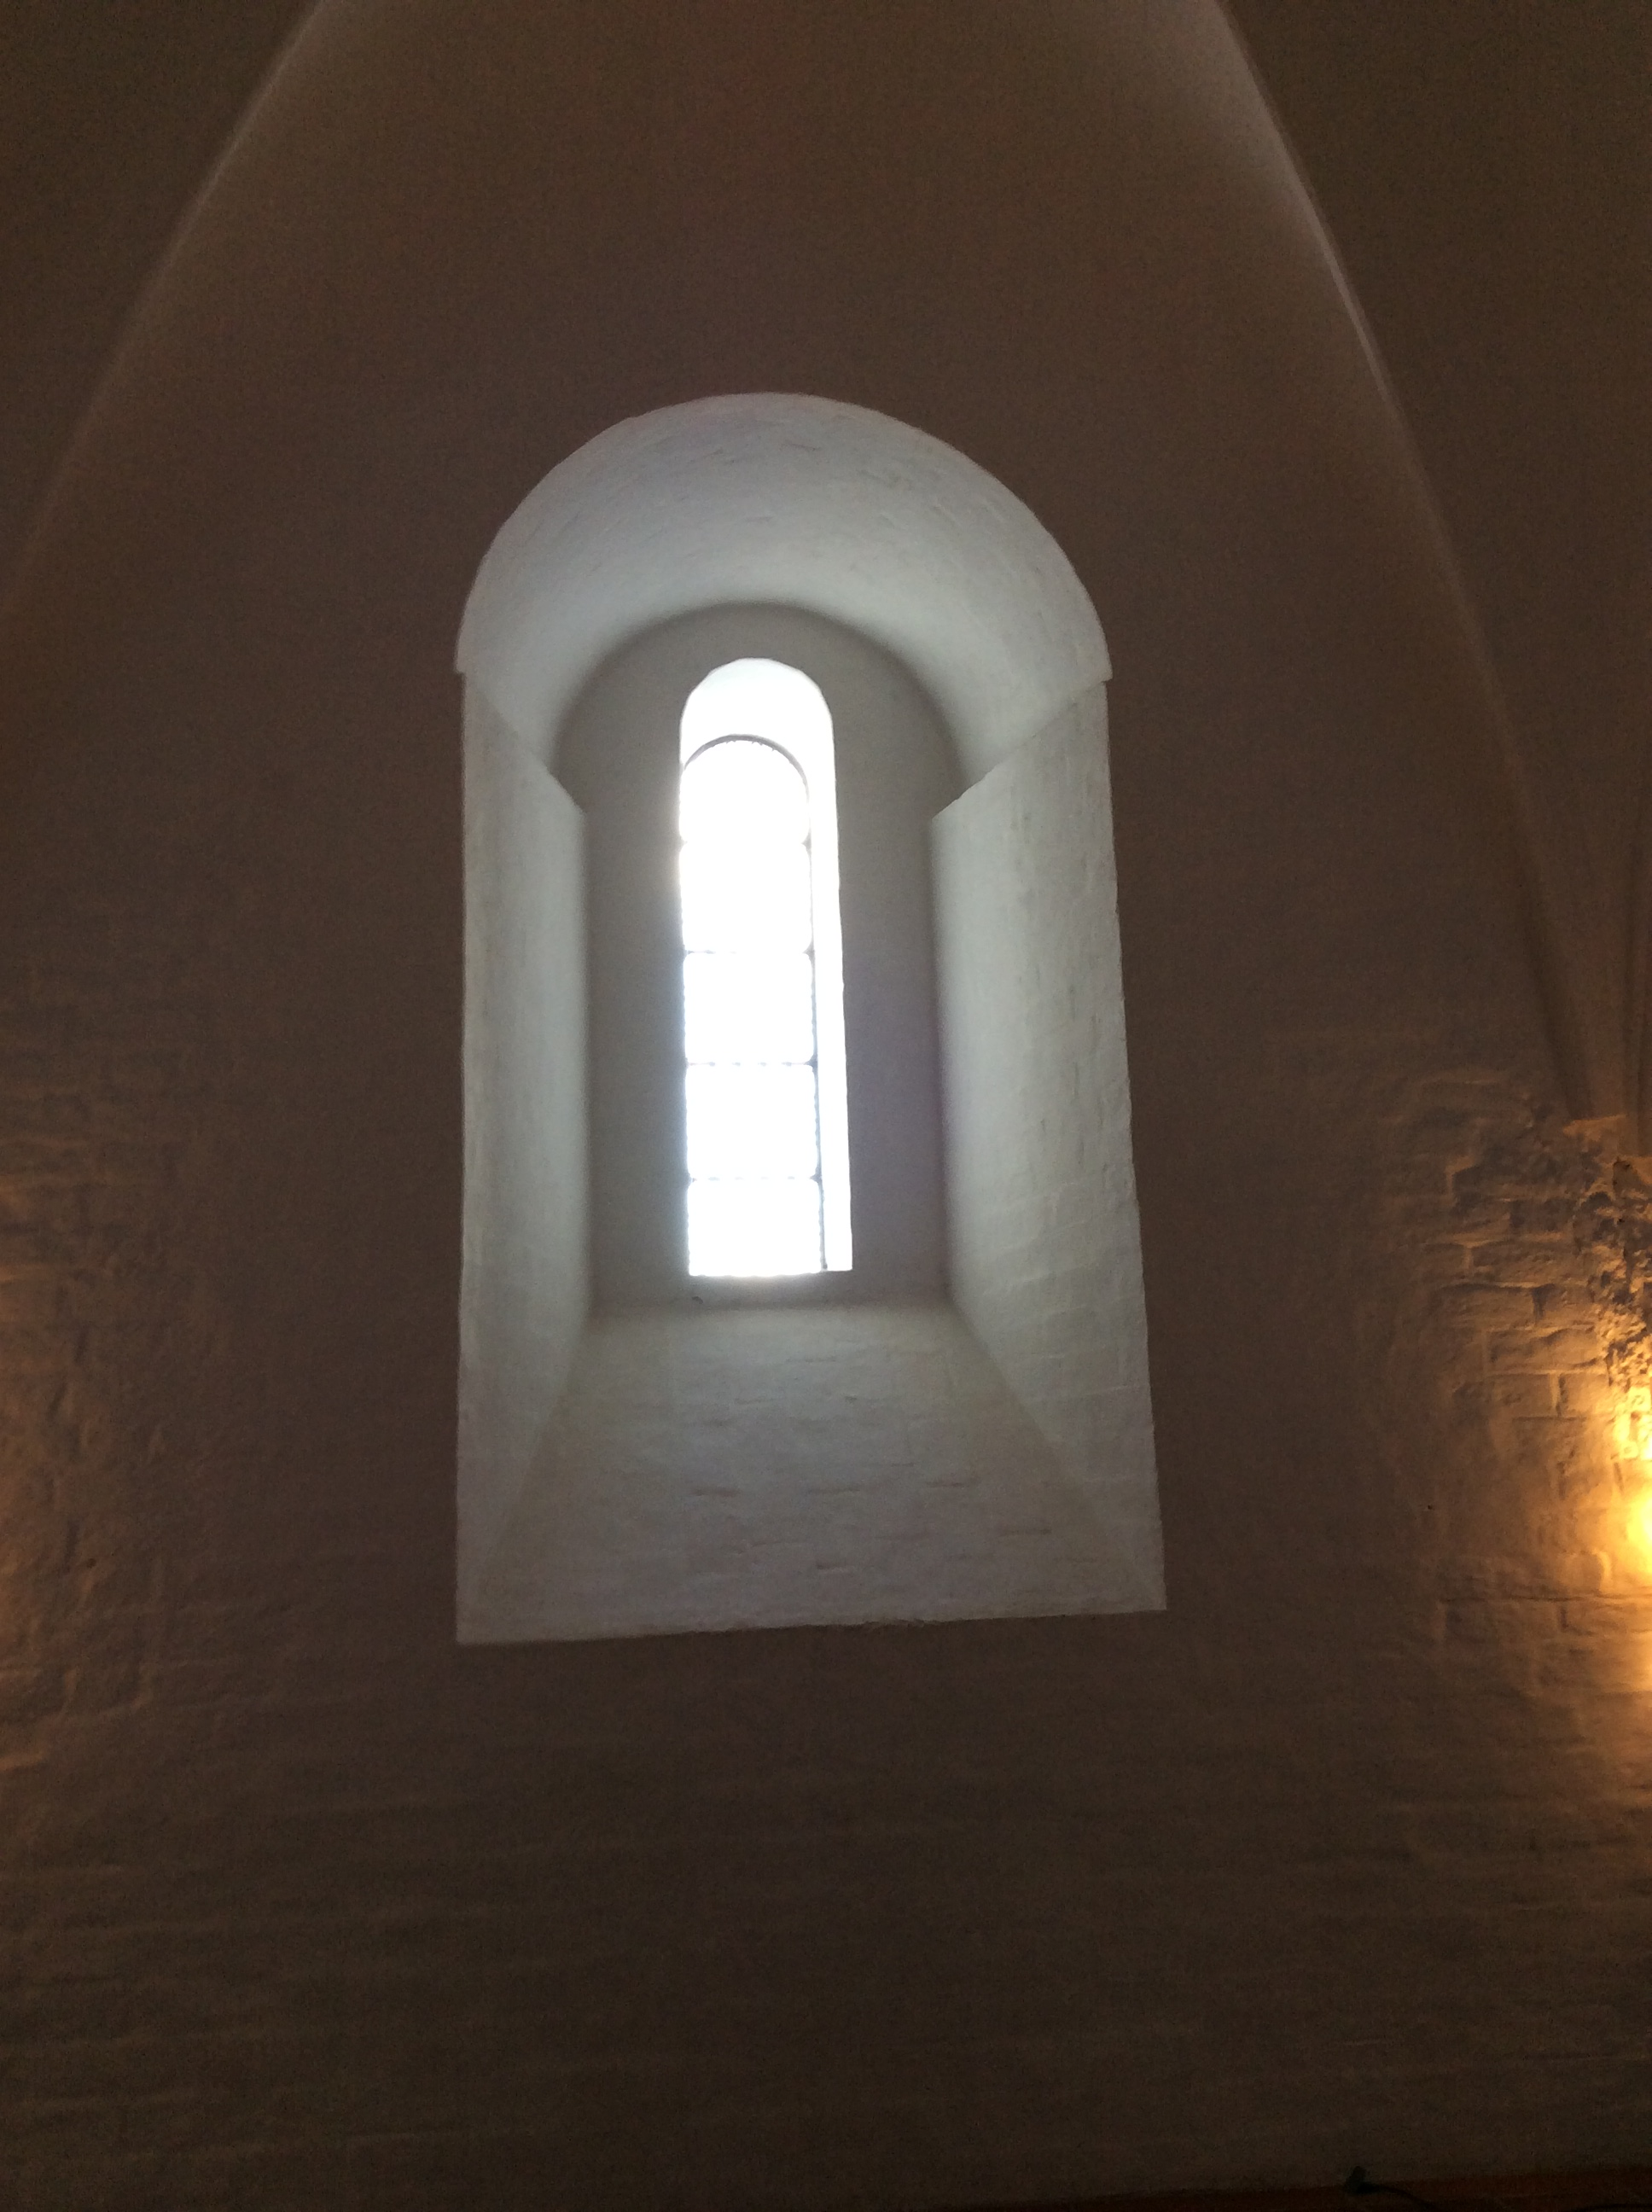
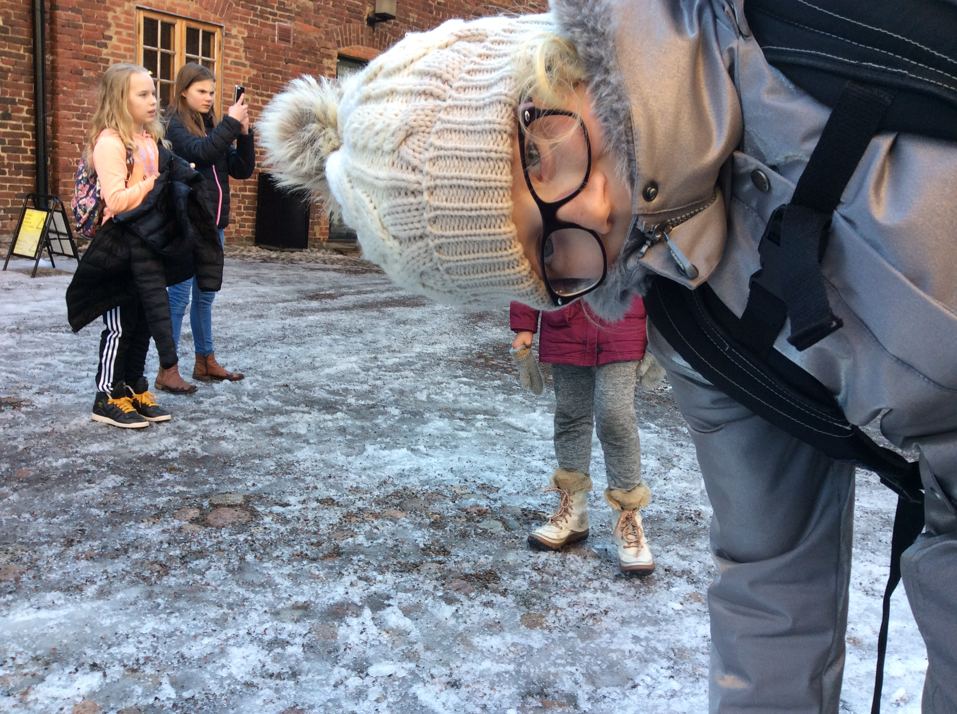

Slide 6
Häme Castle
Häme Castle is 700 years old and it´s build in Middle Ages.

Slide 7
This is what we did, saw and heard during our visit to the Castle
Chain armor workshop
Guided tour
First we learnt about what were the chain armors and about the reasons they were needed for. Then we learnt how to make chains out of iron wire. Some of us made a chain armband and some made a chain necklace.
Then we had a guided tour outside and inside the castle. We heard about the history of this interesting building.

Slide 8
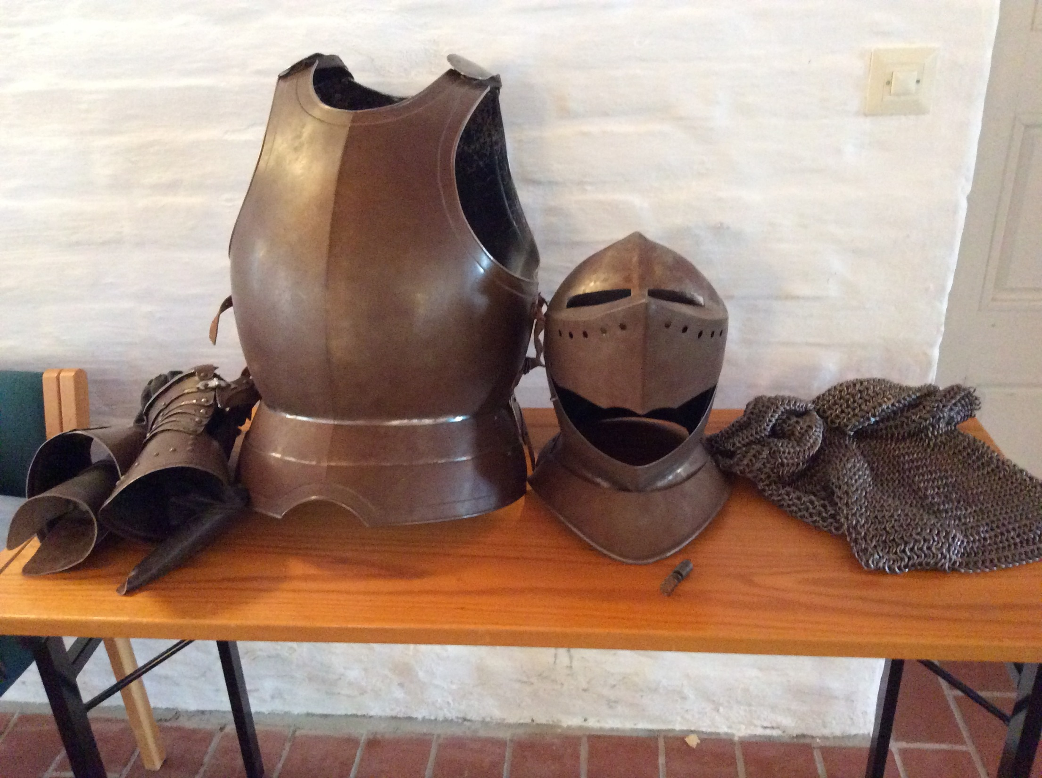

Slide 9
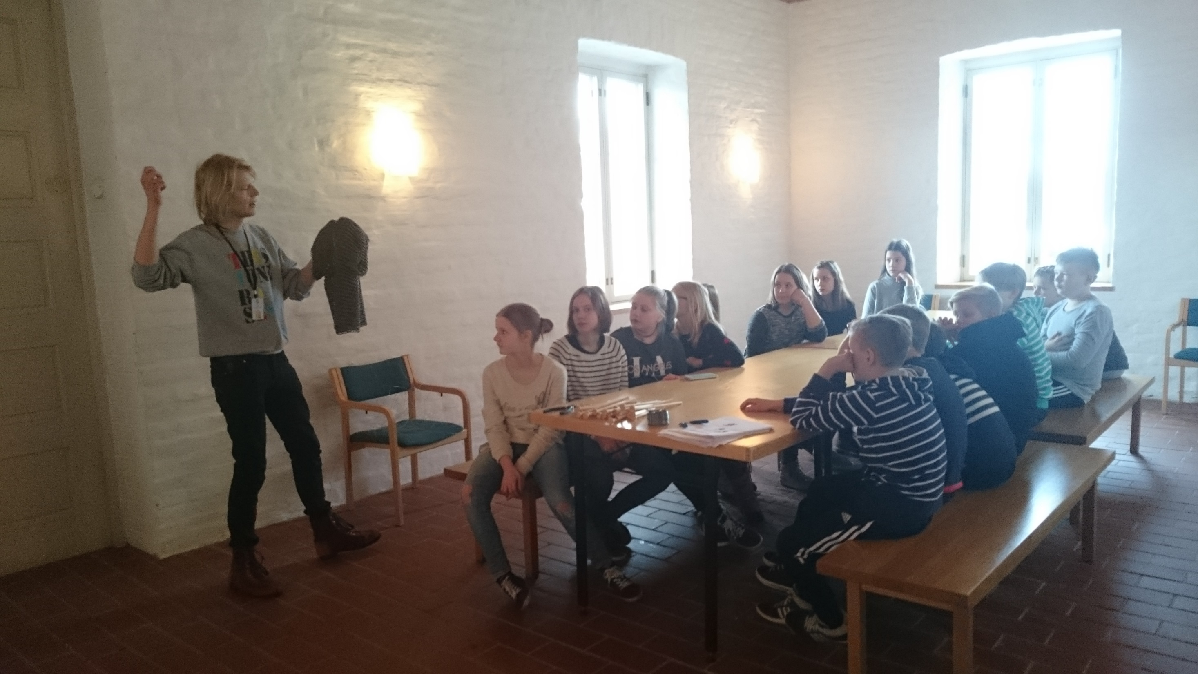

Slide 10
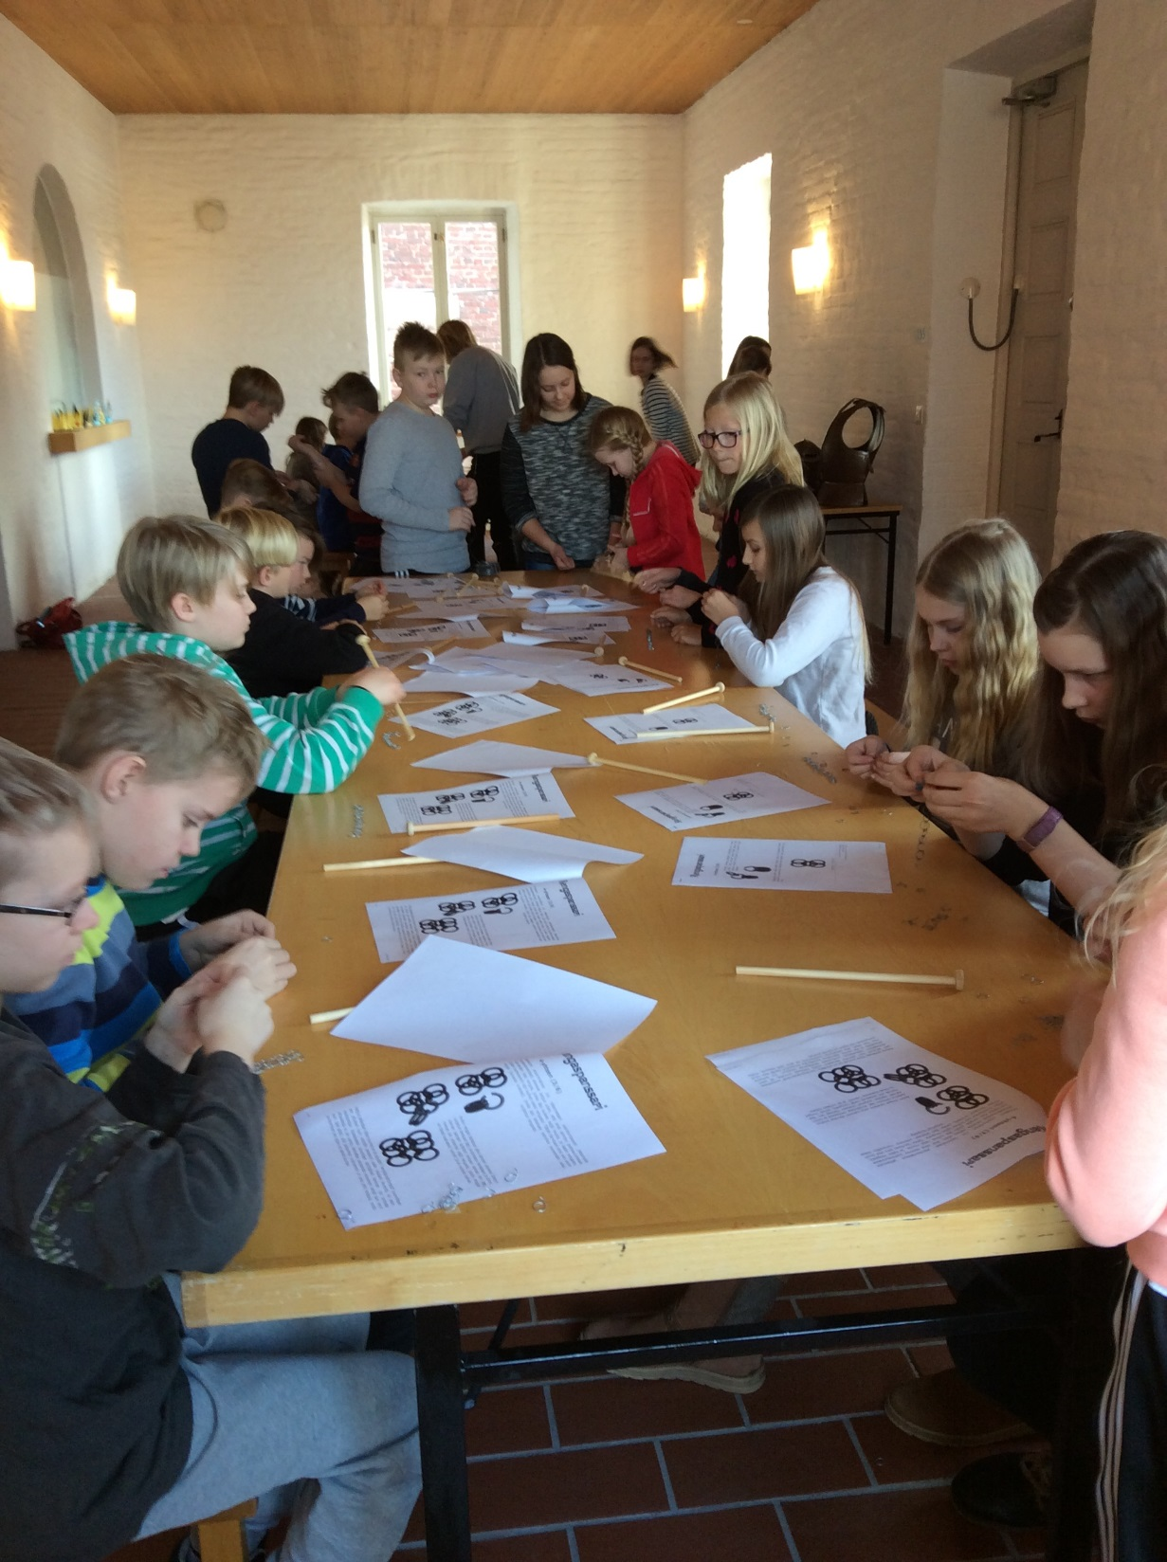

Slide 11
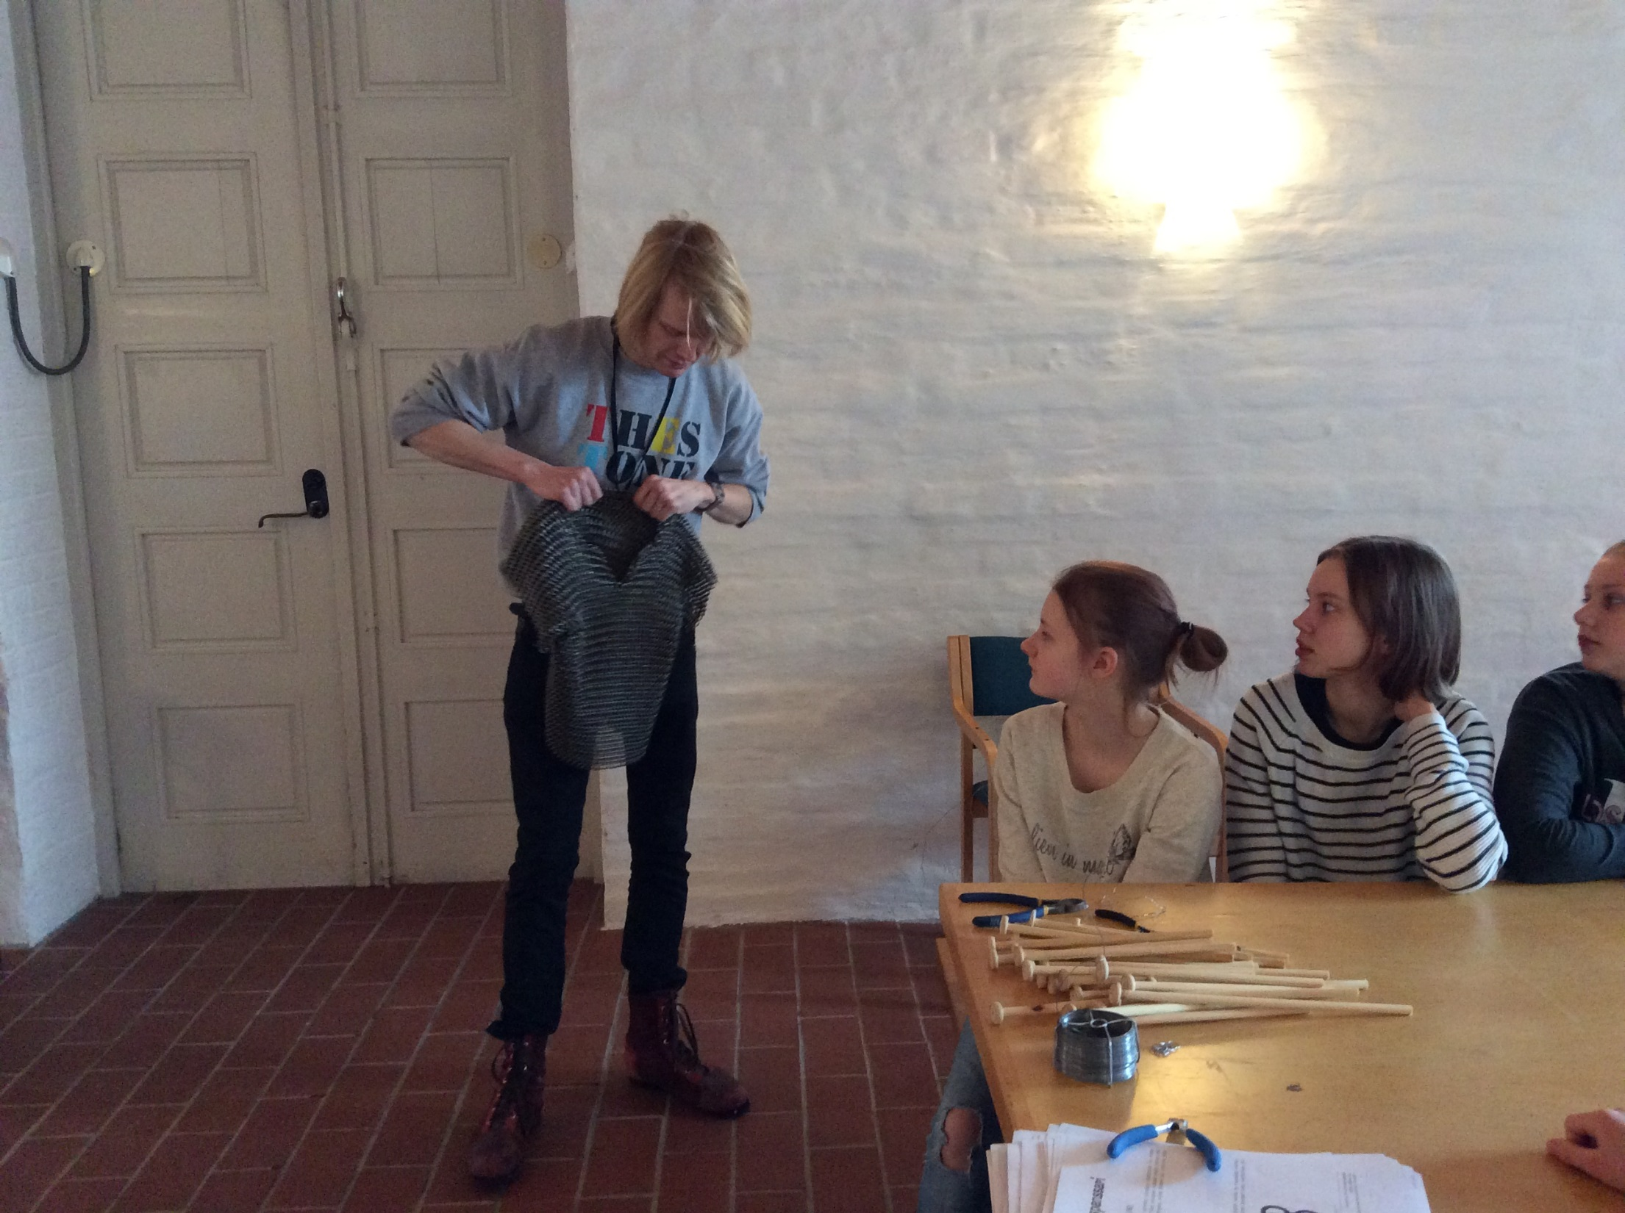
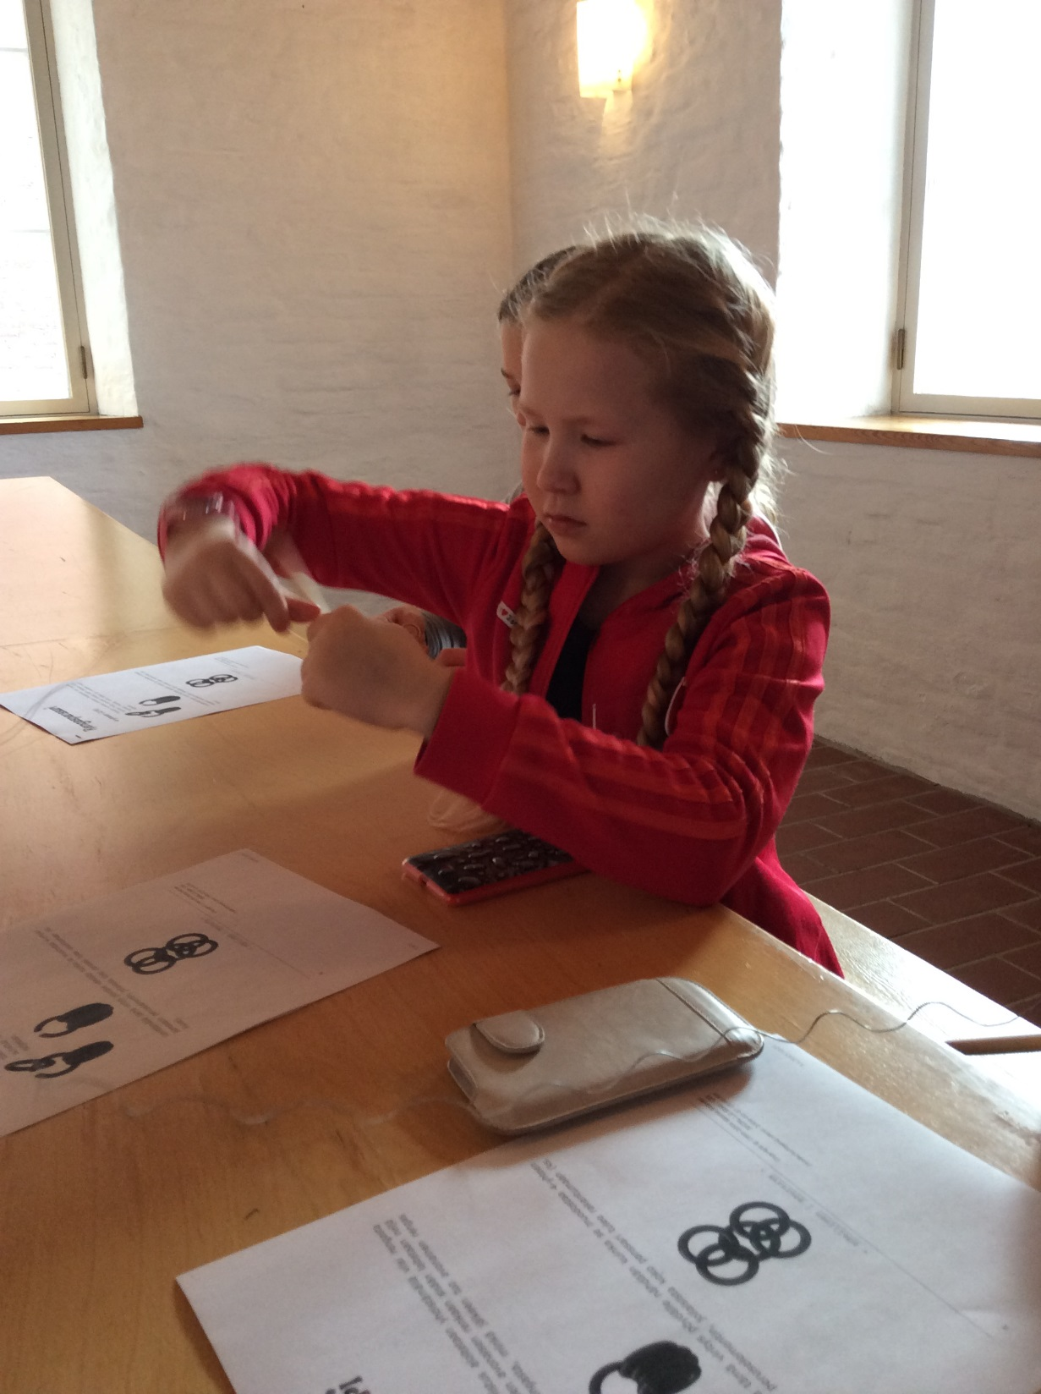

Slide 12
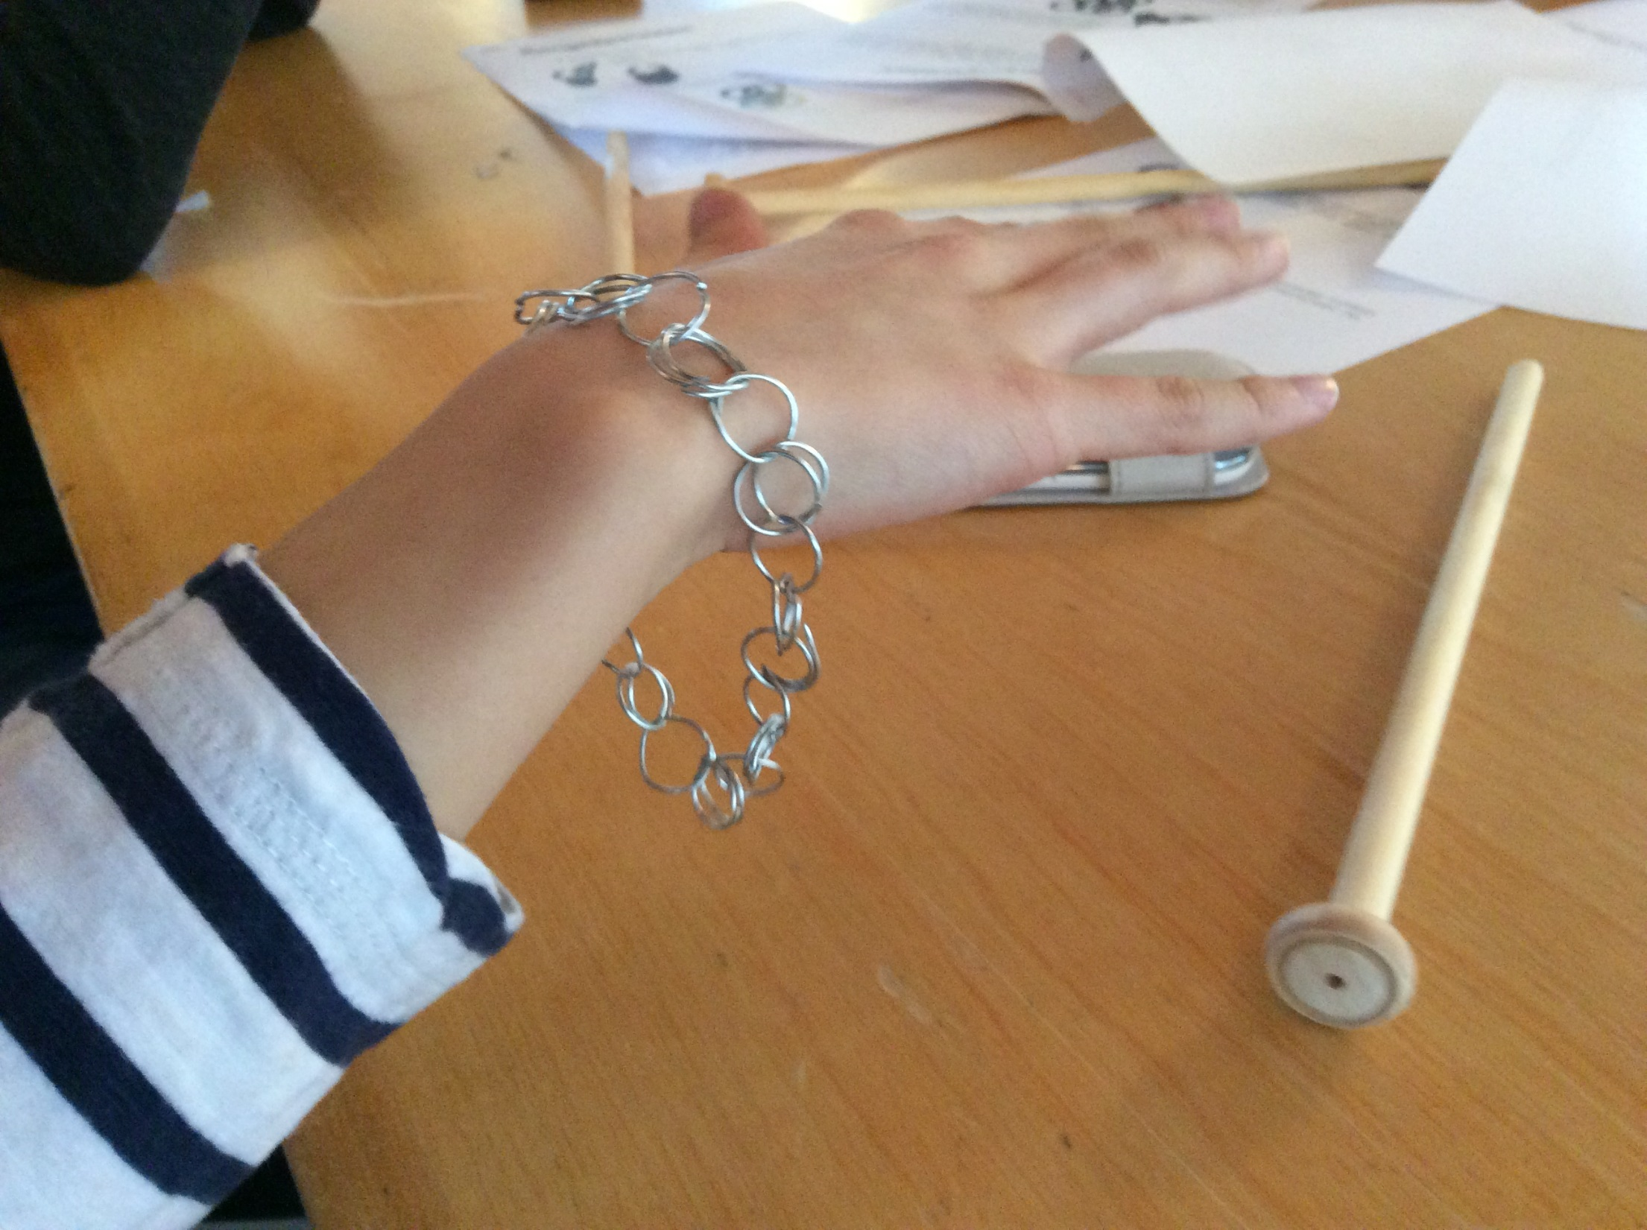

Slide 13
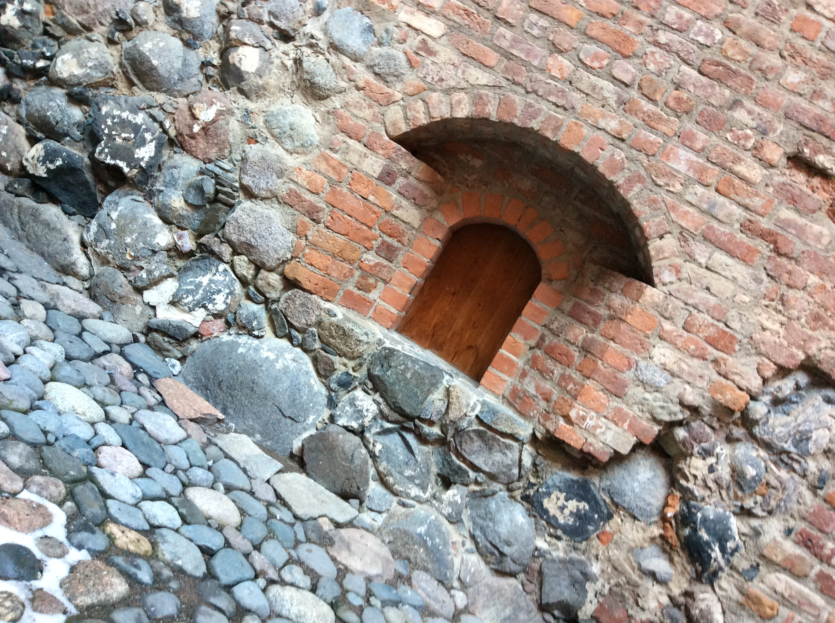
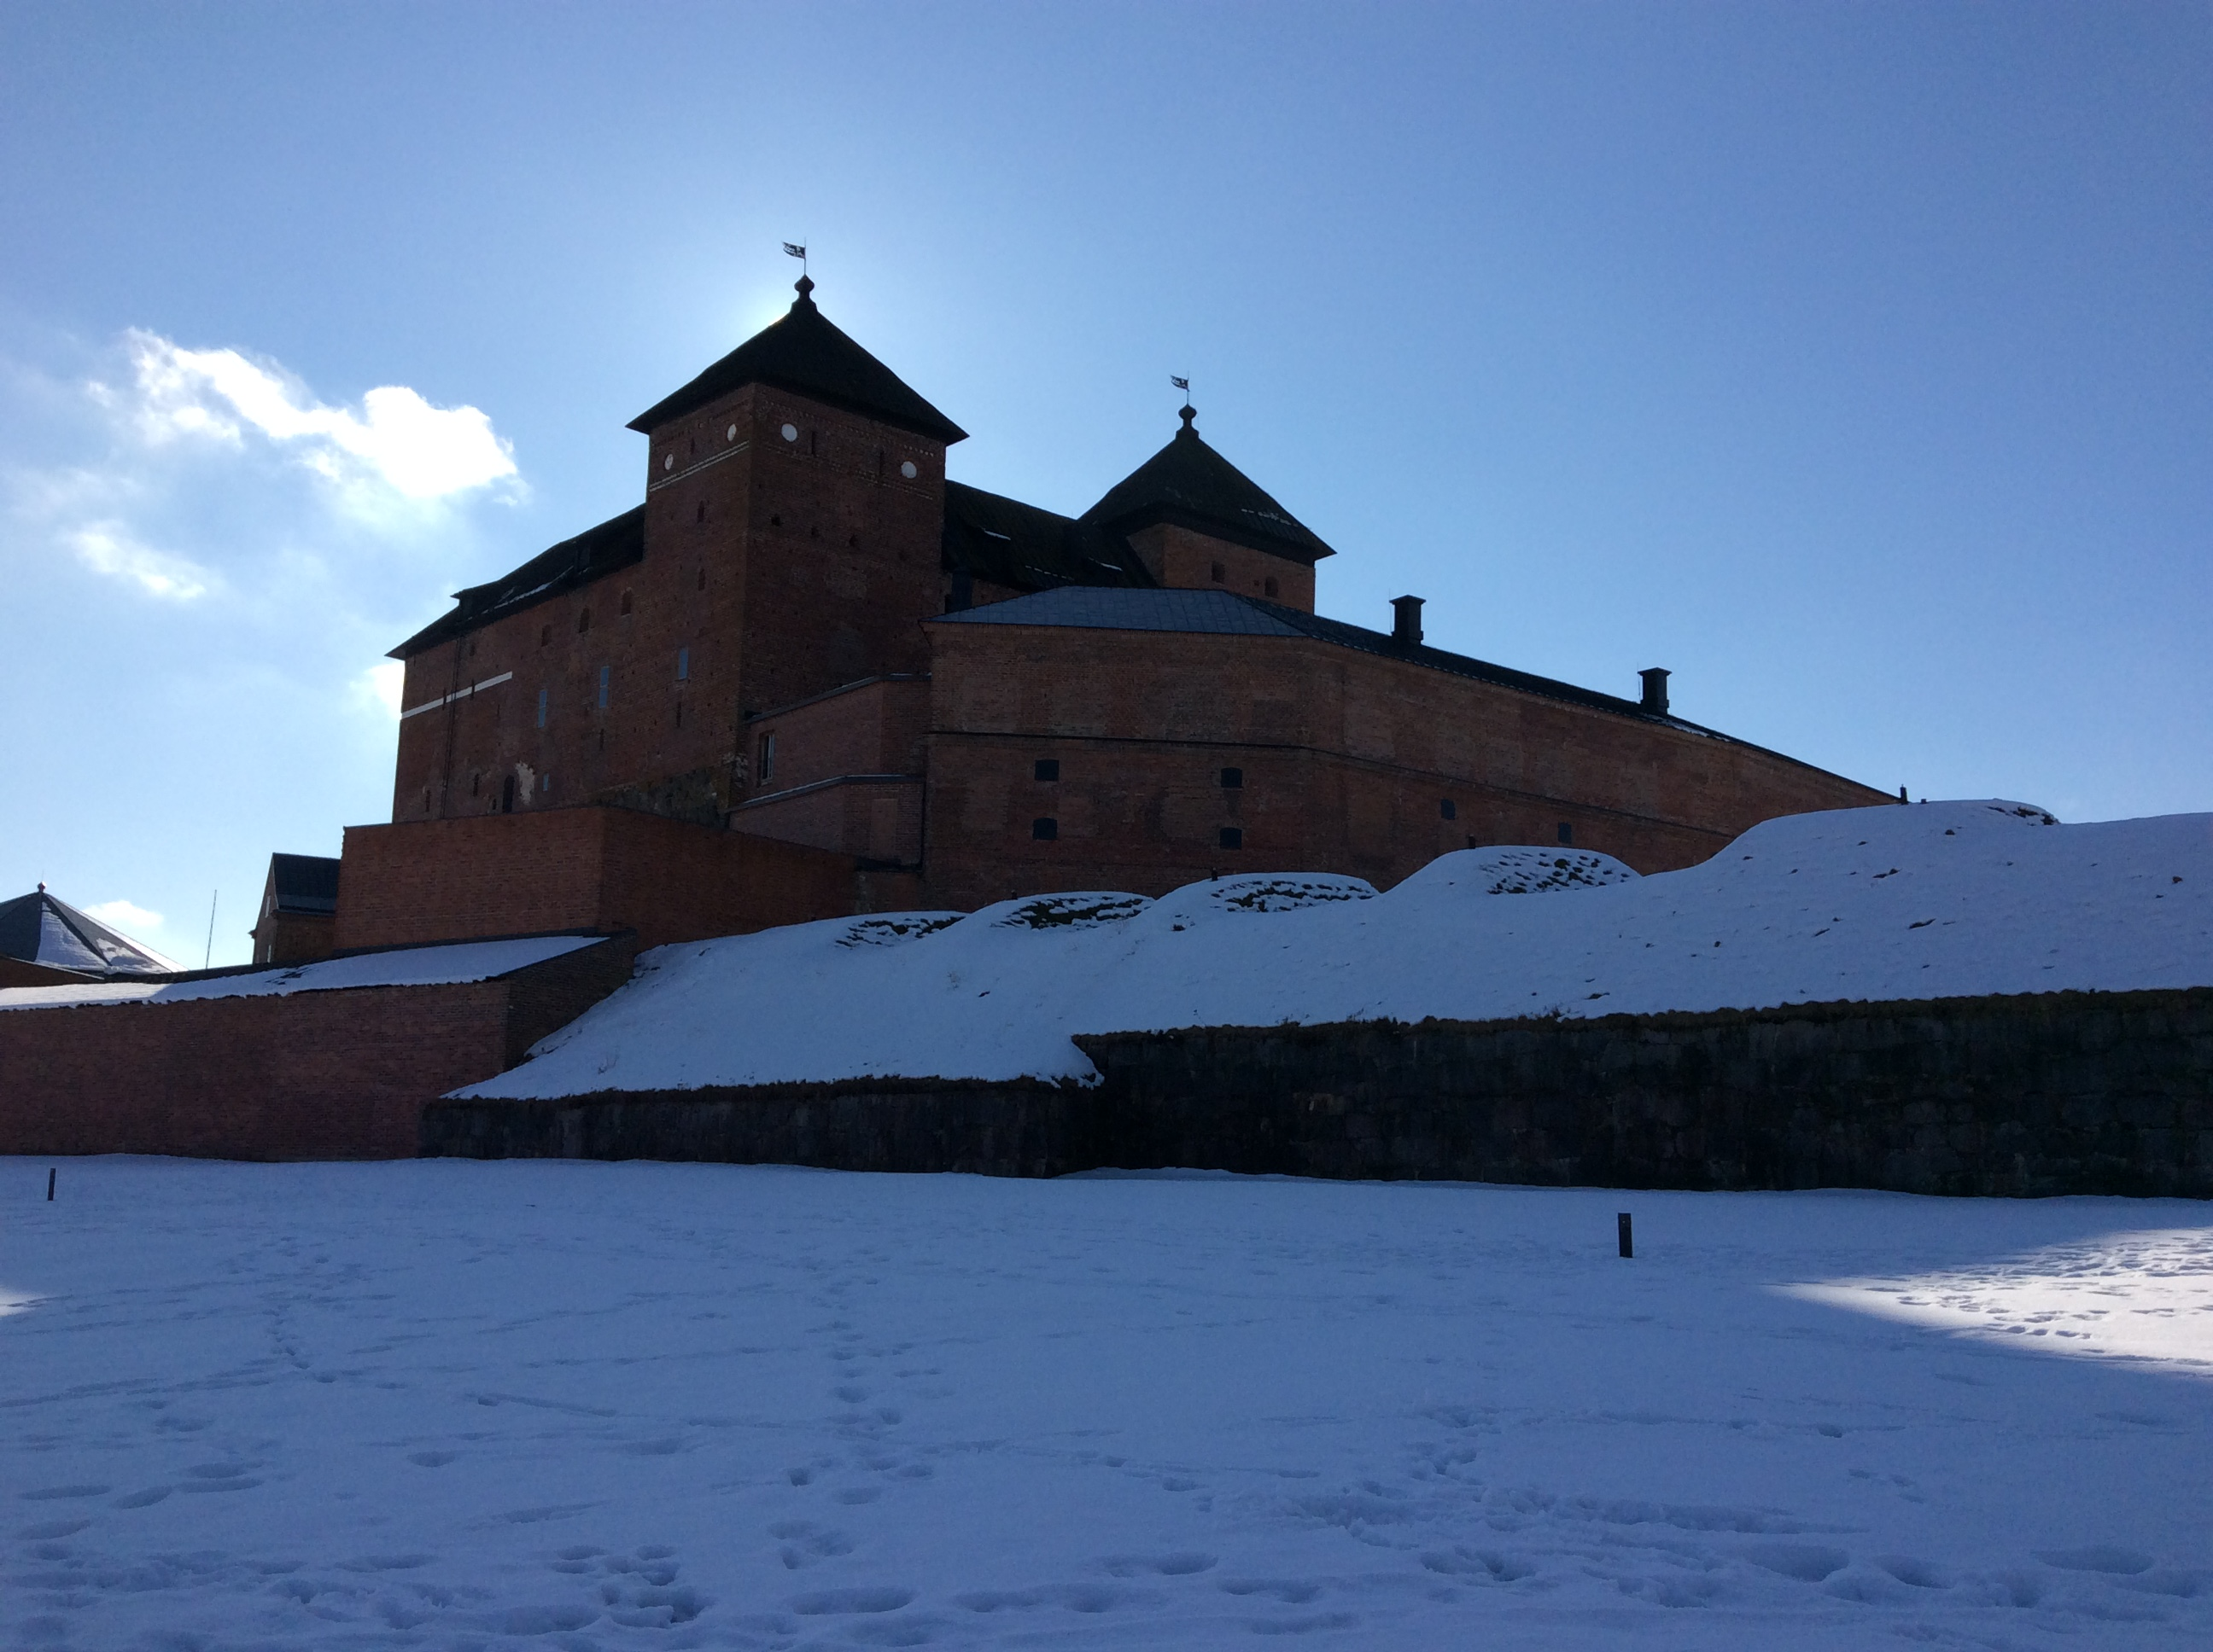
Häme Castle
We visited the Häme Castle.
Häme Castle is 700 years old.
Häme Castle is one of Finland´s medieval castles.
It is built of bricks and stone.

Slide 14
Things What We Did In Häme Castle
We walked around the Häme Castle.
We had a guided tour inside the castle.
We saw the old toilet.
We made a piece of the chain armor.
We visited a cannon tower.
We saw the old ovens inside the castle bakery.

Slide 15
Prison
Häme Castle was jail for the women during the years 1881-1972, but currently it is a museum. Around Häme Castle there is a moat.

Slide 16
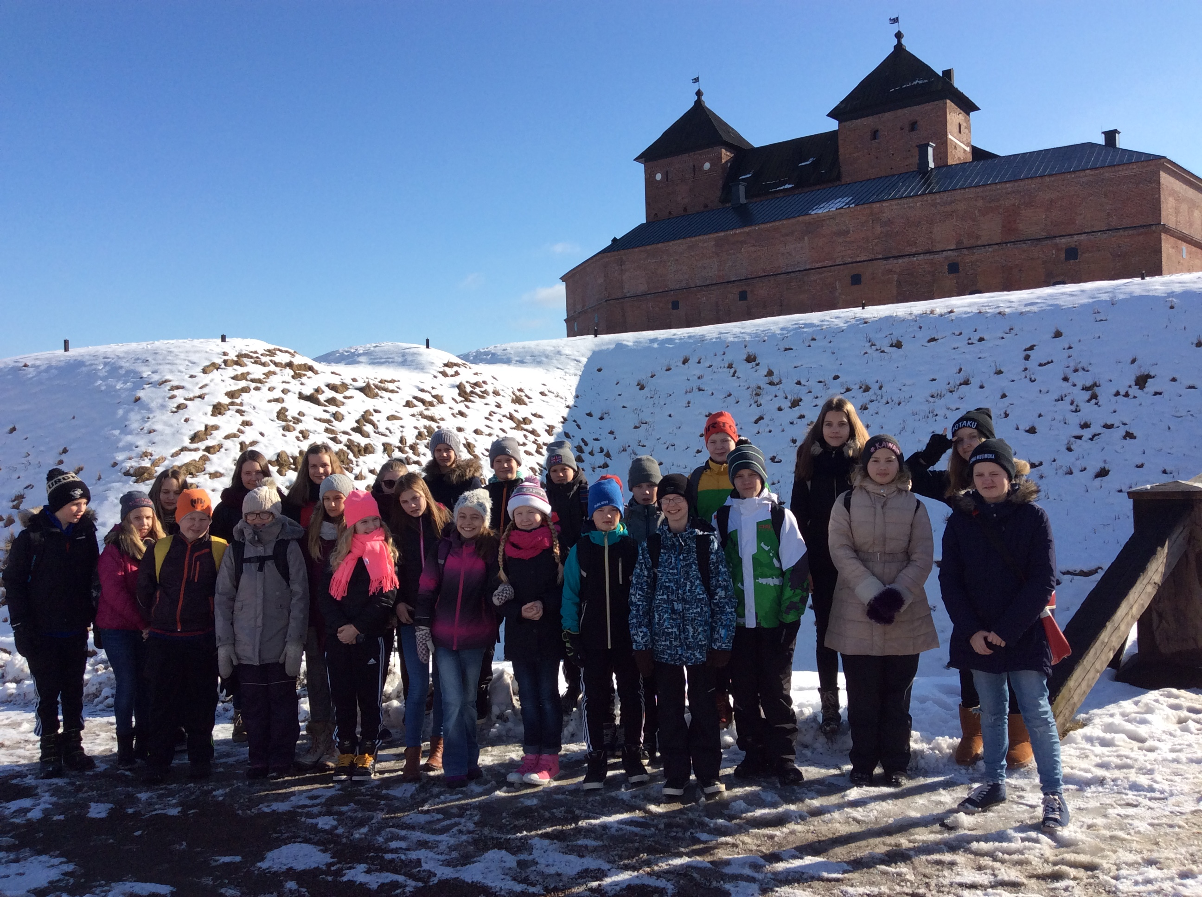
We visited a prison cell that was pich black dungeon.At the middle ages there was no door openings and the food was put down from the hole in the ceiling. At the upper floor of the castle lived the rich and upper-valued and downs stairs lived the lower valued and the poor. Beer was a traditional drink during the middle ages and it was drank by adults and children. The beer was drank for three and a half litres per a day.

Slide 17
Wishing well
In Häme Castle there is a wishing well, that originally worked as water well. But the most common drink in the castle wasn´t water but beer. Superior inhabitants drank wine. Wishing well is emptied every four years and the money is used for the renovation of the castle.

Slide 18
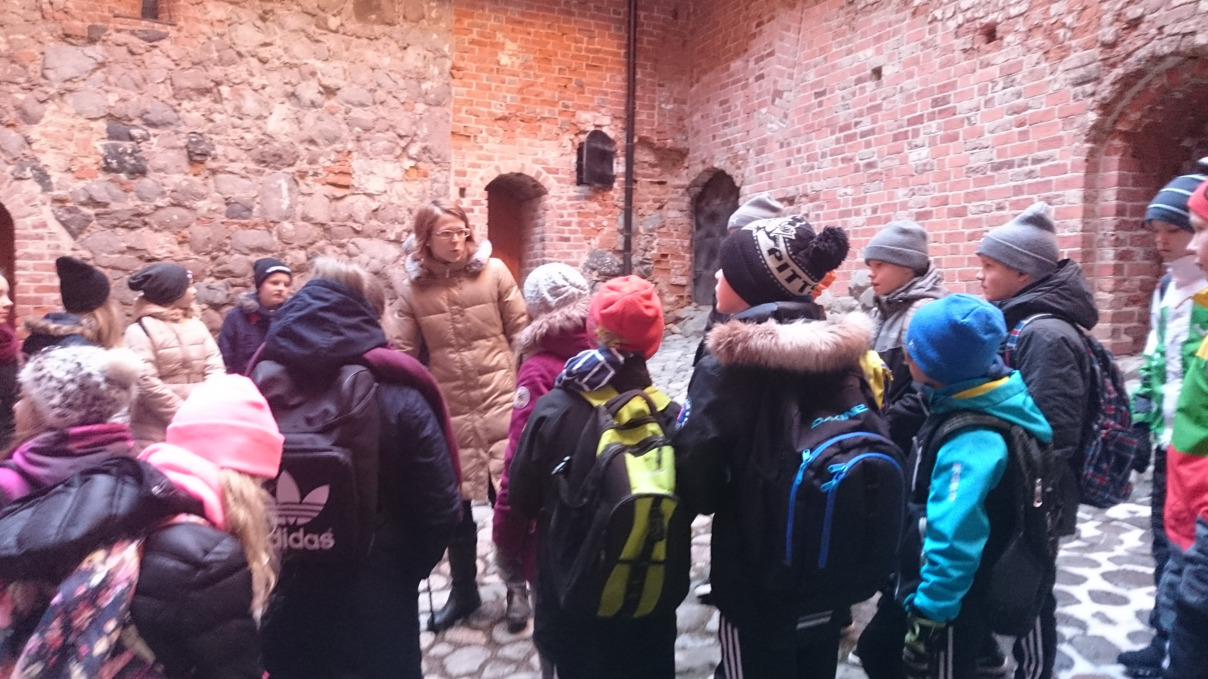

Slide 19
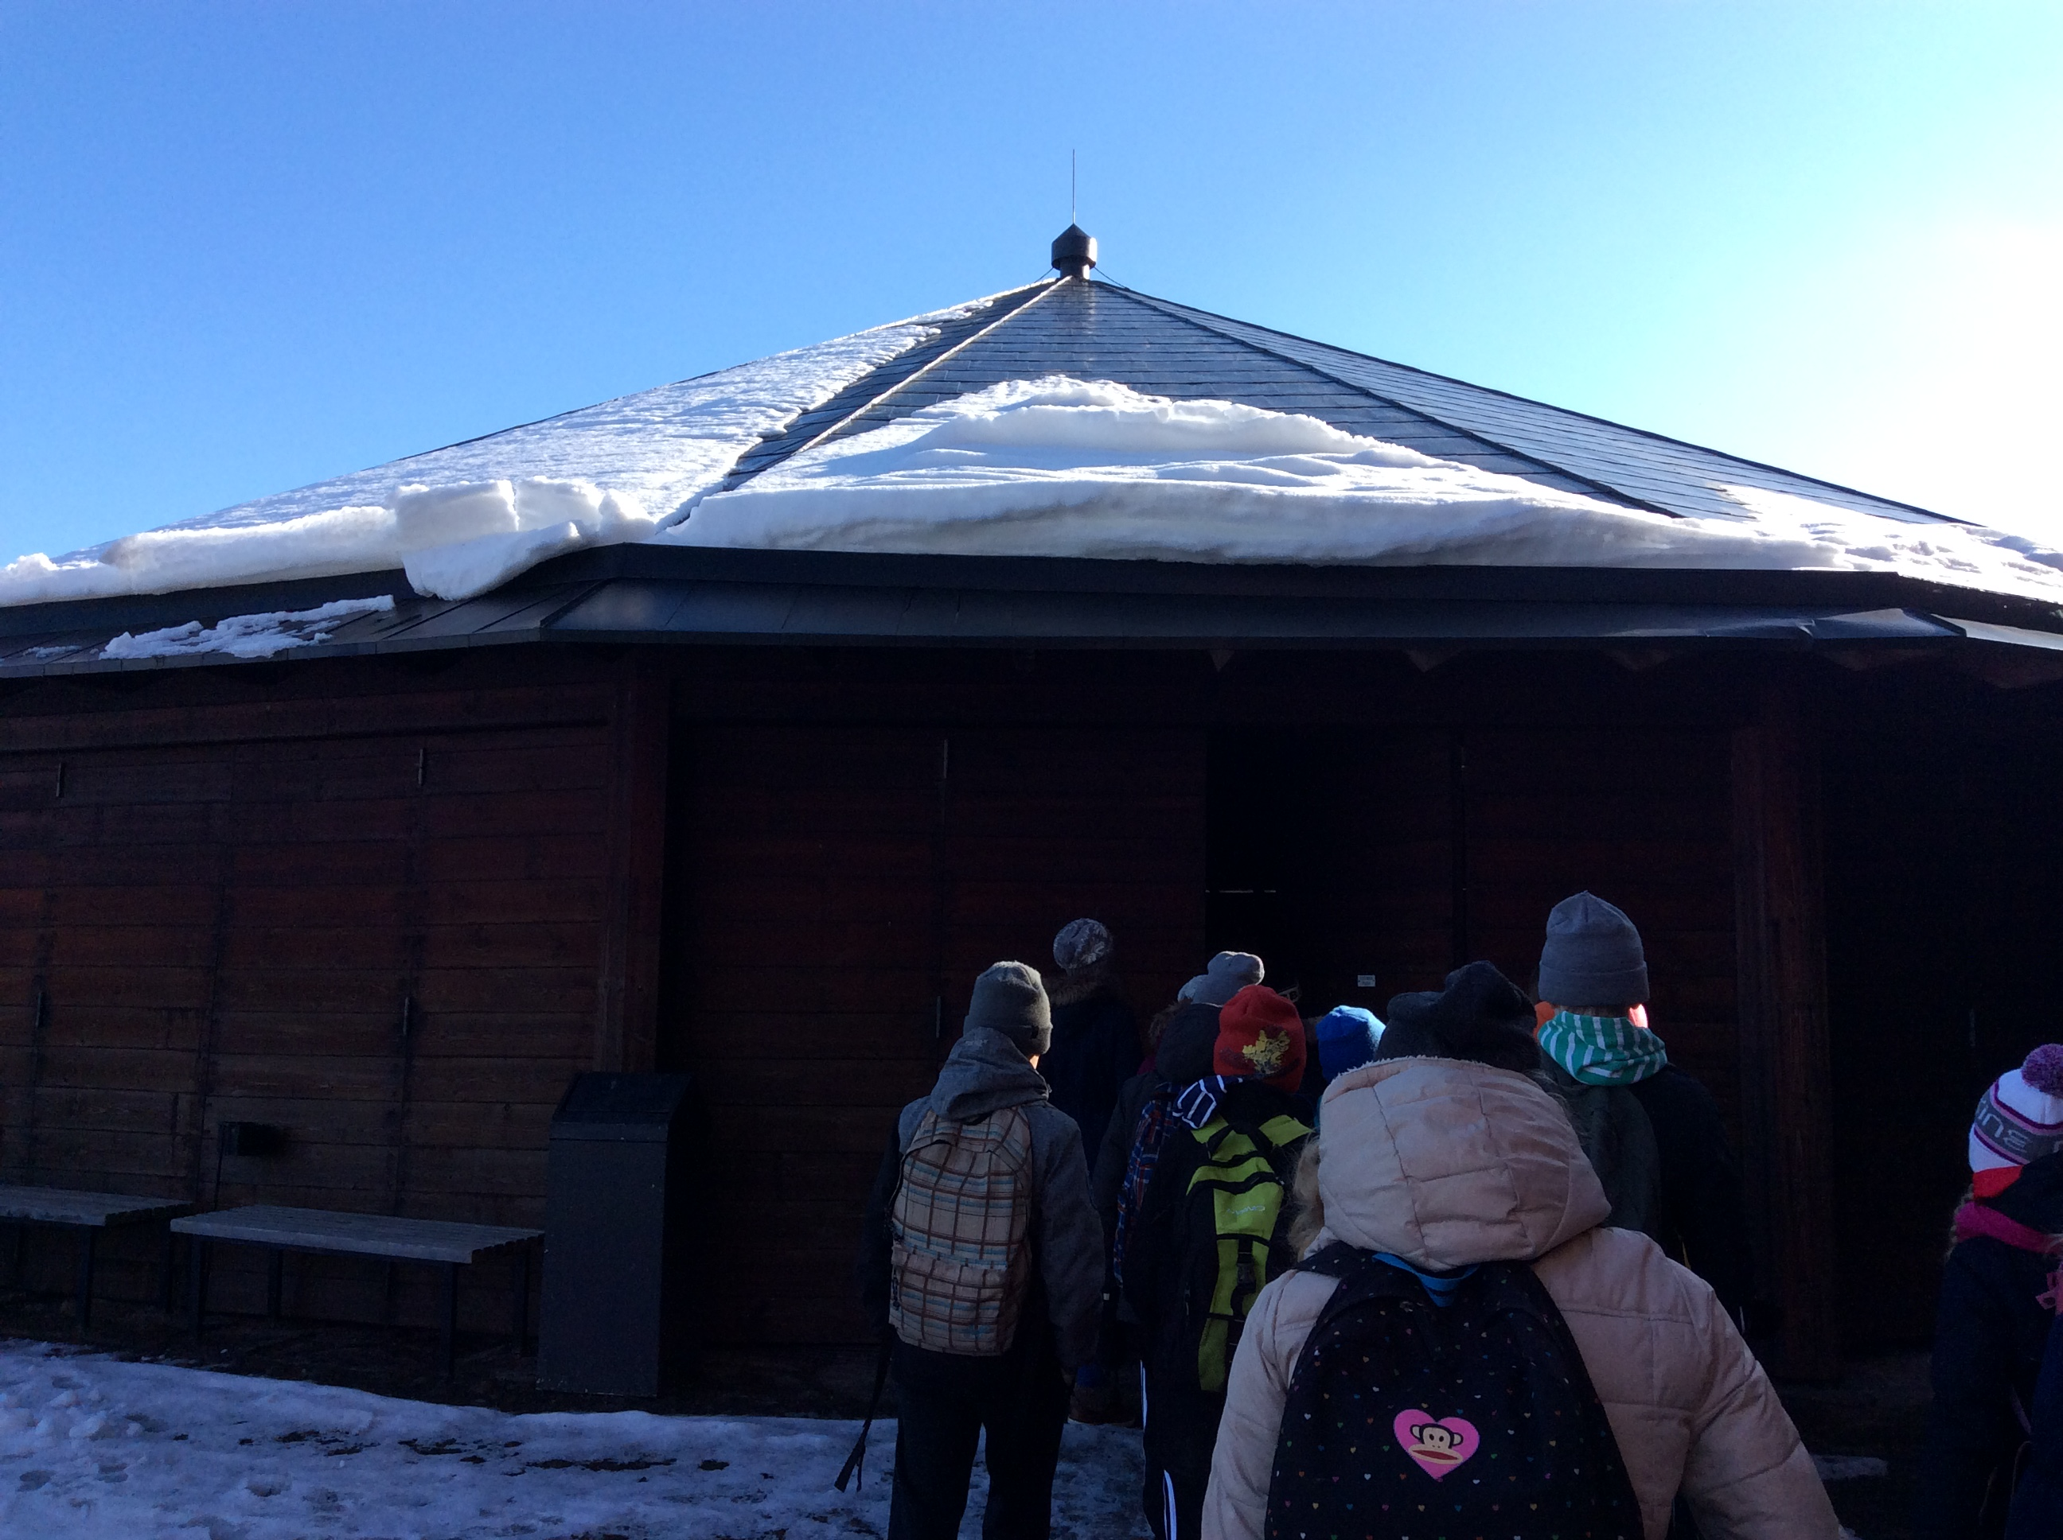
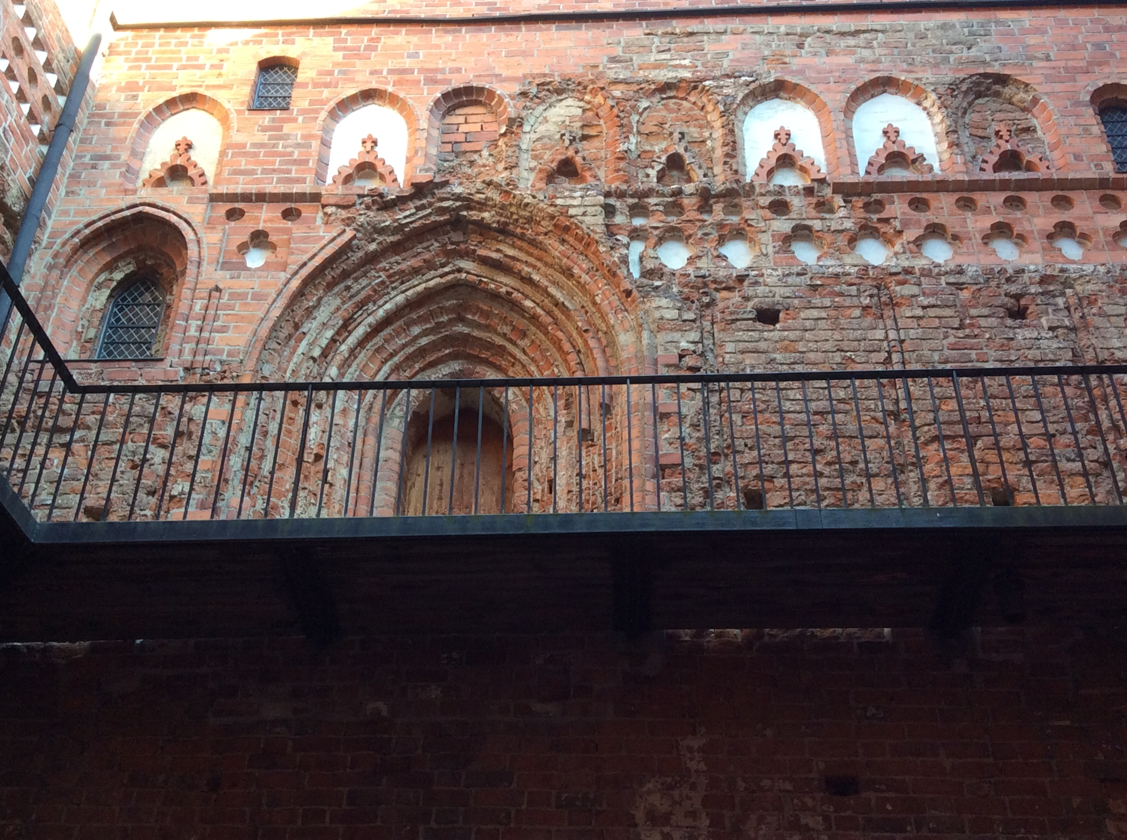
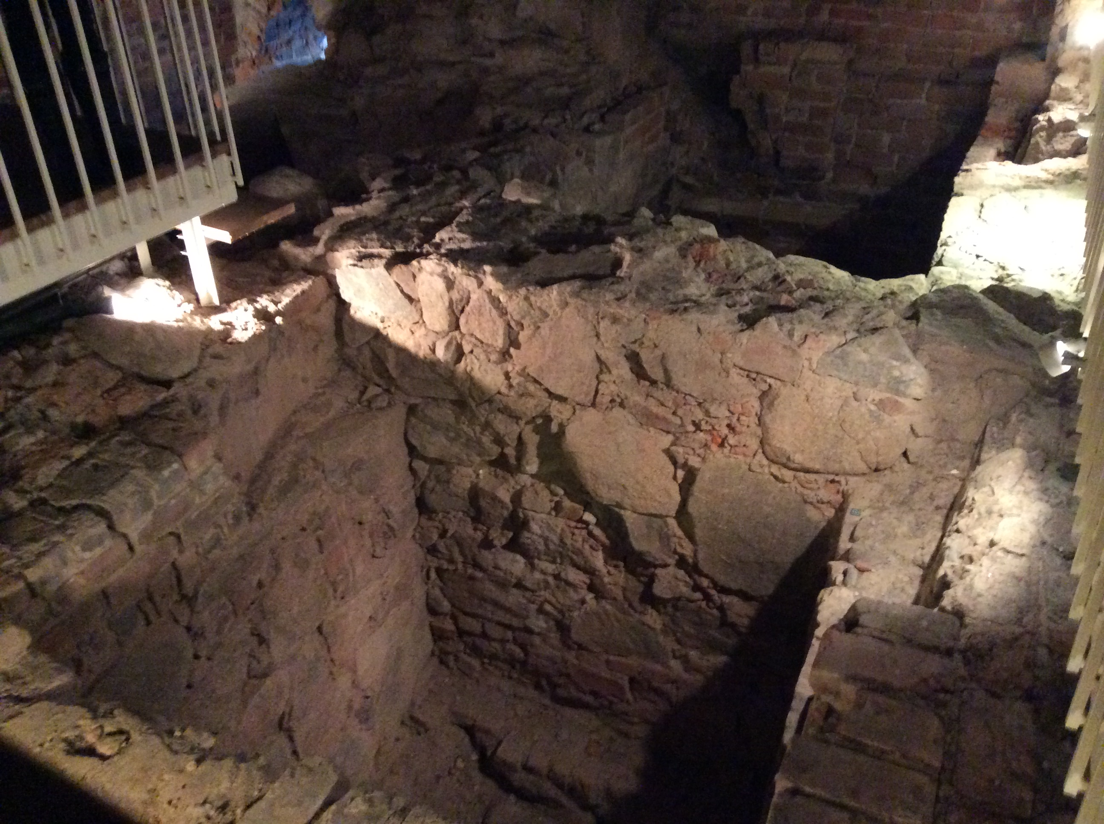
Häme Castle was founded presumably after the crusade of earl Birger Jarl to Häme late 1200s. 1700s castle raised three layers high and was surrounded by a permanent wall of buildings. Häme Castle and its surrouding buildings worked as the prison in 1837-1972. The state started the research and restation work of the castin 1953 and the work was completed in 1988. Today the castle serves as museum under the museums department and it is also rented for various events. There is also a permanent exhibition of the historical museum in the castle. Häme castle is located next to the Lake Vanaja which is a quite big lake.

Slide 20
Tee superiors lived in the upper floors and there are decorative doors, and the downstairs where the common people lived there are simpler doors. But the only decorative door downstairs is the chapel´s door.

Slide 21
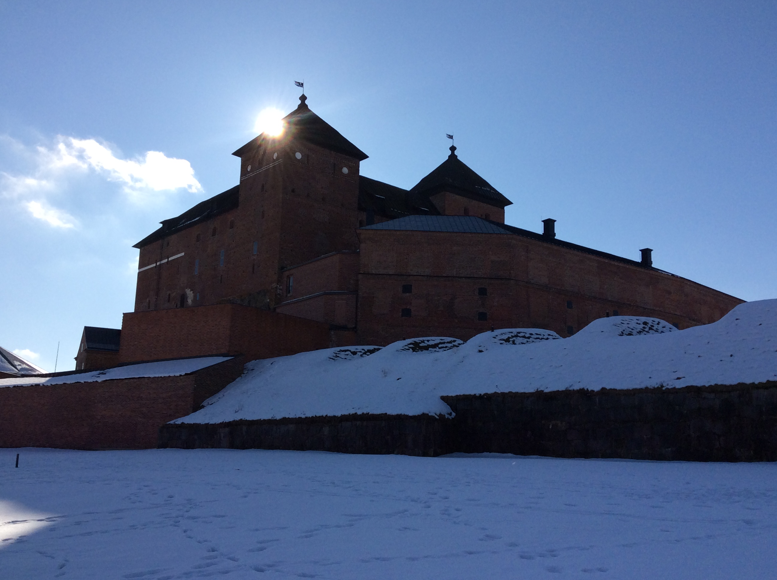
Häme Castle defense

Slide 22
Häme Castles wars and defenses
Inside the castle was a well because in wars you canno't go outside to get water.
Medieval armor in wars was chain armor.
In the castle there is a cannon tower that is rounded. It was good for defending the castle.

Slide 23
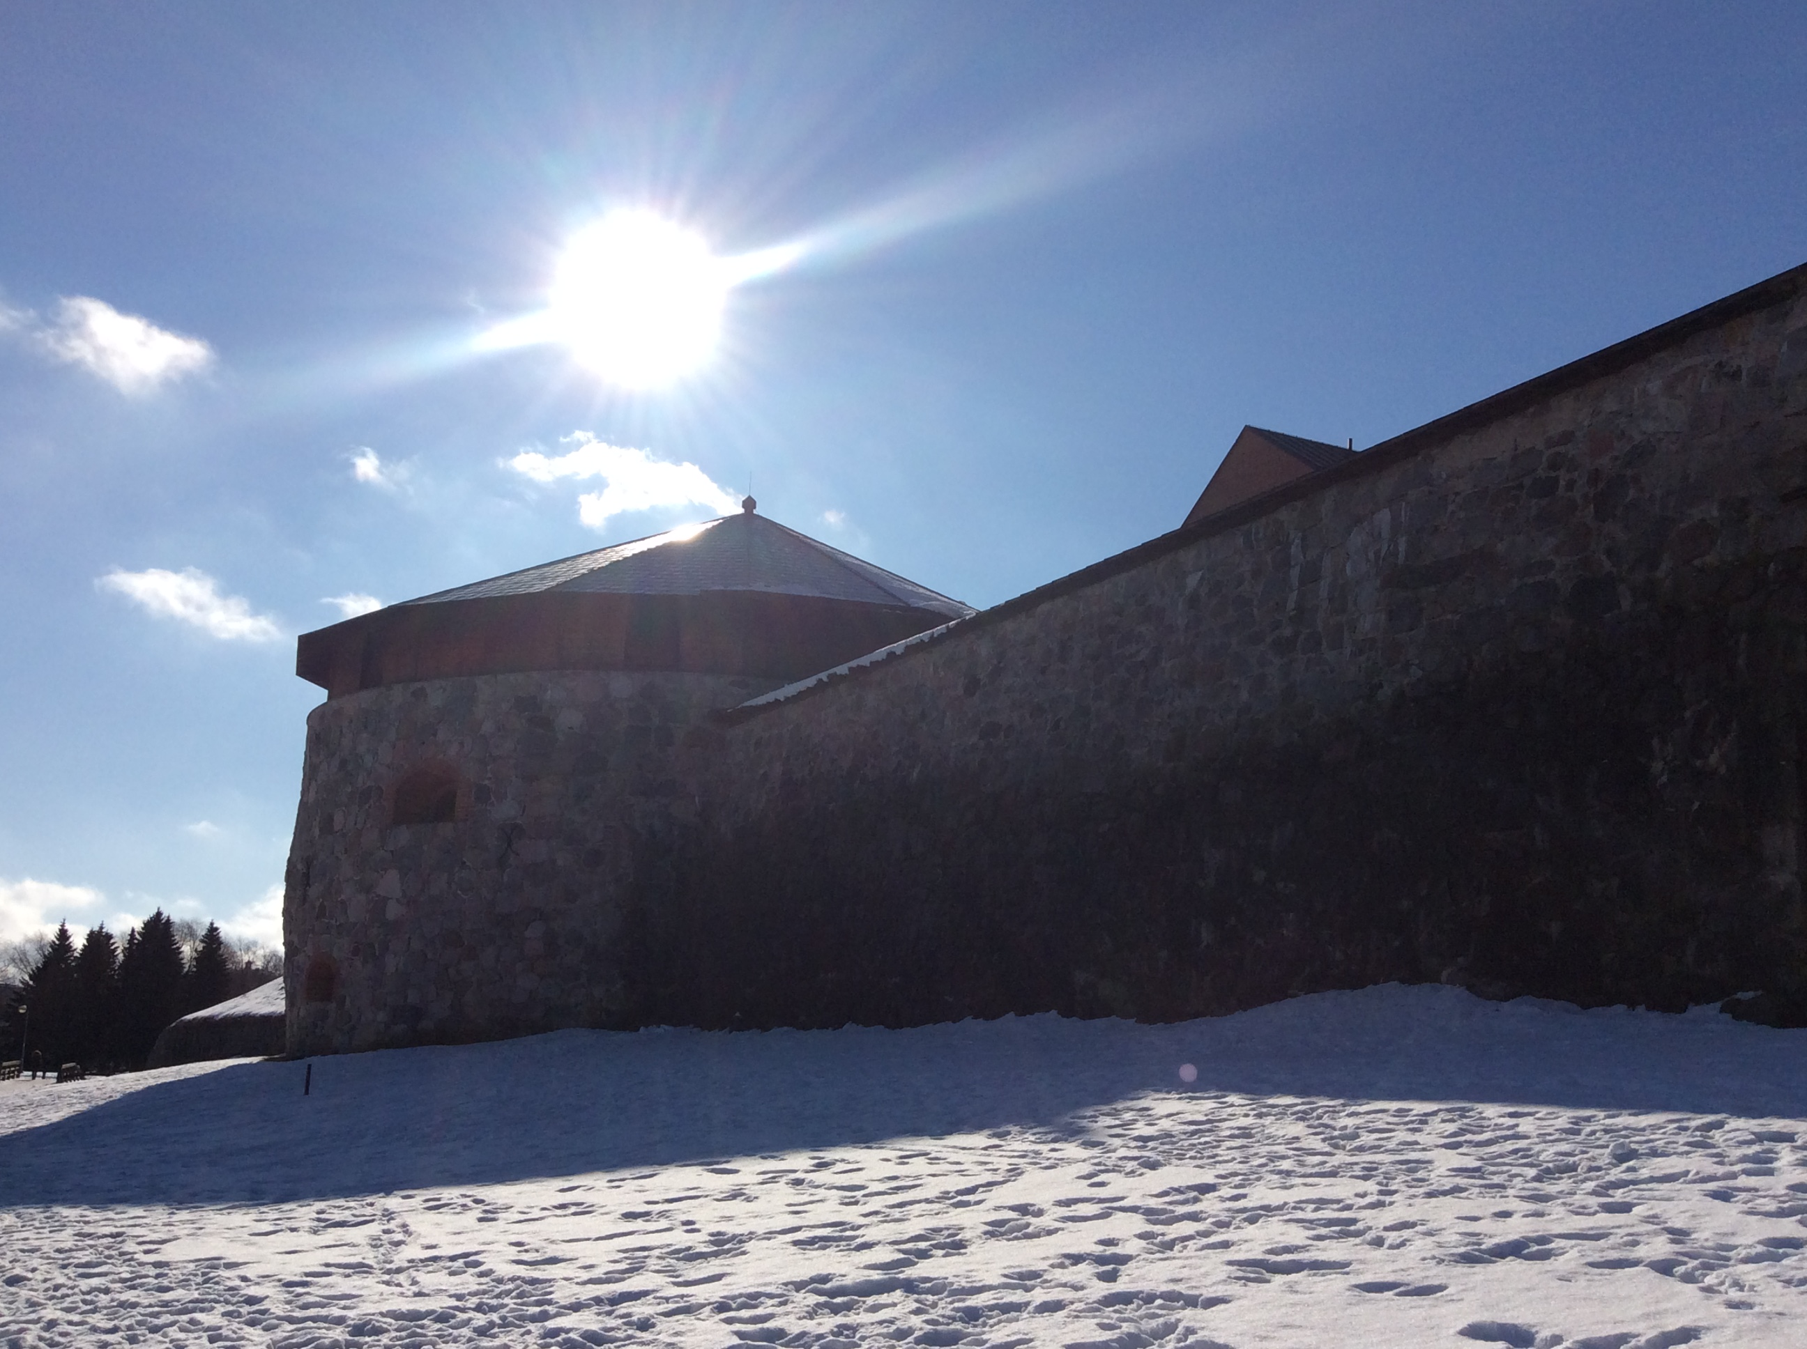
Häme Castle has a turret. Attacks came from Russia and Sweden. They won one battle. Other battles they gave up.
That is a turret.

Slide 24
Häme Castle's cannon tower
Häme Castle's cannon tower was very good defensive tower in Middle Ages because cannons were able to shoot in good range, but it was hard to hit the cannons. But now the towers are emtpty and there is no wars luckily

Slide 25
Medieval time
Medieval money was markka.
In Medieval time some people were called ''Witches'' because they had some ''mystic'' and ''weird '' skills.

Slide 26
Witchcraft, dungeons and punishment.
We are going to tell you about witchcraft, dungeons and punishments in the Häme Castle.

Slide 27
Punishments.
The punishments were really hard in the Middle Ages. For an example, if you stole something, they would chop your other ear off. And if you lied, they would cut off your tongue.

Slide 28
Witchcraft.
Witchcraft was a serious thing in the Middle Ages. If you were suspected of witchcrafts, you were given a death punishment. If you had supernatural powers (as an example), people would suspect that you are a witch.

Slide 29
Dungeons.
The dungeons were pitch-dark. You didn't have to wait in the dungeon for too long. You only had to wait there until the others would've decided what punishment to give you. The only way in- or out of the dungeon was a hole on the ceiling.
The suspects were put in the dungeon by using a cable trough the hole. When the suspects would get food trough the hole, SOMETIMES they would get lantern with the food so they could see to eat.

Slide 30
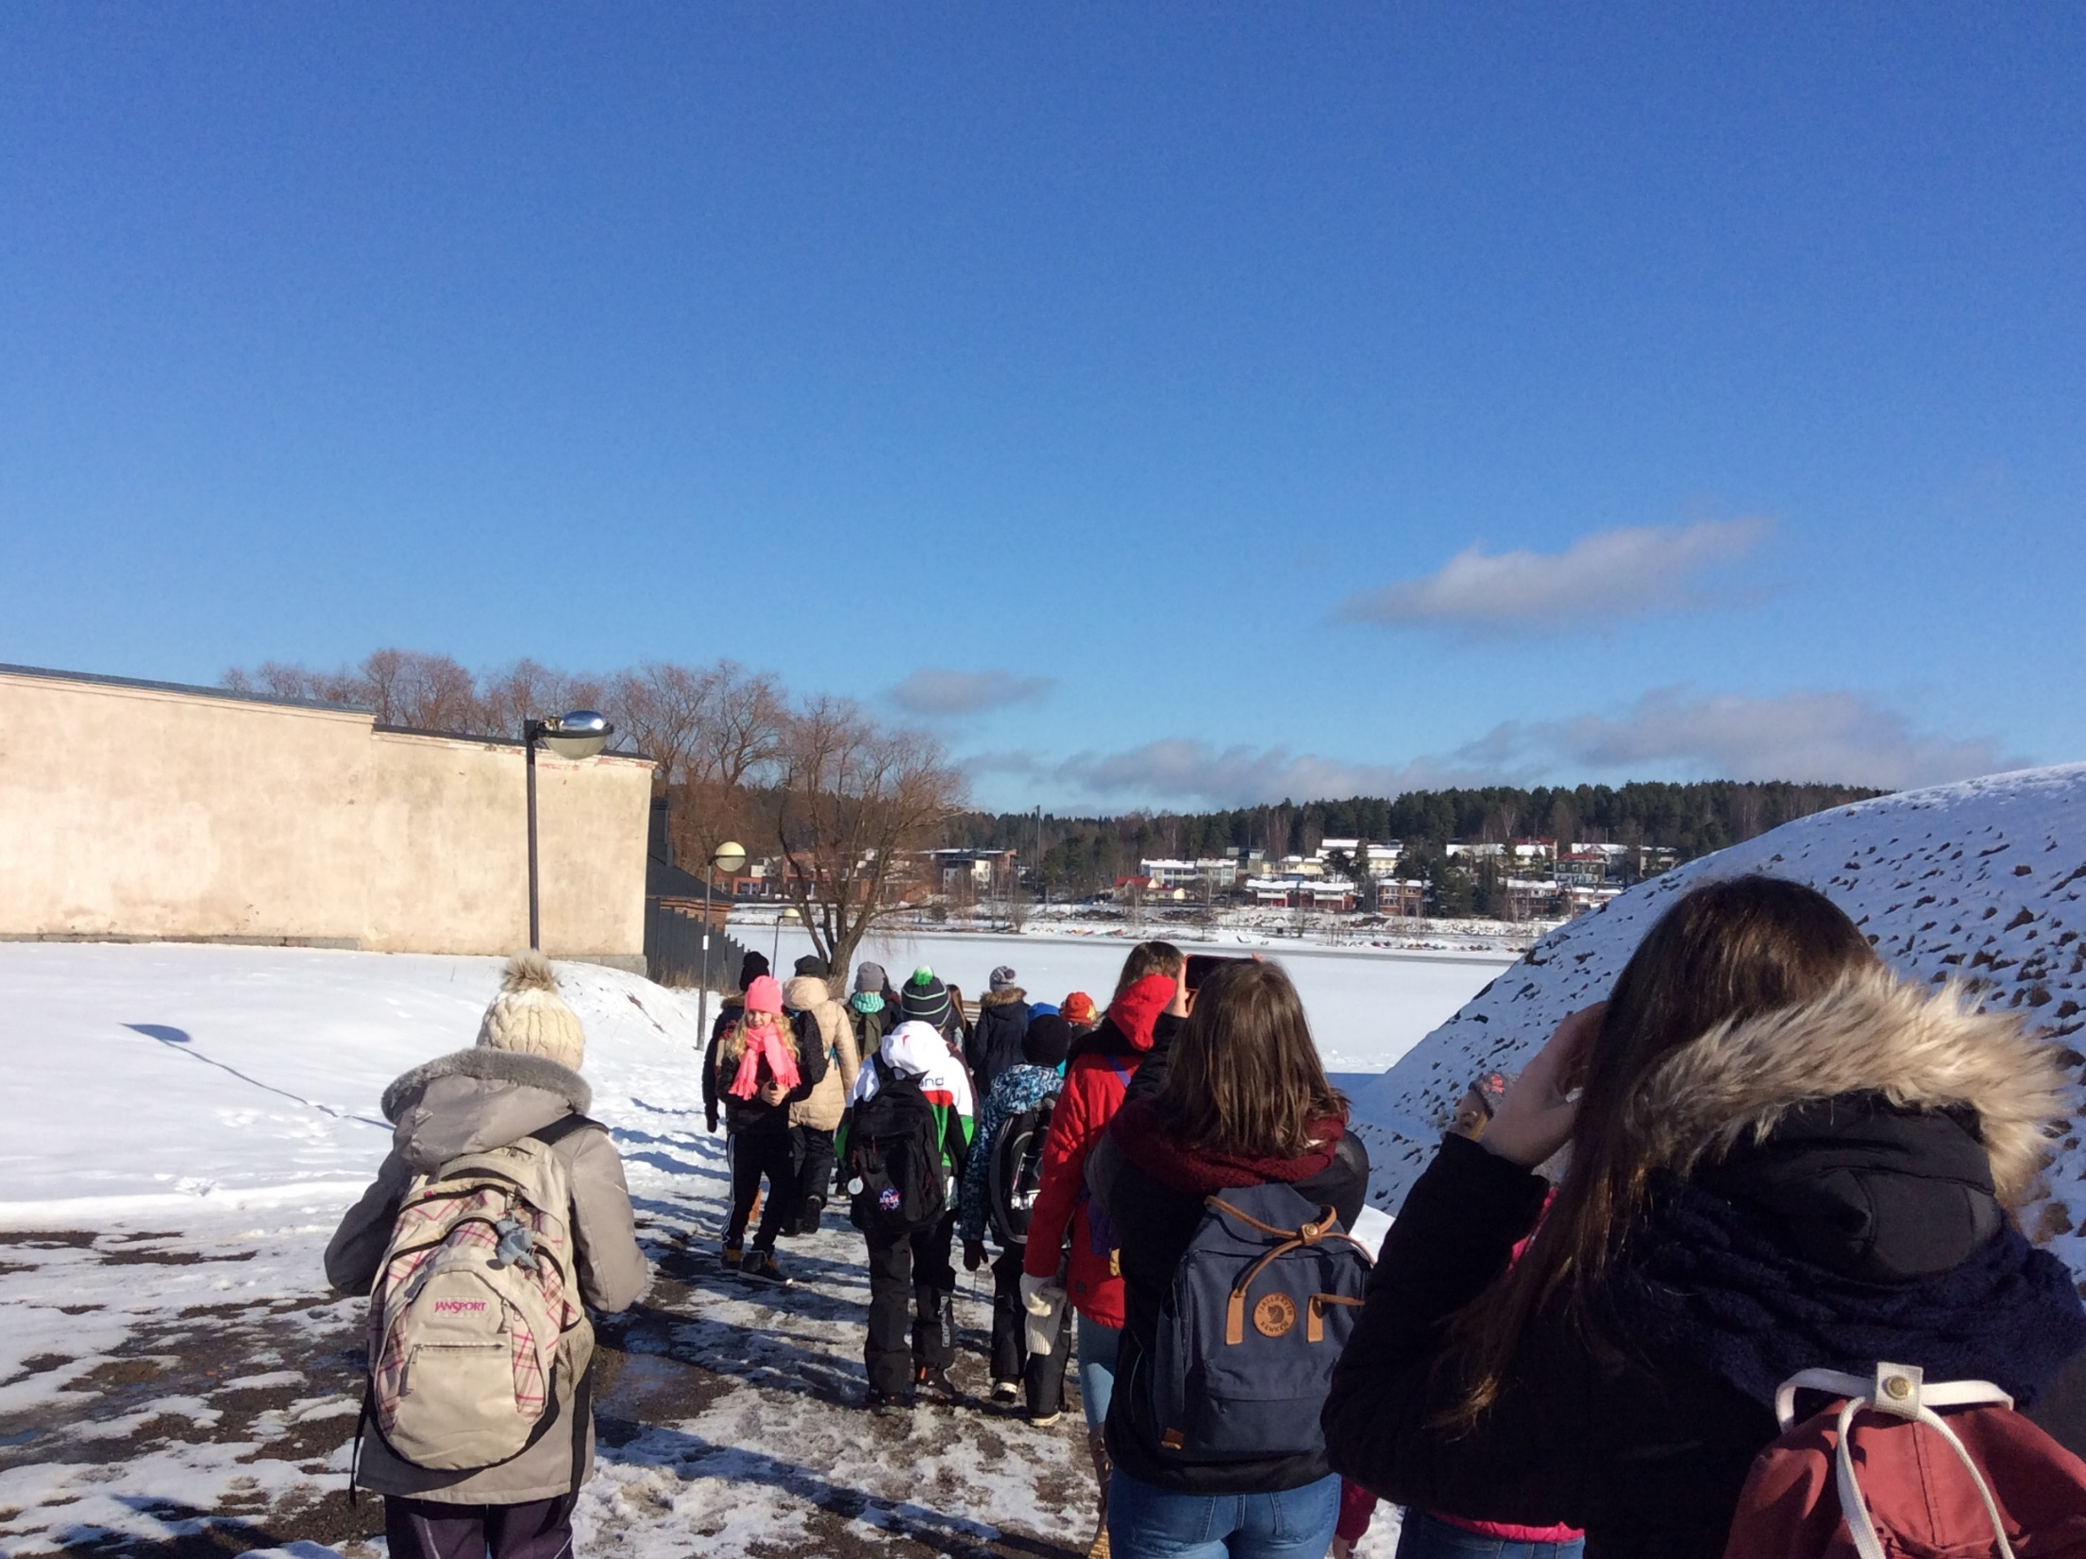

Slide 31
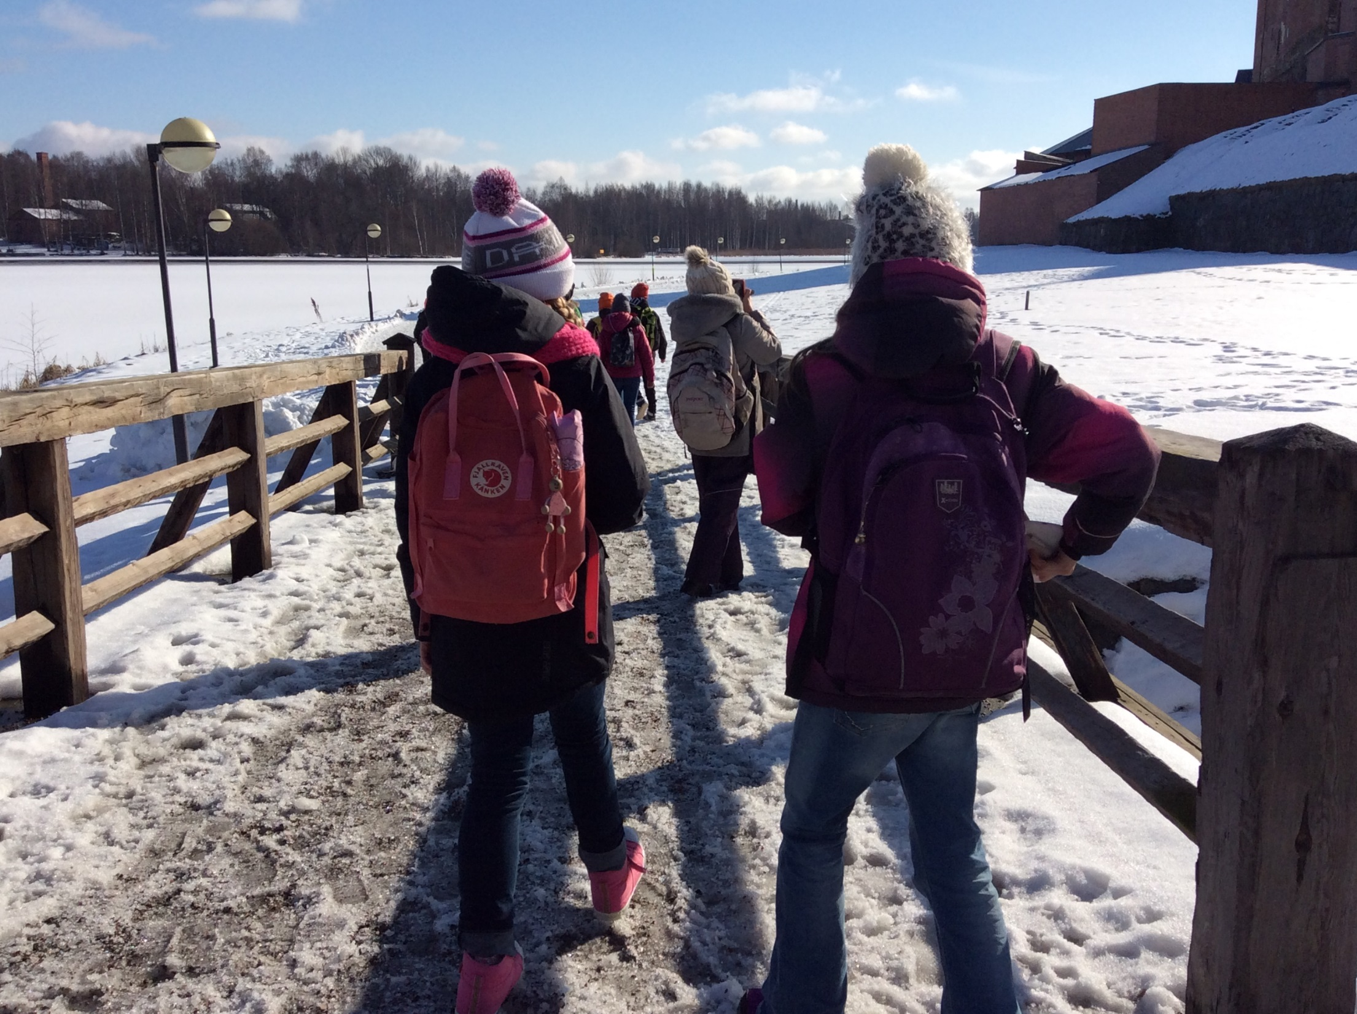

Slide 33
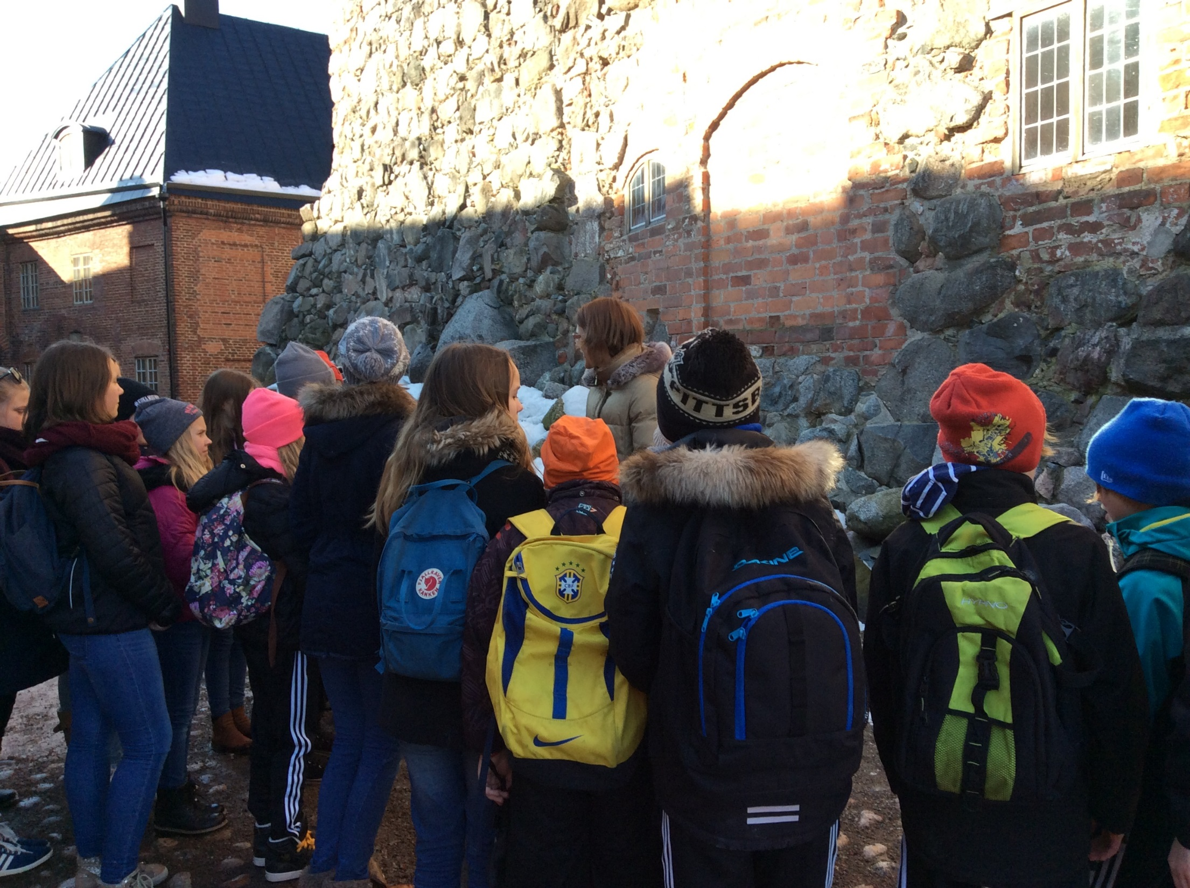

Slide 34
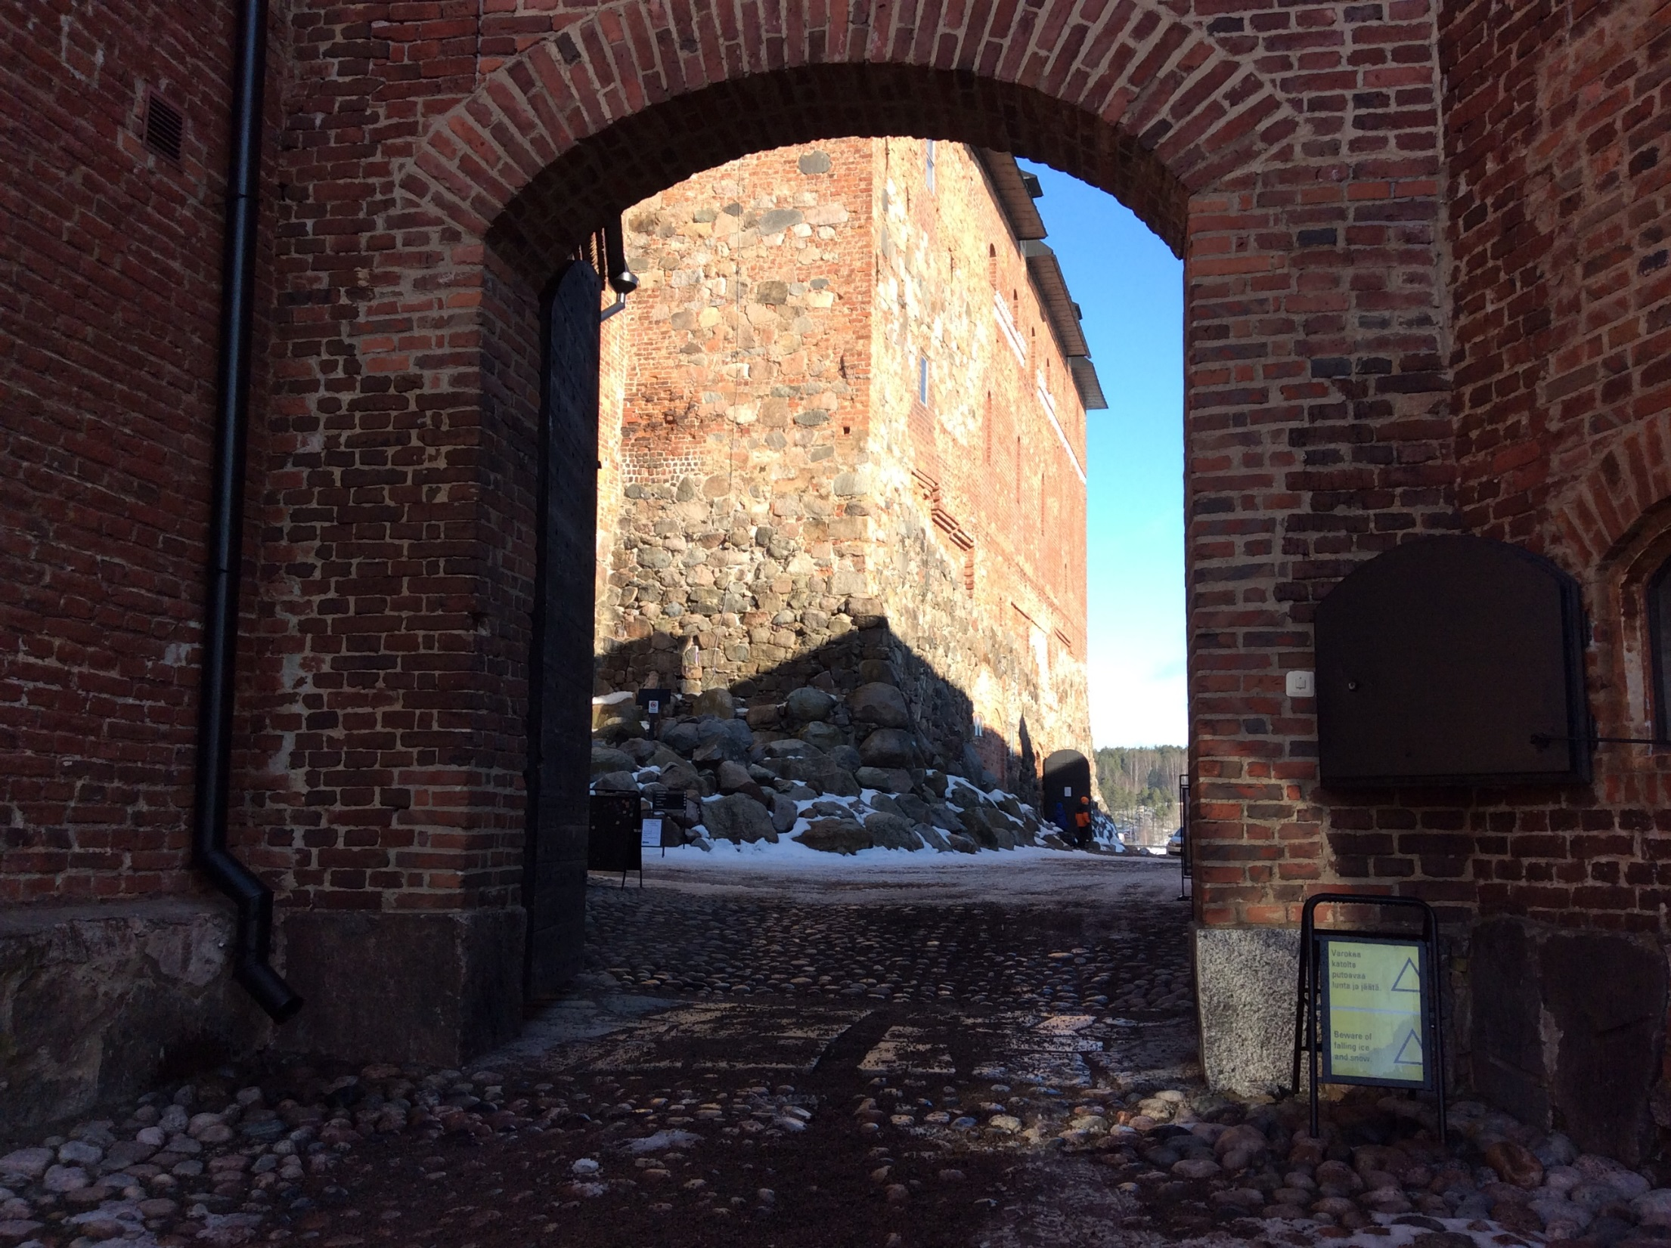

Slide 35
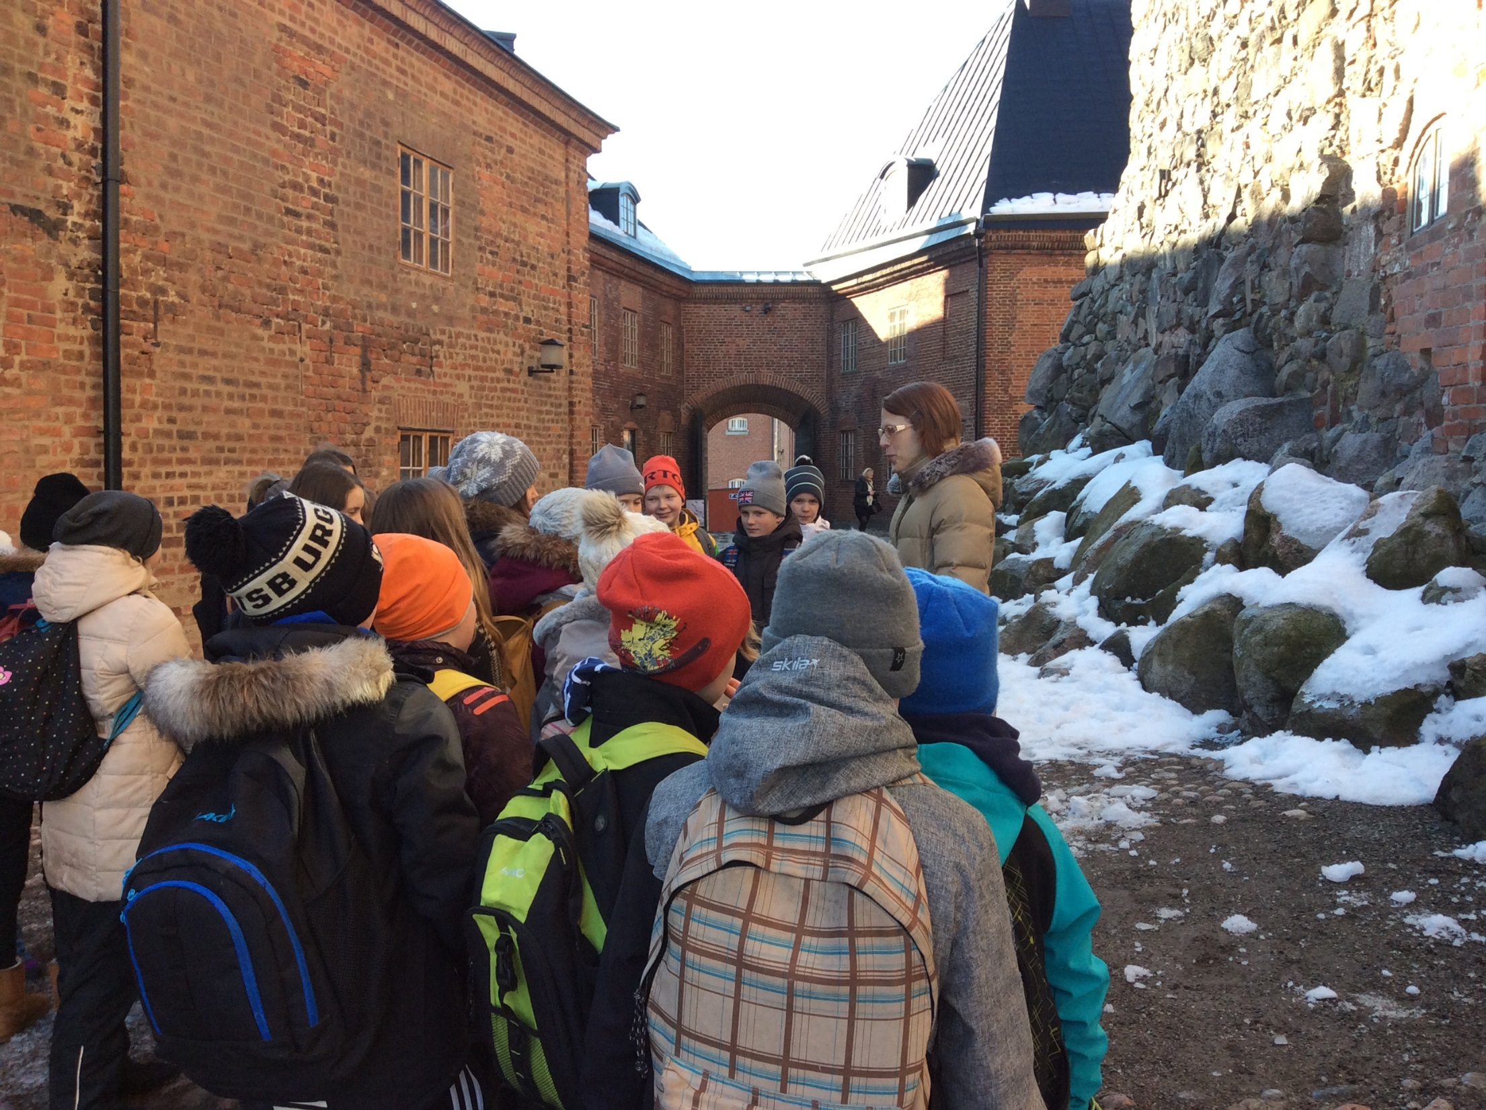

Slide 36
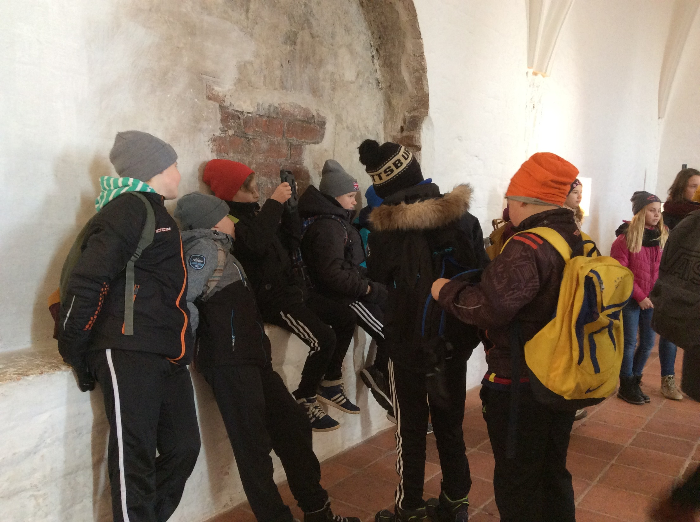

Slide 37
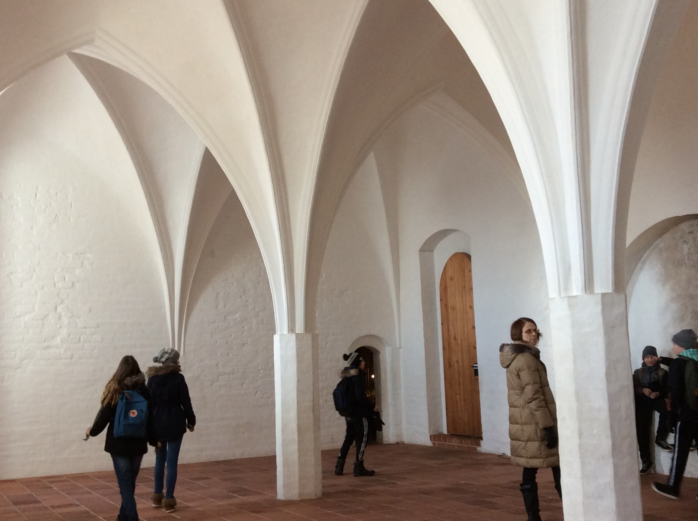

Slide 38
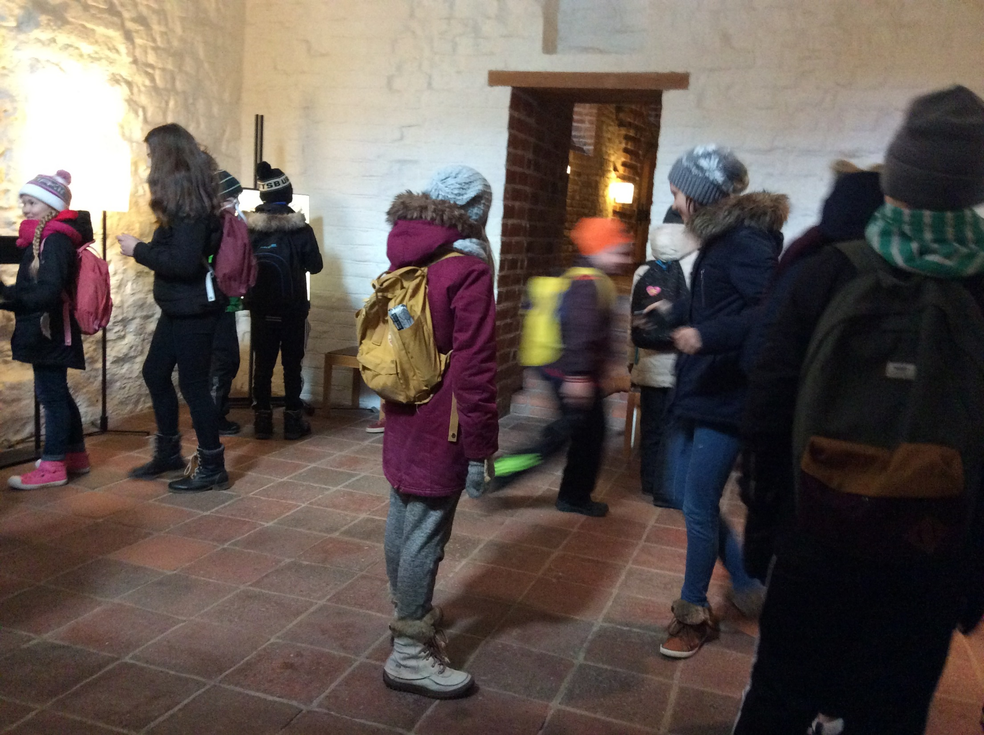

Slide 39
Our visit in Häme Castle
Our visit in Häme Castle was really intresting.
Many our class students enjoyed the visit in Häme Castle.
We made litle chain armor starts and looked at the Castle out side and inside.
After the visit we talked a lot about the castle.

Slide 40
Häme Castle

